Slide 1
Gas Pipeline Safety
Federal Regulatory Update
Pete Chace
Public Utilities Commission of Ohio
Gas Pipeline Safety Program Manager

Slide 2
Federal Rulemaking Process
Legislation – Congress passes a law that prescribes general goals for the agency.
Advance Notice of Proposed Rulemaking (ANPR) – agency publishes initial analysis of legislative intent and asks for public comment (optional).
Notice of Proposed Rulemaking (NPRM) – agency publishes proposed rule language after review by Federal Office of Management & Budget (OMB), with a public comment period.
Final Rule – published with response to issues raised by public comment, subject to judicial review

Slide 3
Gas Transmission and Gathering Lines
  NPRM released 3/15/16, 60 day comment period.
  New assessment and repair criteria for transmission lines, MAOP verification, revised IM requirements, changes to corrosion control, extended regulation of Gathering lines, safety features on launchers and receivers.

Slide 4
Excess Flow Valves for Multi-person Dwellings
NPRM from 7/15/15
  Requires EFV’s to be installed for certain structures other than single family dwellings (multi-family residences and small commercial consuming volumes < 1,000 SCFH.
  PHMSA currently projects this rule to be published January 2017.

Slide 5
Rupture Detection and Valves Rule
NPRM expected 7/27/16
  Installation of automatic shutoff valves or equivalent technology, and establish performance based metrics for rupture detection for gas and liquid Transmission lines. For HCA’s, Class 3, 4 locations.

Slide 6
Plastic Pipe
NPRM issued 5/21/15.
  Addresses composite pipe, 50 year markings, increased design factor for PE pipe (.32 to .40), authorized use of PA12 at higher pressures, tracking and traceability of lines, incorporates revised standards.

Slide 7
Operator Qualifications
NPRM issued 7/10/15.
  Operator Qualification for new construction, “two part test”, incident reporting requirement changes, cost recovery and special permit language.

Slide 8
Excavation Damage Prevention
NPRM issued 7/23/15
  Defines criteria for determining if a State enforcement program for its excavation damage prevention laws is Effective, and allows for PHMSA enforcement if not.

Slide 9
Gas Transmission NPRM
Reporting requirements (Part 191)
  Repeals reporting requirement exemption for unregulated onshore gathering lines (including annual and incident reports)
  Defines an MAOP exceedance that exceeds allowable buildup (192.201) as a Safety Related Condition, subject to the reporting requirements in 191.25.

Slide 10
Gas Transmission NPRM
Gathering Line requirements
  RP80 is no longer used to define Gathering lines.
  Extends regulation to Type A Gathering lines in Class 1 locations, for lines that are 8” or greater.
  Newly regulated class of lines must follow the same requirements as currently exists for Type B Gathering.

Slide 11
Gas Transmission NPRM
Record Keeping Requirements
  Transmission operators must retain mill records, pressure test records, welder qualification records, valve and other component records, class location records, etc. for the life of the pipeline.
  New section 192.13(d) requires all Transmission operators to have a “Management of Change” program as per ASME B31S

Slide 12
Gas Transmission NPRM
MAOP Verification
  “Moderate Consequence Area” is an area in a Potential Impact Circle containing 5 or more buildings, an occupied site, or a right-of-way for a freeway, and otherwise does not meet the definition of a High Consequence Area.
  “Legacy Construction Techniques” (coupled pipe, wrinkle bends, etc.) and “Legacy Pipe” (LF-ERW, etc.) are defined.

Slide 13
Gas Transmission NPRM
MAOP Verification
  192.619 requires areas with inadequately documented MAOP (2012 Annual Report) to re-establish MAOP.
  192.624 requires operators to re-establish MAOP for pipelines in a HCA or MCA. Method is Spike Test for Legacy pipe, Pressure Test for Modern pipe. Other methods may be allowed such as derating, engineering critical assessment, certain in-line assessments.

Slide 14
Gas Transmission NPRM
MAOP Verification
  New 192.607 “Verification of Pipeline Material”. Defines non-destructive techniques, requires material verification for pipelines that do not have “reliable, traceable, verifiable and complete” documentation when the pipeline is exposed, or for HCA and Class 3, 4 locations.
  Operators have to have a “Material Documentation Plan”.

Slide 15
Gas Transmission NPRM
MAOP Verification
  New 192.710. Transmission lines in Class 3 or 4 locations, or in a MCA, must be assessed within 15 years, and every 20 years thereafter. Assessment may be ILI, pressure testing, excavation and examination, guided wave ultrasonic testing, direct assessment (only if the line is not pig-able).

Slide 16
Gas Transmission NPRM
Cathodic Protection
  Transmission operators must perform an above ground indirect assessment to locate moderate to severe coating damage.
  Transmission operators must conduct surveys for interference currents and remediate.
  Quarterly gas monitoring required for internal corrosion.
  (All operators) – interpretation that “prompt remedial action” means the next monitoring interval or 1 year, whatever is less.
  Transmission operators must perform a close interval survey for low CP reads.

Slide 17
Gas Transmission NPRM
Repair of damages and leaks
  General requirements modified to require a 20% pressure reduction when a condition presents an “immediate hazard”.
  Establishes immediate, 2-year, and monitored conditions for imperfections and damages outside of HCA’s.

Slide 18
Gas Transmission NPRM
Pig Launching and Receiving
  New 192.750 “Launcher and Receiver Safety” section requires pig launchers and receivers o have suitable means to indicate barrel pressure and to relieve pressure in the barrel.
  New 192.493 incorporates standards by reference for in-line inspection.
    API STD 1163-2005 “In-Line Inspection System Qualification Standard”
    NACE SP0102-2010 “In-Line Inspection of Pipelines”
    ANSI ILI-PQ-2005 “In-Line Inspection Personnel Qualification and Certification”.

Slide 19
Gas Transmission NPRM
Integrity Management
  Direct assessment only allowed on un-piggable lines. Adds Spike test, GWUT, excavation with direct examination as assessment methods.
  Incorporates NACE SP0206-2006 for Internal Corrosion Direct Assessment
  Incorporates NACE SP0204-2008 for stress corrosion cracking direct assessment.
  Expands the list of immediate repair conditions and preventative and mitigative measures operators must consider.
  Adds detail on risk assessment, model validation.

Slide 20
Gas Transmission NPRM
Other changes
  O&M requirements changed to specifically require procedures to operate pressure relieving devices and control operating pressure.
  Continuing surveillance required after extreme weather events (hurricane, flood, earthquake)
  New Appendix A summarizes record retention requirements.
  New Appendix F provides guidance on the use of Guided Wave Ultrasonic Testing (GWUT) in integrity assessments.
  Appendix D (cathodic protection) modernized.

Slide 21
Annual Report Information
Annual report information can help you identify risks to your system and look for trends.
Compare your system to nationwide and statewide averages

Slide 22
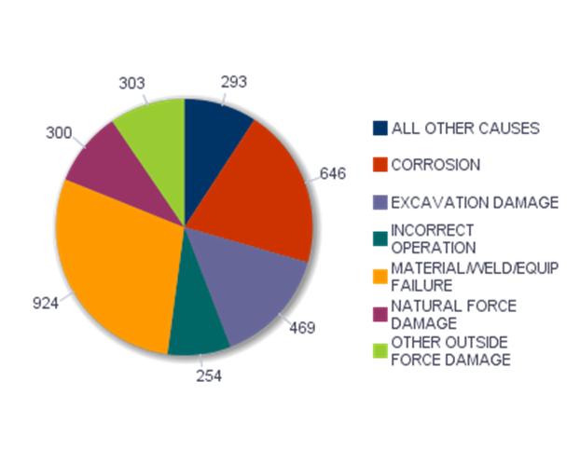
Incidents by cause - Nationwide

Slide 23
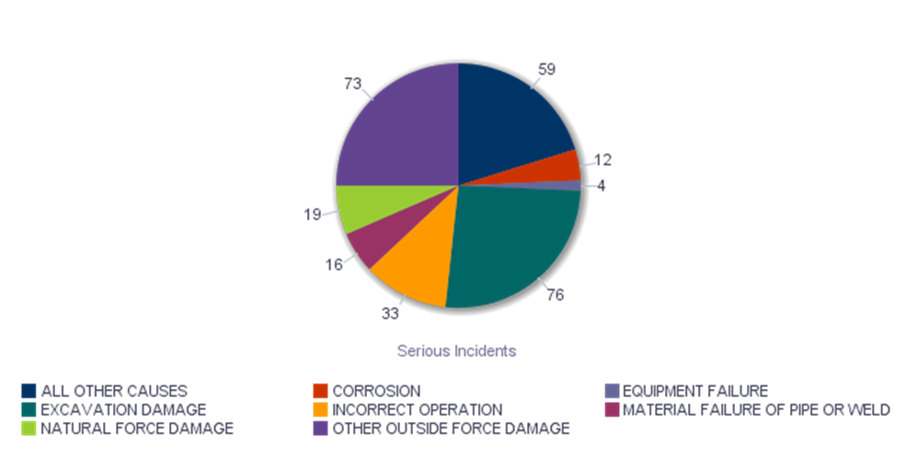
Serious Incidents by cause - Nationwide

Slide 24
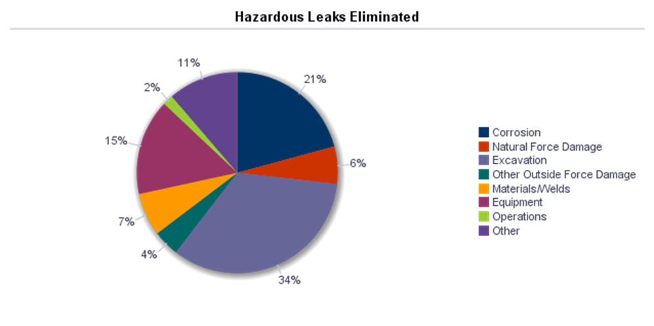
Hazardous Leaks Eliminated- Nationwide

Slide 25
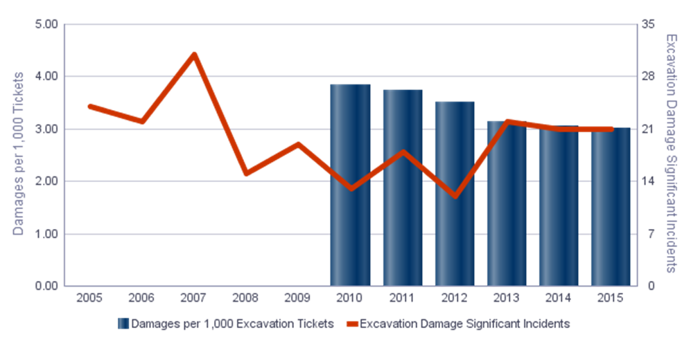
Excavation Damages per 1,000 locate tickets

Slide 26
Annual Report –
Leak Cause information

Slide 27
Annual Report – Excavation Damages

Slide 28
Questions?
Pete Chace
(614) 644-8983
Peter.chace@puc.state.oh.us

