Slide 1
Ohio Gas Association April 1, 2016
Just Safety Culture
Scott Perry
HSE Manager

Slide 2
Leak Investigations

Slide 3
Meter Handling

Slide 4
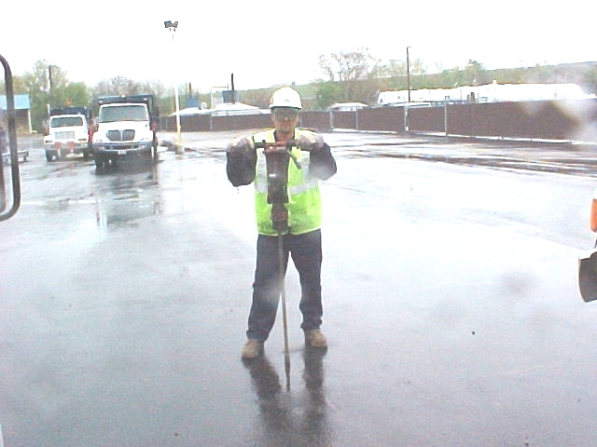
Leak Investigations
Manually Drill Test Holes

Slide 5
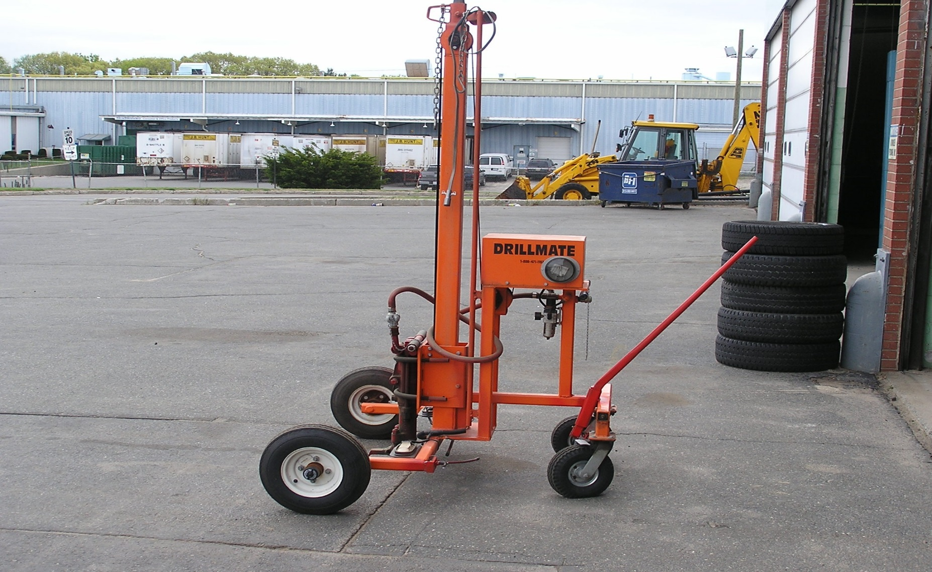
Drill Mate

Slide 7
Must understand why at-risk choices/behaviors are made/occur

Slide 8
Understanding Why Unsafe Choices Are Made
Do We Manage People?
We don’t manage people, we manage behaviors
Understanding behaviors and what reinforces them is key to performance improvements
People unintentionally reinforce behaviors they don’t want.

Slide 9
Understanding Why Unsafe Choices Are Made
Unsafe Behaviors are Rewarding:
Take less time
Take less effort

Slide 10
Understanding Why Unsafe Choices Are Made
Safe Behaviors are Punishing:
Take more time
Take more effort

Slide 11
What Influences Behavior
Need to understand consequences of unsafe behavior/choices
Develop skills to understand your own choices
Organization and leadership understands how they influence behavior

Slide 12
Unintended Consequences
The “Go-to-Guy”
Git ‘er done

Slide 14
Brad Livingston – 100% Preventable Injury & Fatality

Slide 15
What Happened & Why?
Employee knew it was unsafe - but it saved time & effort - rewarding
Leadership ignored unsafe behavior – enabling it
Organization didn’t empower younger employee to speak up

Slide 16
Understanding Behavior & Consequences
Understanding Behavior
Behavior (what the person does or says)
Consequence (the result of the behavior)

Slide 17
Example
Behavior | Consequence
Safe Behavior | 1972 | 2016
Wear Seat Belts | Punishing | Rewarding

Slide 18
What’s The Difference Between Then and Now?
Education
Acceptance
Reduced Peer Pressure
Understanding of Personal Consequences – feels rewarding!

Slide 19
Example
Driver sees police car ¼ mile ahead
Behavior = Driver steps on brakes
Consequence = Driver does not get speeding ticket
Reinforcement = Spouse gives positive reinforcement through praise!

Slide 20
Example
See hot stove
Behavior = Touch hot stove
Consuqence = Get burned
Meaningful Consequence?
Immediate
Certain

Slide 21
Example
See cigarette
Behavior = Smoke
Consequence = Get cancer
Meaningful consequence?
Future
Uncertain

Slide 22
Consequences
Minimal Effect =
Future
Uncertain
Negative Reinforcement

Slide 23
Consequences
Maximum Effect =
Immediate
Certain
Positive Reinforcement

Slide 24
Pinpointing, Measurement, and Reinforcement
Pinpoint desired behaviors
Track desired behaviors (small improvements)
Use of positive reinforcement to increase desired behavior

Slide 25
Example
Behavior
62% of worksite inspection results safety compliant, last month was 55%
Consequence
Feedback on performance
Positive reinforcement where appropriate

Slide 26
Where do we start?

Slide 27
Just Safety Culture
Create a learning organization
No blame or shame for honest mistakes
Notes:
What are the benefits of working in a positive environment?
People care about each other, they work to help each other improve, they speak up when things don’t look right.
In a Just Culture, care is taken to ensure that we don’t act to shame, blame or punish people. Just is “getting what’s earned”.

Slide 28
Background Explanation of Just Safety Culture
High performing organizations build trust, and cultivate an environment of continuous learning
Balanced accountability for all is key
Notes:
Where does “Just Culture” come from? Most common in HIGH Risk industries, like the medical field where mistakes can result in serious results. When mistakes occur, people must feel confident that they can openly share to help others learn and avoid having mistakes repeat.
A strong culture is one that anticipates at-risk behavior and implements multiple layers of protection, barriers, controls and defenses into our work processes to keep our most valued asset, the employee safe.
Just culture is not about willing people to be perfect; rather it’s about management providing a high functioning SMS (safety management system) and relying on properly trained and fully engaged employees to make safe choices in their work practices.
Work is accomplished through people (human performance). People to not set out to get injured or injure others.
When an individual employee makes an honest mistake, we need to keep in mind the employee’s choices and decisions are most often a direct reflection of what the organization enabled and the leadership allowed.
A “just” culture creates an atmosphere of trust in which people are encouraged to provide all safety-related information. Any event related to safety, especially human or organizational errors must be considered as a valuable opportunity to improve operations through experience and share feedback for “lessons- to –be –learned”.
Our goal is to create an environment where employees are encouraged to report incident, errors, and near misses so ewe can learn from them and not repeat them.

Slide 29
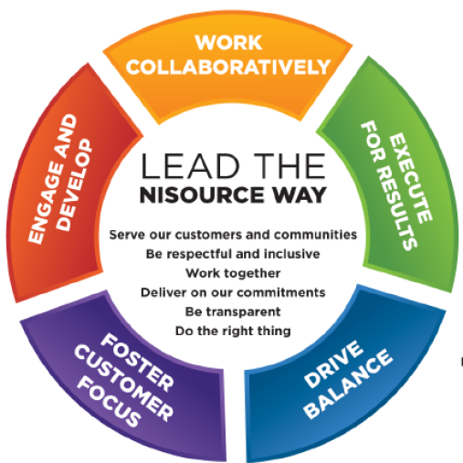
How and where does Just Safety Culture “fit”?
Fairness
Honesty
Integrity
Trust
NiSource Ethics and Compliance
Just Culture is a way in which Safety demonstrates it is living to the NiSource Way … Respectful and Inclusive, Working Together, Transparent, and Doing the Right Thing …
Notes:
At NiSource, Personal Safety is something that we all share as a common value.
As illustrated in the Ethics & Compliance graphic above, we demonstrate fairness, honesty, integrity, and trust in our business dealings. All four of these values also reflect aspects of a Just Safety Culture.
NiSource has been recognized for the third consecutive year, as one of the World’s Most Ethical Companies by the Ethisphere Institute. This prestigious list includes 143 companies from 30 different countries around the world.
We are honest and conduct our selves with integrity (following through with commitments) and we work to develop and maintain trust.
Just Culture is really a large part of the “NiSource Way”. Where we work collaboratively to build positive relationships with our teams, communities and regulators.
We value diversity in all forms including diversity of thought and encourage people to contribute to identifying solutions that result in sustainable improvements in safety and all aspects of the business that lead to providing safe, reliable service to our customers.
Employee engagement is strengthened by a transparent safety program, helping to attract and retain the BEST available talent.
Employees are proud to work for an organization that values their contributions, invests in their personal and professional development and actively demonstrates a commitment to safety on……..and off of the job.
Bottom line, we treat people with the respect they deserve.

Slide 30
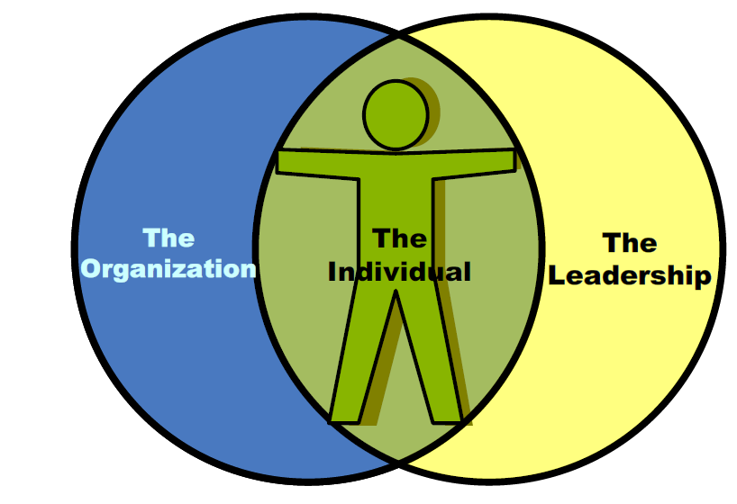
What are we doing to promote a Just Safety Culture?
We have developed a “Just Culture Protocol” for incident reviews, so that we can focus more on what we can learn from our incidents.
Notes:
Would you drive a moped on the freeway? What if I dare you? What if I tell you to do it?
Not all risk choices are good ones, were human after all.
We all make mistakes and must understand that we can’t out perform the system we are working in- at any level if were not properly equipped and supported.
The moped is not designed to travel at 55- 70 MPH. Failure is imminent, but it’s not the mopeds “fault”.
Researchers have found that 78% of injuries and events- including injuries, autos, major system failures etc are within managements control. That is, organizational and programmatic weaknesses are the main cause for most incidents. Think about that. We are human too and are faced with our own “risk choices”. We, as leaders can set up the system in error.
The individual is influenced by the organization and leadership.
Leadership- YOU, and me contribute to our employees “risk choices”. Are we creating inducements, undue time pressures?
When incidents occur, we need to look past the employee, and rather focus on the systems first. Remember, people don’t set out to get injured. What are the factors that enabled the event to occur?
We should not look to place blame, shame or punish at any level, but rather seek to understand the gaps in our systems and work to reinforce our shortcomings.
A systematic approach to help us understand contributing factors and root causes will aid us in establishing a “just safety culture”. (we have a hand out for this) “Just Culture Protocol” for incident review.

Slide 31
Positive Personal Safety Accountability
Management tasks
Create an open learning environment
Strive to understand why human errors occur
Strive to understand why at-risk behaviors occur
Notes:
Positive Personal Safety Accountability means that we are all comfortable to take “ownership” of our actions and outcomes, both good and bad.
We can share our experiences with others and help them to learn from our experiences.

Slide 32
Positive Employee Personal Safety Accountability
Look for risks in systems
Look for risk in our own behavioral choices
Understand risk versus benefit
Participating in the learning culture- being open and honest about what happened

Slide 33
The role of leaders is not to find fault or place blame, but to analyze why people are behaving as they are, and modify the consequences to promote safe behaviors.
Balanced Accountability
Live Here
Support of Just Culture
Blame Free
Punitive
When trust is established, people will give you the benefit of the doubt if you make a mistake. If you are not trusted, they will not believe you even when you tell the truth.
Notes:
We all have biases.
Risk choices may- or may not be influenced by the environment.
Outcome bias. Question about medical error results good, results bad.
Severity bias. Punish un-justly or apply “no harm, no foul”.
In a “JUST CULTURE”, we strive to find “BALANCED ACCOUNTIBILITY”.
Not “blame free” but not “punitive”.
“JUST is what’s earned”.

Slide 34
Summary
Learn causes of unsafe behaviors
Pinpoint desired behaviors
Reinforce desired behaviors
Track and provide frequent meaningful feedback
Look for small improvements
Revaluate for effectiveness

Slide 35
Questions?

