Slide 1
Odorant Measurement and Injection Control
Tomek Marchlewski, Eric Schaumloffel
Ohio Gas Association
March 31, 2016

Slide 2
Presentation
Introduction
Why do we measure?
Presentation and analysis principle of the energyMEDOR analyzer
Performance and results validation
Summary

Slide 3
Why do We Analyze for Sulfur Compounds?
Security (Health and Safety)
Odorant injection control
Pipeline integrity
Quality of supply
Cost concerns

Slide 4
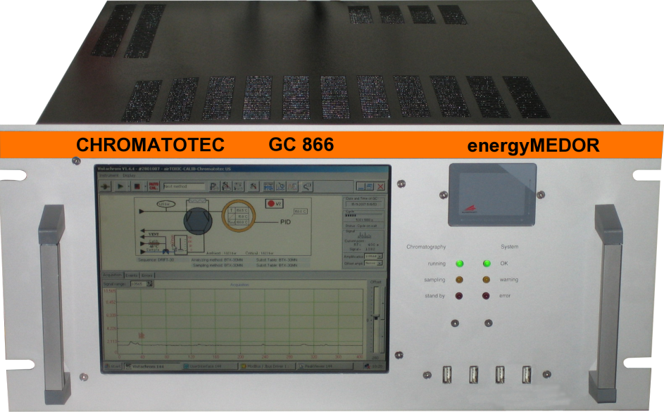
EnergyMEDOR
The EnergyMEDOR is an online analyzer for continuous monitoring of sulfur compounds (H2S, mercaptans, THT and TS) present in matrices such as Natural Gas.

Slide 5
Analysis Principal
The EnergyMEDOR uses an electrochemical cell that allows the specific detection of sulfur species.
The detection is achieved by a gas-liquid reaction without altering the sample (no conversion of the sample).
An internal permeation unit is used to validate the results during each analysis (DMS permeation tube). This enables automatic internal calibration that allows for auto validation of the results.

Slide 6
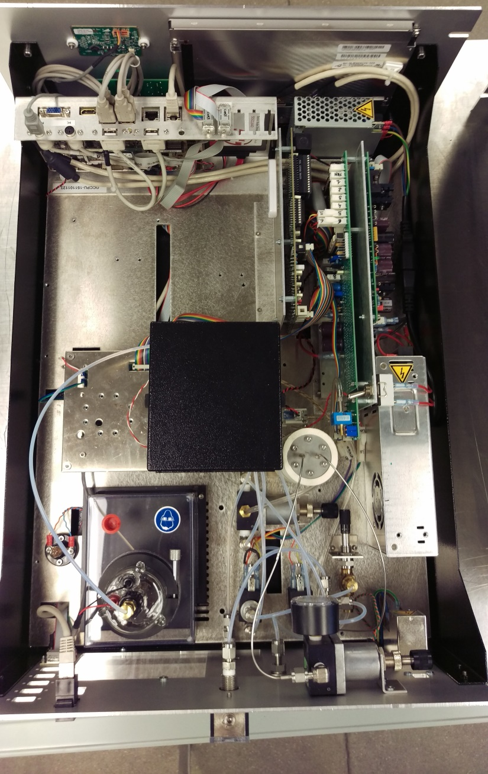
Overview
Oven (inside): injection valve, sampling loop and chromatographic column
Pressure regulator to adjust carrier gas flow
Calibration system (permeation tube inside the oven)
Selection valve (solenoid valve)
Adjustment valve to set the sampling flow
Electrochemical detector and reservoir
Pressure regulator to adjust the flow of the calibration system

Slide 7
Analytical Operation
Sample is introduced into the system.
Sample gas travels through the sampling loop.
Carrier gas travels through the columns and into detector.
The sulfur compounds are separated in the column according to their affinity to the column film.
The sulfurs are then detected by the wet cell through a gas-liquid reaction. The individual compounds are qualitatively and quantitatively identified by elution time and detector response.

Slide 8
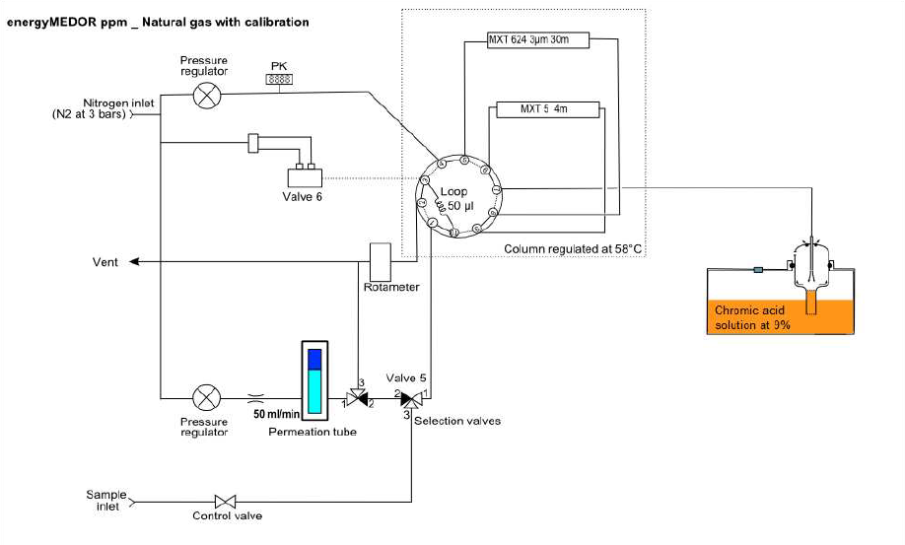
Analysis

Slide 9
Software
Analytical control
Storage of data (calibrations, results and alarms)
Full traceability for quality and audit trail purposes
Real-time results transmitted via standard transfer protocols
Set up of process alarms (injection monitoring)

Slide 10
Sulfur Compounds Analyzed
Compound | Chemical formula
Hydrogen Sulfide Methyl Mercaptan (MTM) Ethyl Mercaptan (ETM) Dimethyl Sulfide (DMS) (iso) 2-Propyl Mercaptan (IPM) tert Butyl Mercaptan (TBM) Methyl Ethyl Sulfide (MES) (n) 1-Propyl Mercaptan (NPM) (sec) 2-Butyl Mercaptan (SBM) Diethyl Sulfide (DES) TetraHydroThiophene (THT) | H₂S CH₃-SH CH₃CH₂-SH CH₃-S-CH₃ (CH₃)₂-CH-SH (CH₃)₃-C-SH CH₃CH₂-S-CH₃ CH₃CH₂CH₂-SH CH₃CH₂CH(CH₃)-SH CH₃CH₂-S-CH2CH₃ C₄H₈S
Compound | Chemical formula
Hydrogen Sulfide Methyl Mercaptan (MTM) Ethyl Mercaptan (ETM) Dimethyl Sulfide (DMS) (iso) 2-Propyl Mercaptan (IPM) tert Butyl Mercaptan (TBM) Methyl Ethyl Sulfide (MES) (n) 1-Propyl Mercaptan (NPM) (sec) 2-Butyl Mercaptan (SBM) Diethyl Sulfide (DES) TetraHydroThiophene (THT) | H₂S CH₃-SH CH₃CH₂-SH CH₃-S-CH₃ (CH₃)₂-CH-SH (CH₃)₃-C-SH CH₃CH₂-S-CH₃ CH₃CH₂CH₂-SH CH₃CH₂CH(CH₃)-SH CH₃CH₂-S-CH2CH₃ C₄H₈S
Note: Compounds can be grouped to provide the odorization levels
as well as the relative index of odorization.

Slide 11
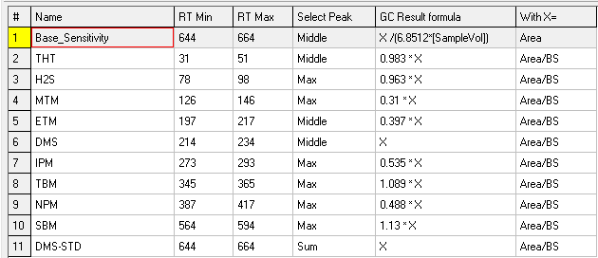
Sulfur Compounds Analyzed

Slide 12
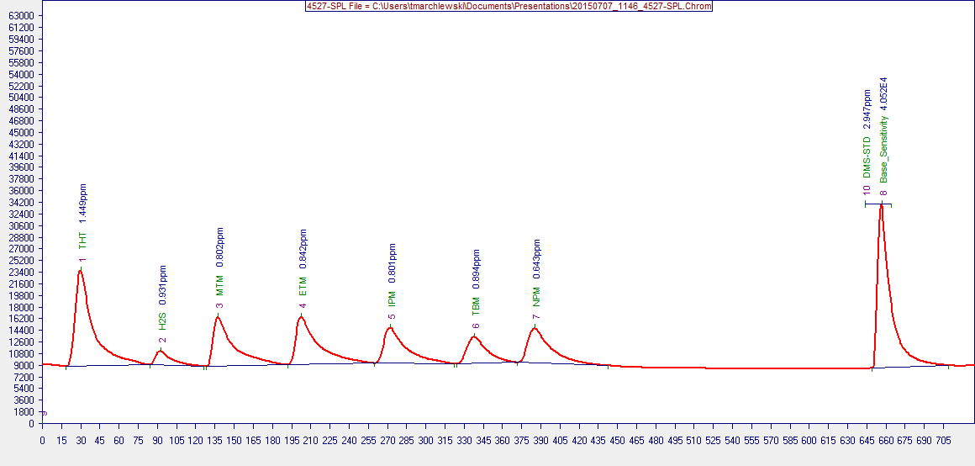
Sulfur Speciation

Slide 13
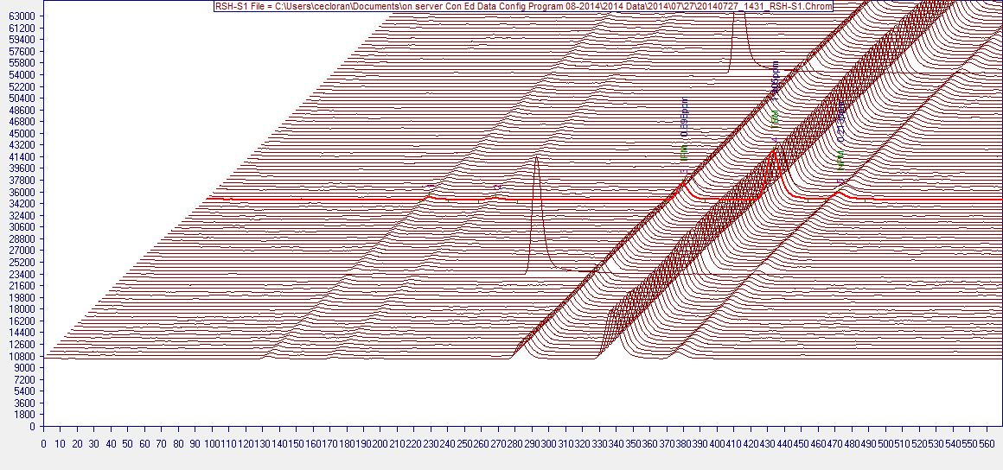
3D Chromatograms

Slide 14
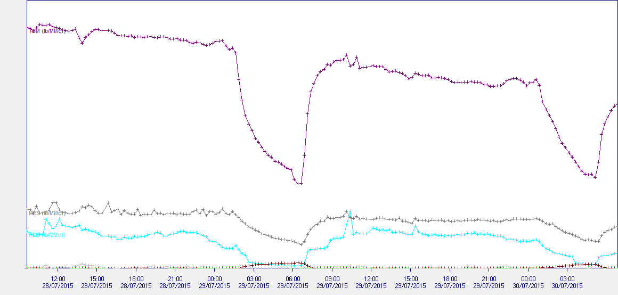
Trend
0.5
lb/MMcf
0

Slide 15
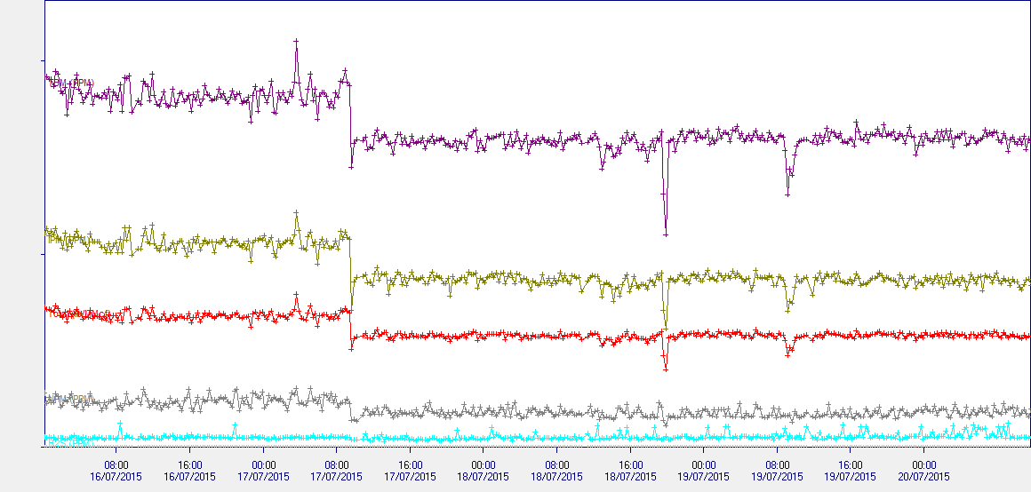
Trend
2
ppm and lb/MMcf
1
0

Slide 16
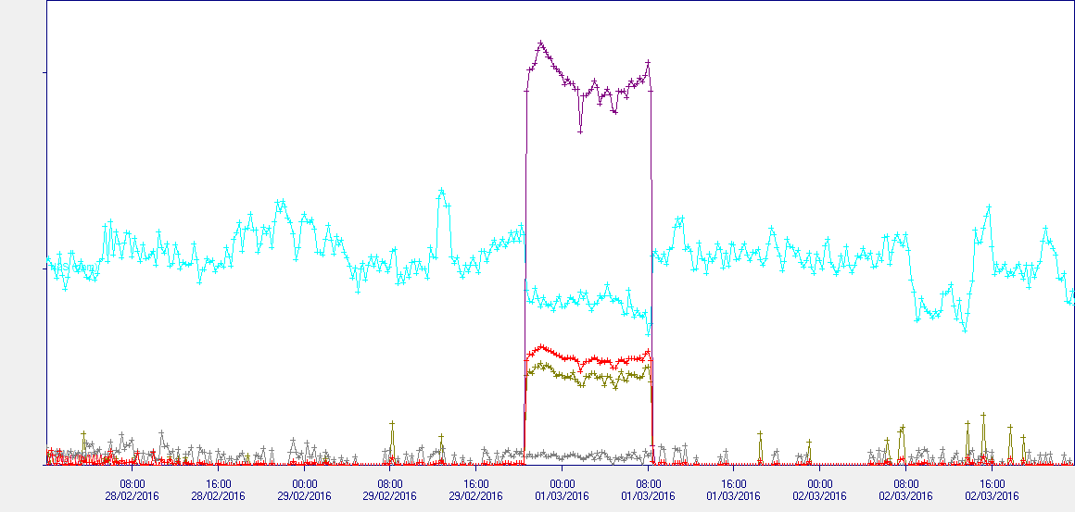
Trend
2
ppm and lb/MMcf
1
0

Slide 17
Annual Service
Permeation tube replacement
Permeation oven O-ring replacement
Rotor Replacement
Rotor housing cleaning
Sampling loop replacement
Detector cleaning
Flow and temperature check
Calibration check

Slide 18
Summary
Detector is highly sensitive to sulfur compounds at ppm or ppb level
Very clear separation of the compounds
Stability of the results and validation of the results with standard permeation tube
Rugged industrial analyzer that needs very low maintenance
Odorant injection can be closely monitored allowing optimization of injection rates to reduce costs

