Slide 1
NEXUS Gas Transmission Ohio Gas Association Market Conditions Conference
Erika Young
Project Director, Business Development
July 20, 2016

Slide 2
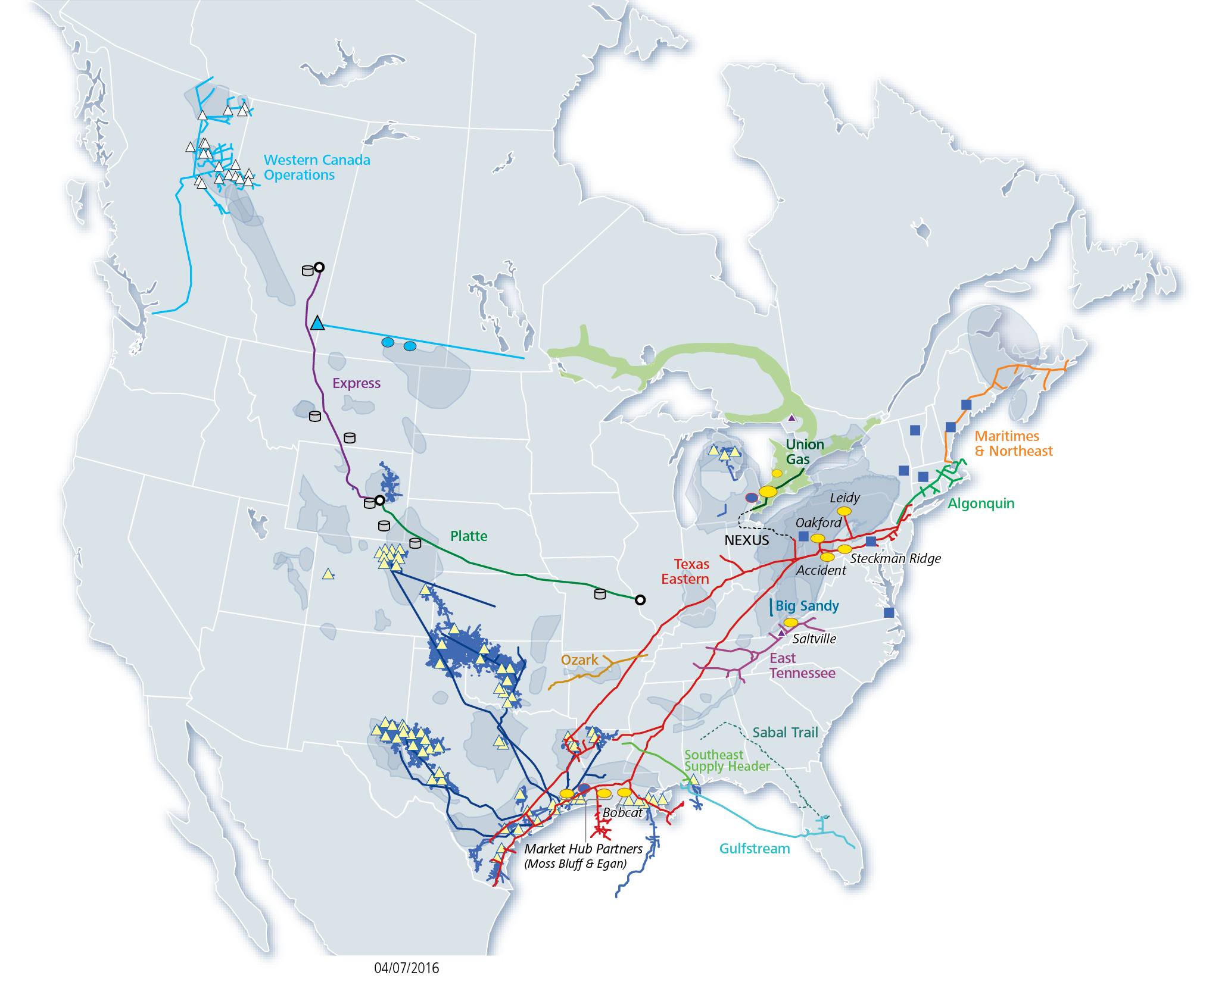
Our Portfolio of Assets
Natural Gas Transmission Pipe: | ~19,000 mi
Natural Gas Storage Capacity: | ~300 Bcf
Natural Gas Gathering Pipe: | ~70,000 mi
Crude Transmission Pipe: | 1,700 mi
DCP NGL Transmission Pipe: | 2,100 mi
SE Gas Processing Capacity: | 3.7 Bcf/d
1Q16 DCP Gathered and Processed: | 6.9 Tbtu/d
1Q16 DCP NGLs Produced: | ~380 MBbl/d
Distribution Pipe: | 40,300 mi
Union Gas Retail Customers: | 1.4 million
Gas storage facility
Gas processing plant
Propane terminal
NGL storage
Shale gas formations
Crude storage
Major oil pipeline terminal

Slide 3
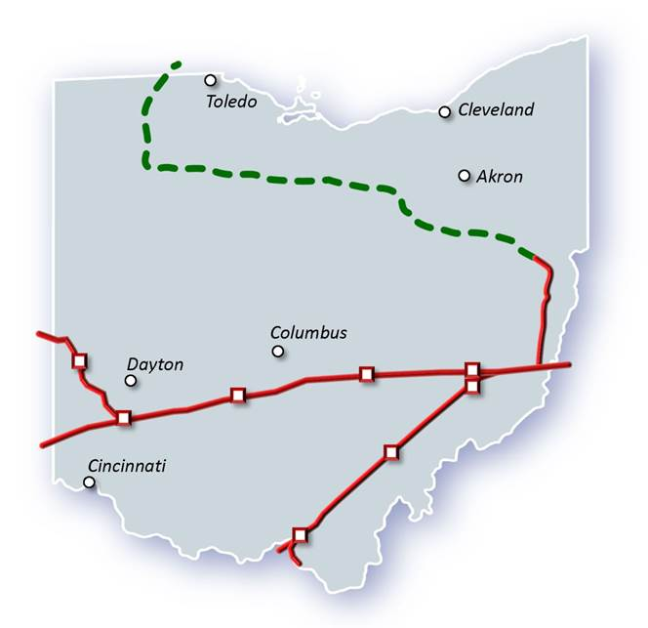
Spectra Energy’s Ohio Presence
Spectra Energy’s Texas Eastern pipeline has been operating in Ohio since 1947
1,023 miles of pipeline in 22 counties
9 compressor stations
150 Bcf of gas delivered annually to Ohio
94 employees in Ohio
Texas Eastern’s Ohio customers include Duke Energy, American Electric Power, Dayton Power & Light, Columbia Gas of Ohio and East Ohio Gas Company
Texas Eastern currently serves 7 power plants and 5 LDCs in Ohio
Providing gas to over 5,200 MW of power generation
Equivalent to over 15% of OH’s total generation
With 9,096 miles of pipeline, Texas Eastern Transmission (Texas Eastern) connects Texas and the Gulf Coast with high demand markets in the northeastern United States, supplying fuel for electric generation facilities and helping to meet peak-day demands.

Slide 4
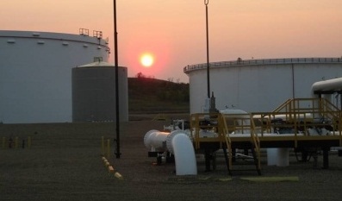
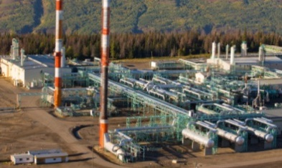
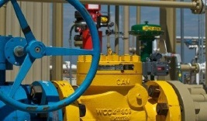
Our Businesses: What We Do
U.S.
Transmission
Liquids
Western Canada
Distribution
Field Services
Deliver & store
natural gas
Transport crude oil from Canada to Midwest U.S.
Process & deliver natural gas & natural gas liquids
Distribute natural gas to homes & businesses in Ontario
Produce natural gas liquids & process natural gas

Slide 5
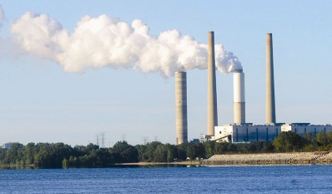
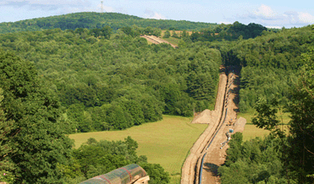
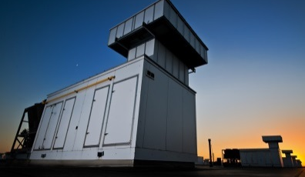
DTE Corporate Overview
Strong, Stable and Growing Utilities
~80% of earnings
Complementary Non-Utility Businesses
~20% of earnings
DTE Electric
DTE Gas
Gas Storage & Pipelines
Power & Industrial Projects
Energy Trading
10th largest U.S. electric utility in the US
2.1 million distribution customers in southeast Michigan
Fully regulated by the Michigan Public Service Commission
11th largest U.S. gas utility
138 Bcf of working gas storage capacity; purchases 120 – 150 Bcf/yr
900 Bcf annual throughput
1.2 million distribution customers
Fully regulated by the Michigan Public Service Commission
Transports and stores natural gas
91 Bcf of gas storage; 535 miles of pipeline
Owns and operates energy assets
Industrial / utility solid fuels
Utility services and renewable energy
Transports gas on more than 60 pipelines
Asset management and sales to major utilities
Producer services, including risk management

Slide 6
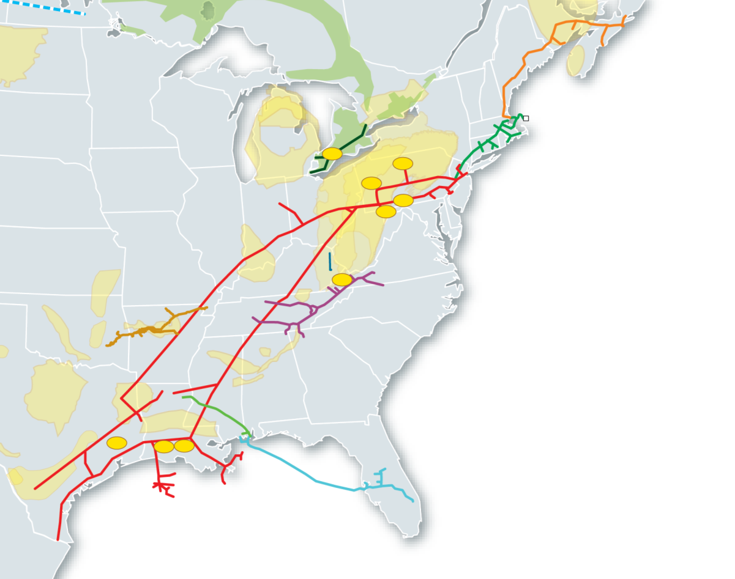
Appalachian Shale Supply
21 Bcf/d
Current Estimate
41 Bcf/d
2025 Avg Estimate
Power Generation
City Gate & Power Generation
City-Gate Market Growth
Power Generation
Mexico
Gulf Coast LNG & Industry

Slide 7
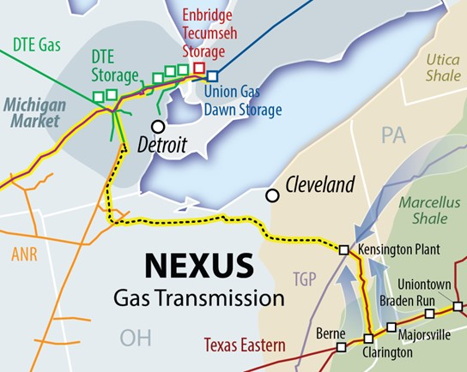
NEXUS - Scope
Project Scope:
Capacity: | 1.5 Bcf/d
Design: | ~255 miles of 36” pipe 130,000 HP with 4 compressor stations
New M&R Stations | Kensington Processing Plant Tennessee Gas Pipeline Texas Eastern Ohio Line DTE Gas Transportation System at Willow Run, MI (delivery) Dominion East Ohio Columbia Gas of Ohio
Connections | Various Ohio LDCs and end-users
In-Service: | November 2017
CapEx: | $2+ billion
Vector
Key Advantages:
Market pull and producer push project
Project leverages existing infrastructure, minimizing environmental impacts and providing greater access to secondary markets
Northern route through Ohio connects NEXUS to growing market demand centers, including power generation and industrials
Connects shippers to growing markets in Michigan and Ontario, with a combined 3 + Bcf/d incremental demand expected by 2025
NEXUS is on target for November 2017 in-service

Slide 8
NEXUS – Favorable Supply/Demand Dynamics
Abundant Marcellus & Utica Supply
Growing & Diverse Demand Markets in Great Lakes Region*
Flexibility with Storage
Liquidity
Long-term Value
Over 40 Bcf/d of supply by 2025 needing an economic outlet
Declining supply to Great Lakes region from Gulf Coast and Western Canada
Peak month demand averaged ~26 Bcf/d in January 2014
3.3 Bcf/d increase in Power Sector Gas Demand from 2014 to 2030.
LDCs and End-Users connected along the route.
950 Bcf of working capacity, 23 Bcf/d peak design withdrawal capacity
Dawn - 2nd largest physical natural gas trading hub
Daily traded volumes at MichCon, Chicago and Dawn have exceeded that of Henry Hub
Attractive basis at Dawn and economic transport over long-term
*Great Lakes Region - Ohio, Michigan, Illinois, Indiana, Ontario and Wisconsin
Sources: CERA; DTE Analysis; Various Consultants

Slide 9
NEXUS Market Connections in Ohio
NEXUS has also signed 13 market connection agreements with LDCs, industrial facilities and power generators that could connect incremental load across northern Ohio of up to 1.75 Bcf/d
In addition to these confirmed market connections, NEXUS is actively negotiating with multiple parties for future firm deliveries at multiple market connections
NEXUS will be the foundation for growth in the region for decades to come

Slide 10
NEXUS Project Schedule
NEXUS has consistently met milestones and is on target for a November 2017 in-service date
Key Milestones
2014
October Held 9 voluntary informational sessions in OH and MI
2015
January FERC accepted project use of pre-filing process
Submitted first drafts of Resource Reports 1 & 10
February Held 10 Open Houses in OH and MI
April/May FERC held 6 scoping meetings in OH and MI
June Submitted draft Resource Reports
November Filed FERC Certificate Application
December Received Notice of Application (NOA)
2016
Feb/March Placed Compression Order
March Pipeline Construction Contractors Awarded
April Filed Supplemental Filing on FERC docket
May Received FERC Notice of Schedule (NOS)
July Received FERC Draft Environmental Impact Statement (DEIS)

Slide 11
Economic Development – Benefits
*Source: Public Finance Resources, Inc. Estimated Ohio Property Tax Revenue for NEXUS Transmission Natural Gas Pipeline, April 2016.
**Estimate of first year revenues.

Slide 12
Local Vendor Registration
Like any large-scale infrastructure project, NEXUS will purchase a significant amount of goods and services from local businesses across the region – from transportation and construction companies to equipment and maintenance.
Whenever possible, NEXUS is committed to using local vendors. We are currently registering interested vendors through the NEXUS website.
Vendors will be selected by our prime construction contractors
www.nexusgastransmission.com/vendor

Slide 13
Committed to Safety
Safety is at the forefront of everything we do as a company
Our dedication to continuously improve our operational safety practices stems from our relentless focus on protecting the people within the communities where we operate, our employees and the environment.
We are committed to building and operating safe pipelines through development and application of technically superior, effective practices.

Slide 14
Layers of Safety
Safety Above All Else
Design Phase
Construction Phase
Operations
Optimize routing
Utilize pipe manufactured from high strength alloyed steel
All welds will be ultrasonically or X-ray inspected
Pipe and welds are sealed with protective coatings
Install cathodic protection
Test pipeline prior to placing in-service
24 hours a day / 7 days a week monitoring
Remote control shut-off valves
One-Call & Right-of-Way monitoring
PHMSA inspections
Ongoing inspections
Ongoing coordination with first responders

Slide 15
Stakeholder and Agency Outreach
NEXUS held over 20 public meetings both voluntarily and within the FERC process as well as countless local agency and governmental meetings.
Based on stakeholder feedback and survey data collected throughout the FERC Pre-File process, NEXUS has evaluated over 350 route variations, of which over 230 have been implemented.
NEXUS built a coalition of over 100 individuals, businesses and organizations who support the project.
The NEXUS Helping Hands in Action program provides monthly volunteer hours to assist local organizations along the route.

Slide 16
NEXUS Advantages
Connects growing supply with growing markets
Flexible service to liquid markets
Foundation for Economic Growth
Long-Term Community Investment
Connections provide Utica and Marcellus production access and flexibility
Demand growth, coupled with declining flow from Western Canada and Gulf Coast will create a need for new supply
Access to growing supply basin in close proximity to the Great Lakes region provides competitively priced, diverse supply for Ohio, Michigan, and Ontario consumers
Path provides secondary in-path access to:
DTE Gas and DTE Electric load centers
MichCon trading hub
DTE storage
Consumers Energy
Vector
ANR Pipeline
Panhandle Eastern Pipe Line
Dawn Hub
Approximately one third of route uses existing infrastructure
Greenfield route is approximately 87% co-located in utility corridors and/or is in agricultural areas
Diverse set of customers
13 market connection agreements with LDCs, industrial facilities and power generators
NEXUS Investment Focus Areas:
Community Vitality (Safety)
Education and Workforce Development
Environmental Stewardship
NEXUS provides long-term value for its customers, key stakeholders and the communities it serves.

Slide 17
Why NEXUS? The Need for Expanded Natural Gas Infrastructure
Need to deliver from production to users
Safest and most efficient
Powering our homes, businesses, factories and filling stations
Cleaner burning
Growing demand
Current lack of sufficient infrastructure
NEXUS will build the infrastructure necessary to deliver clean-burning natural gas to local distribution companies, industrial users and power generators across the region.

Slide 18
Get Involved
Take action to help support timely regulatory approvals:
Join the coalition
Send a letter of support to FERC
Host a meeting to help recruit additional supporters
Submit an op-ed to your local paper
Help educate others
Erika Young
Project Director, Business Development
Spectra Energy
O. (713) 627-4609
edyoung@spectraenergy.com
Kristen Bussell
Stakeholder Outreach
Representing: NEXUS Gas Transmission
O. 614.221.2800
kristen.bussell@hickspartners.com

