Slide 1
2016 Market Conditions Conference Dominion East Ohio Market Outlook
July 20, 2016

Slide 2
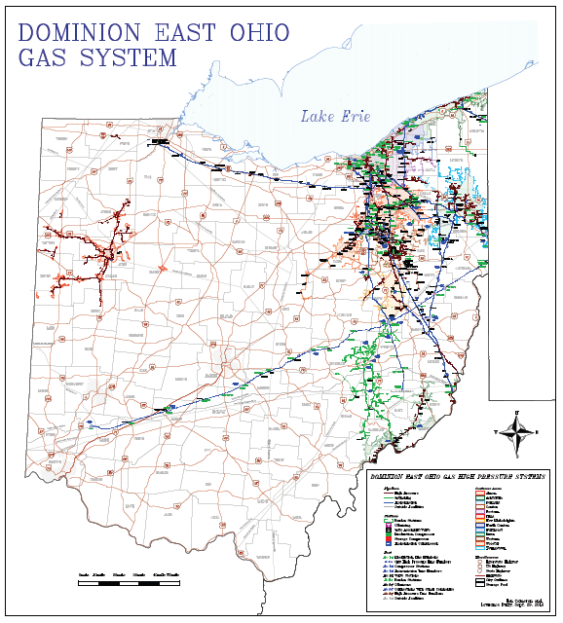
Dominion’s market and assets are unique.
Market Size
1.2 million customers
> 250 Bcf on-system usage
> 2.5 Bcf peak day usage
Extent of Pipeline Assets
20,000 miles – Distribution
1,100 miles – Trans/Storage
1,000 miles – Gathering
Unique Operations
> 50 Bcf of storage capacity
> 35 Bcf conventional production
Served by 7 interstate pipelines

Slide 3
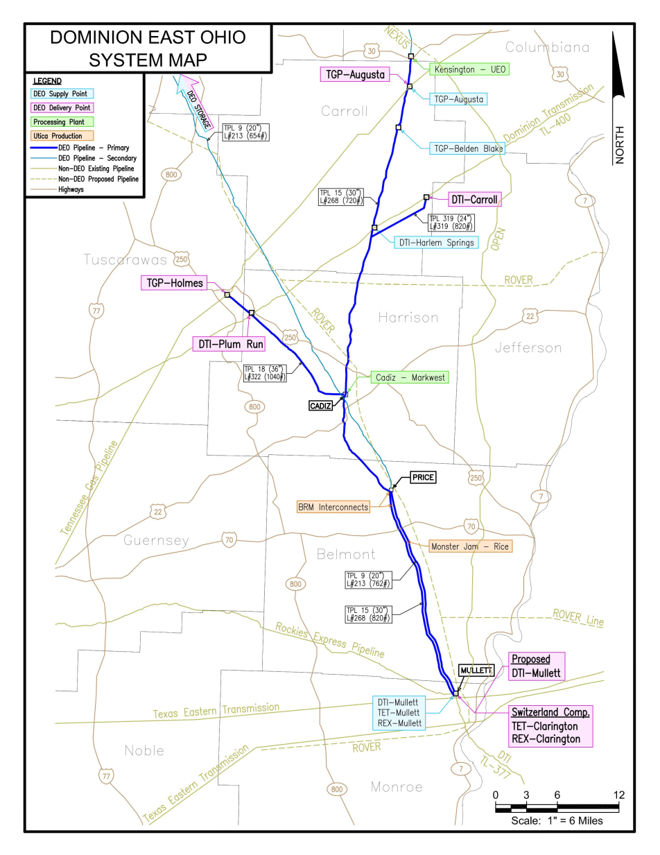
Dominion sits on top of the Utica sweet spot.
A single Utica production receipt point can deliver 250 MMcf/day to Dominion.
By contrast, 40,000 conventional wells deliver a grand total of 100 MMcf/day.
Dominion has major pipelines overlaying dry and wet portions of the Utica play.
TPL-9 – 20” 762 psi MAOP
TPL-15 – 30” 820 psi MAOP
TPL-18 – 36” 1040 psi MAOP
Dominion can deliver Utica production to DTI, REX, Tennessee and Texas Eastern.
Includes 10,650 HP compressor station in Switzerland Township.
TPL-18
TPL-15
TPL-9&15

Slide 4
Low gas prices are driving demand.
National prices are low, but regional prices are even lower.
41% of DEO’s 2015 receipts came from Utica production.
YTD

Slide 5
Industrial & power gen are growth segments…
$100 million aluminum casting plant in Lordstown
Produces billets for construction and auto industries
Went on-line in Apr-2016
Required nearly 2-mile lateral
800 MW combined cycle power plant selling into PJM
Commercial in-service in mid-2018, pipeline in-service Sep-2017
Permit applications to be filed in Q3
Will require nearly 6-mile lateral

Slide 6
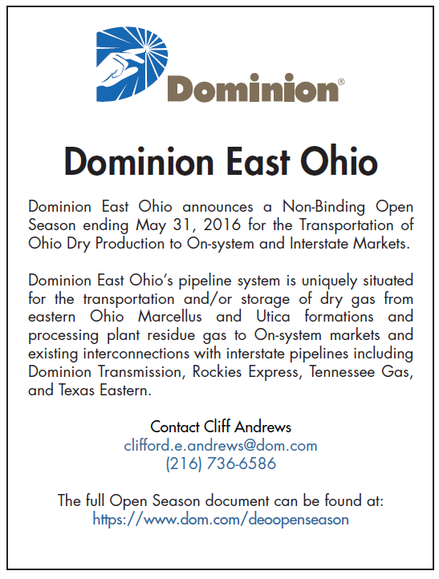
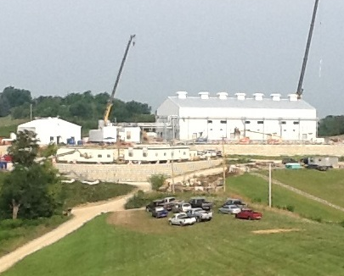
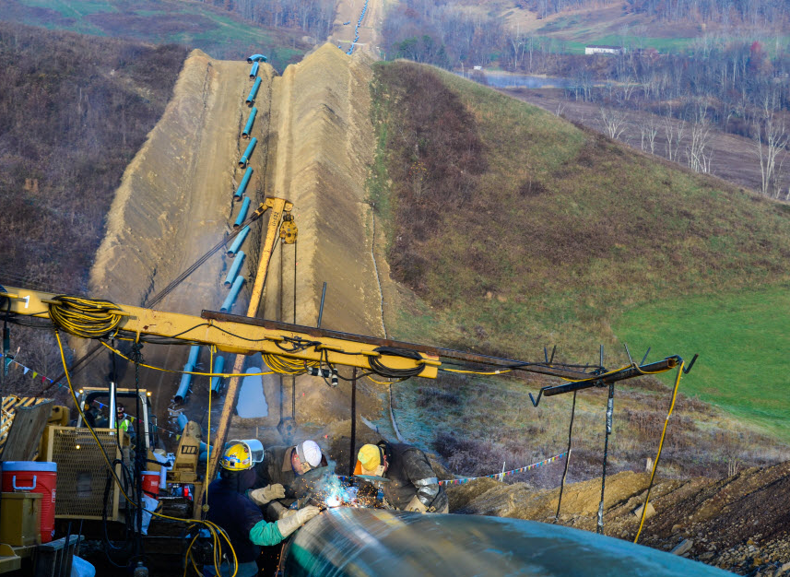
Along with off-system transportation…

Slide 7
And the residential conversion market.
The Opportunity:
Low prices and a recovering economy position natural gas for market share gains.
The Challenge:
We need to make it easy to convert without making the customer a project manager.

