Slide 1
OGA Market Conditions LDC Panel: Growth Initiatives and Outlook Colleen Ryan President, Vectren Energy Delivery of Ohio

Slide 2
Agenda
Vectren at a glance
Modernization update
Regulatory update
Outlook and growth initiatives – Ohio and Indiana
Residential
Commercial and Industrial
Combined Heat and Power

Slide 3
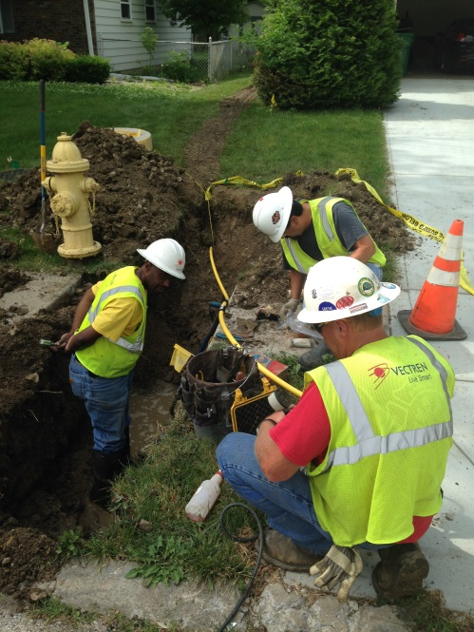
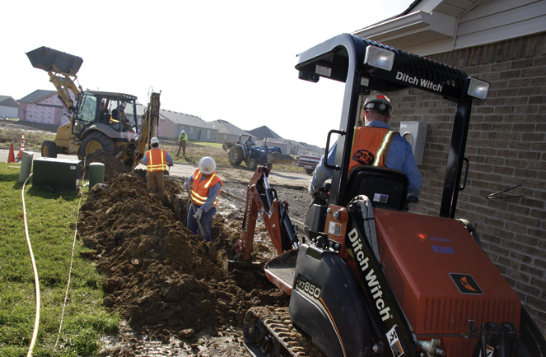
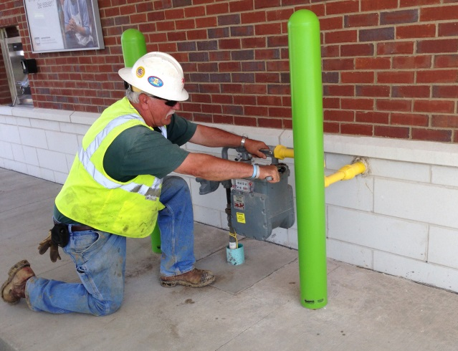
Vectren at a glance
Headquartered in Evansville
Fortune 1000 company
13th largest public company in Indiana
NYSE: VVC
Approximately 5600 employees (including nonutility companies)
Utility 80-90%
Gas
55%
Gas
55%
Notes:
Merger in 2000 – parent companies of Indiana Gas and SIGECO (gas assets of DP&L)

Slide 4
Vectren at a glance
Vectren
Utility
Vectren
Nonutility
Vectren North
Indiana Gas
Infrastructure Services
Energy Services
Vectren South
SIGECO - Electric
Miller Pipeline
Energy
Systems Group
Vectren South
SIGECO - Gas
Minnesota
Limited
Vectren Ohio
VEDO

Slide 5
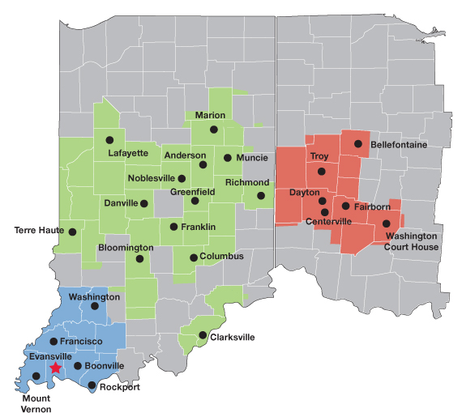
Vectren’s gas footprint
Vectren Energy Delivery of Indiana – South
110,000 gas customers
Vectren Energy Delivery of Indiana – North
578,000 gas customers
Vectren Energy Delivery
of Ohio
315,000 gas customers

Slide 6
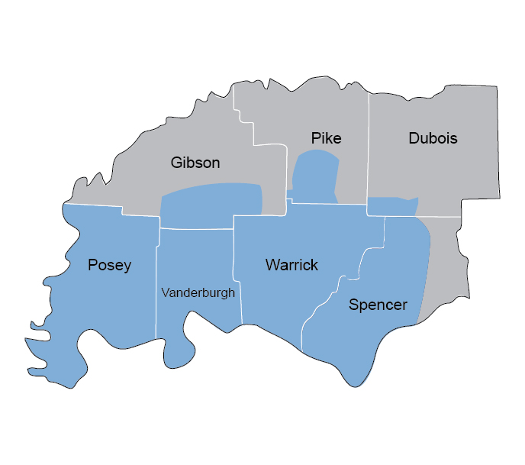
Vectren’s electric footprint
Vectren Energy Delivery of Indiana – South
142,000 electric customers
1,300 MW
Power plants
AB Brown
FB Culley
Warrick Unit 4
Blackfoot Clean Energy Plant

Slide 7
Modernization Update
Vectren has 5,500 miles of gas mains and pipeline in our Ohio system
To ensure system safety, reliability and compliance with federal regulations, we plan to spend approximately $68M on pipeline modernization projects in 2016 and $75M in 2017
Projects include:
Bare steel / cast iron gas main replacement, including meter move outs and service line replacement
Program began in 2009, this year we will replace ~55 miles of BS/CI pipe, and be 43% complete by end of 2016, 100% complete by 2023
Enhancement of distribution pipeline, replacing ineffectively coated steel, replacing services and moving out meters, replacing obsolete regulators/relief valves
Enhancement of transmission pipeline system including pressure testing, installing remote control valves, and retrofitting for in- line inspection
Installation of Automated Meter Reading devices throughout territory

Slide 8
Regulatory update
BTU vs Therm
Defer the revenue impact associated with the heat content of the natural gas
Distribution Accelerated Risk Reduction (DARR) program
Identified six initiatives to enhance our DIMP program, mitigate identified threats and risks, and achieve accelerated risk reduction
Notes:
-- increasing BTU values (hotter gas) from shale gas results in lower Ccf throughput, resulting in annual margin risk on volumetric base rates

Slide 9
Outlook and Growth Initiatives in OH and IN

Slide 10
Residential natural gas sales vs. customer growth
Natural gas usage per household has decreased even as overall demand for natural gas has risen due to increasing customer count.
Source: AGA, 2016

Slide 11
Residential natural gas consumption
Vectren customers have followed this national trend.
Vectren’s Ohio natural gas energy efficiency programs have saved 22.9 million Ccf’s since 2009
Source: American Gas Association, AGA

Slide 12
Residential energy use on the decline
Newer homes consume 21% less energy for space heating on average than older homes (pre-2000)
Since 2009, the Building Technologies Office (in the Dept. of Energy) has issued 40 new or updated standards, which are projected to save consumers over $540 billion off their utility bills through 2030
By 2040, lighting in U.S. households is expected to use nearly 1,000 kilowatts hours less of electricity per year.
Source: EIA, March 2016

Slide 13
Vectren short-term historical & 2015 performance
Gas customer additions
2015 was the strongest year of gas growth since 2007
We saw 13% growth YOY for 2015
Rural expansion contributed to this growth in our Indiana territory
In 2003-2005, we averaged twice as many new customer additions than we do today
Returning to pre-recession new customer addition levels not likely

Slide 14
Market share and 2015 highlights
~90% market share of new residential housing in the counties that surround the Indianapolis area (largest market)
~99% market share of new residential housing in the Dayton region (second largest market)
Single-family housing permits in the areas that we serve have been relatively flat between 2014 and 2015
Growth in North largely attributed to an increase in conversions , multi-family success and rural expansion
For VEDO, the increase in additions can largely be attributed to multi-family development projects (most single-story)
Dayton-area conversions account for about a quarter of all gross customer additions

Slide 15
Growth through Rural Expansion
Rural Expansion activity in Northern IN in 2015
Completed 11 rural expansion projects in 2015 and exceeded goal set
Personal outreach driving success
Plan to continue rural expansion efforts in 2016 and beyond in IN
Regulatory mechanism in IN allows this effort
Exploring similar mechanism in OH
Notes:
Re-evaluating original approved plan
Firming cost estimates vs 20-year test
Validating propensity of propane saturation and ability to convert enough customers to warrant the extension
Some communities, like Scotland, will not be able to move forward without a customer contribution
Challenges that will continue to arise
Overall conversion process (lead time with plumbers)
Timing of the main completion (Lizton & Jamestown); late start to construction in some towns in 2015 but warm weather helped us meet customer expectations
Timing of customers’ propane summer refills and/or their reserves
Life events of customers pulling discretionary income in another direction for the heating season

Slide 16
2016 Residential market challenges
Many expect interest rates to rise in 2016 making ownership less appealing to some
Student loan debt will keep many millennials out of the market and they are not inclined to plant roots and prefer renting in areas with a mix of retail and natural space
Home ownership (around 64%) is expected to continue to decline; with more moving into the rental space
Home ownership at lowest level in the past 50 years
Urban Institute study in 2015: 60% of new household formation over the next 15 years will be renters
Fewer entry level homes being built
Ohio conversion opportunities continue to be more challenging; low-hanging fruit has been picked

Slide 17
2016 Residential focus for growth
On-main conversion
Identified pockets of customers / neighborhoods that are located directly on existing main
Have identified some areas where service lines have been installed but no meter was ever set (i.e. the deal was never closed on conversion)
Considering pilot efforts with all-electric neighborhoods
Multi-family opportunities
Partner with a multi-family developer on pilot project with new technologies
Tankless water heater and hydronic furnace (small footprint, lower energy costs and appliances last longer)
Unique position for affordable housing; lower energy costs helps the developer qualify for more “points” on Federal tax incentives
Notes:
Cannot expect single-family home building to drive growth.

Slide 18
Macro Economic Indicators
Labor Force Participation Rate*
U.S. is approx. 63% -- full employment considered at 75%
Stronger indicator than traditional unemployment rate
Purchasing Managers Index (PMI)
Considered a growth market > 50.0
6 year trend peaked in 2010 at 60.0 following the recession
Declined steadily through 2013 with another peak at 58.0 in July 2014
June – nice uptick to 53.2 as compared with May of 51.3
Workforce Competitive Pressure
Skilled workforce is usually a top priority for site selectors reviewing options for plant expansion.
Finding the next generation of manufacturing workforce is vital to the success of the Indiana and Ohio economies.
Rebranding and training in advanced manufacturing is key at the high school and collegiate levels.
*Bureau of Labor Statistics

Slide 19
Solid Industries
Automotive remains strong leader for U.S. Economy
Lower gasoline prices assisting with larger vehicle production
Little concern regarding Federal rate increases and impact to sales (offset by lower gasoline prices)
Major OEMs expect strong year in 2016
Impreza expansion for Subaru is moving forward
Toyota continues to produce at high volumes
Honda $340M announcement for Anna plant and new 4 cylinder production model
General Motors -- Bedford announced expansion in 2015 of $130M -- new engines blocks and components for large vehicles
Food Products Sector
Nestle, Tate & Lyle, Cargill, St. Gobain, ConAgra, Dannon and White Castle
Orders for these companies remain strong and expect solid 2016
Nestle running maximum production (Boost, Breakfast Essentials, Coffee Mate)
Construction
Knauf, US Gypsum and National Gypsum
Cautiously optimistic on commercial and residential markets in 2016
Similar market in 2016 vs. 2015 (Remains delicate)

Slide 20
VEDO – Combined Heat and Power (CHP)
VEDO CHP Basics seminar
Commercial and Industrial Customers continue to demand more constructive creativity from their energy service providers
VEDO hosted a seminar on CHP basics and equipment options
Utilized market, industry and energy knowledge to provide customers solution-based offerings
Approx. 60 customers and trade allies attended to gain insight into CHP technologies
CHP leads to reduced greenhouse emissions and can create greater onsite reliability for customers while potentially reducing steam prices
Traditionally, CHP utilizes natural gas to produce steam and power to directly to customers with high thermal needs
DOE’s CHP Technical Assistance Program (TAP) provided information on evaluating potential CHP projects.
2012 -- Obama executive order of 40 GW of CHP by 2020
DP&L has program on incentives available for CHP projects, including engineering studies for evaluation.

Slide 21
Questions?

Slide 22
Natural gas = best choice for home heating
Average heating costs: 2013-2014 heating season (5-month period)
$1,859
$990-$1,445
$470- $685
$433
$497
High-efficiency model
All amounts are based on normal winter weather
Notes:
Electric rate is the range between Duke (higher amount) and IP&L.
5-month usage / 5-month cost / charge per unit
VEDI-North Gas 557 therms / $497.25 / $0.893
VEDI-North High Eff. Gas⁽¹⁾ 472 therms / $432.80 / $0.916
Duke Energy Heat Pump - Standard Rate 7,718 kWh / $685.21 / $0.089
Duke Energy Resistance - Standard Rate 16,329 kWh / $1,444.89 / $0.088
Duke Energy GSHP⁽²⁾ - Standard Rate 5,993 kWh / $530.23 / $0.088
Duke Heat Pump - Opt. High Eff. Rate⁽³⁾ 7,718 kWh / $631.40 / $0.082
Duke Resistance - Opt. High Eff. Rate⁽³⁾ 16,329 kWh / $1,335.97 / $0.082
Duke GSHP⁽²⁾ - Opt. High Eff. Rate⁽³⁾ 5,993 kWh / $490.25 / $0.082
IPL Heat Pump 7,718 kWh / $468.62 / $0.061
IPL Resistance 16,329 kWh / $991.21 / $0.061
IPL GSHP⁽²⁾ 5,993 kWh / $363.93 / $0.061
REMC⁽⁴⁾ Heat Pump 7,718 kWh / $777.43 / $0.101
REMC⁽⁴⁾ Resistance 16,329 kWh / $1,644.78 / $0.101
REMC⁽⁴⁾ GSHP⁽²⁾ 5,993 kWh / $603.68 / $0.101
No. 2 Fuel Oil- Indiana⁽⁵⁾ 401 gal. / $1,468.53 / $3.664
Propane - Indiana⁽⁵⁾ 608 gal. / $1,858.78 / $3.056

Slide 23
Natural gas = best choice for water heating
Average annual water heating costs: 2014 (12-month period)
$593
$300-$350
$161
$137
* High-efficiency model
Notes:
Charge per Unit/Annual Usage/ Annual Bill
VEDN Gas .59 EF $0.893 / 180 therms / $161
VEDN Gas High Eff. .62 EF $0.893 / 167 therms / $149
VEDN Gas High Eff. .67 EF $0.893 / 154 therms / $137
Duke $0.113 / 3,110 kWh / $352
IPL $0.094 / 3,110 kWh / $293
Municipal $0.096 / 3,110 kWh / $300
No. 2 Fuel Oil- Indiana $3.676 / 129 Gallons / $476
Propane - Indiana $3.066 / 197 Gallons / $593

