Slide 1
Ohio Gas Association
2016 Market Conditions Conference
James Eckert
Vice President, Commercial East

Slide 2
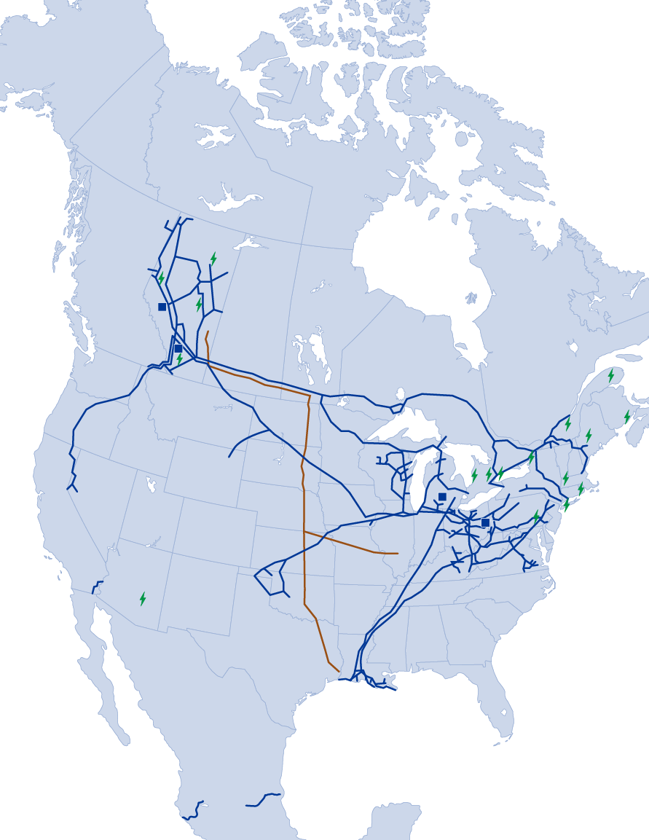
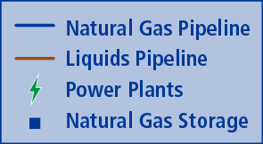
TransCanada Corporation (TSX/NYSE: TRP)
One of North America’s Largest Natural Gas Pipeline Networks
Operating 90,300 km (56,100 miles) of pipeline
Transports more than 25 per cent of continental demand
North America’s Largest Natural Gas Storage Operator
More than 664 Bcf of capacity
Canada’s Largest Private Sector Power Generator
17 power plants, 10,500 MW
Diversified portfolio, including wind, hydro, nuclear, solar and natural gas
Premier Liquids Pipeline System
Keystone Pipeline System: 4,300 km (2,700 miles), 545,000 bbl/d contracted capacity
Safely delivered more than 1.2 billion barrels of Canadian oil to U.S. markets since 2010
Notes:
2

Slide 3
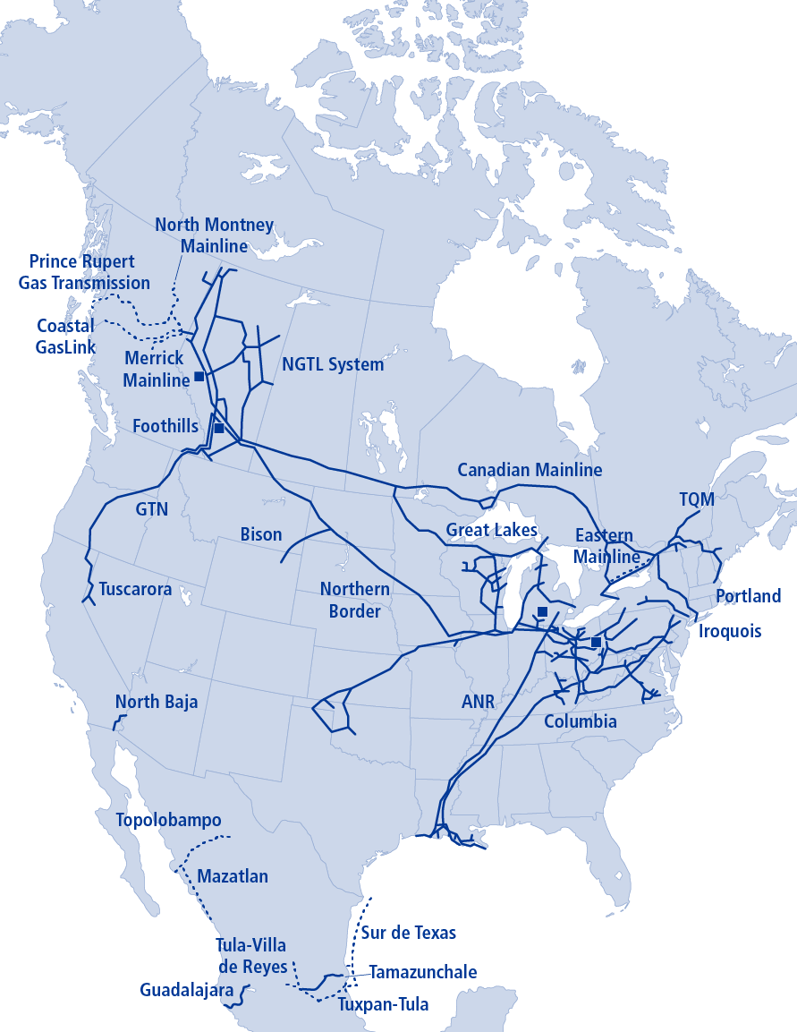
Natural Gas Pipelines
90,300 km (56,100 miles) network of natural gas pipelines supplies more than 25 per cent of North American demand
Unparalleled connections from traditional and emerging basins to growing markets in Canada, the U.S. and Mexico
More than 664 Bcf of working gas storage capacity
Notes:
3

Slide 4
Leach XPress
Overview: TCO project designed to transport up to 1.5 Bcf/d of constrained Marcellus and Utica supply to higher netback value/liquidity points along TCO (Leach and TCO Pool)
Anchor Shippers:
0.4 Bcf/d - Kaiser Francis
0.4 Bcf/d - Ascent Resources
0.3 Bcf/d - Range Resources
0.2 Bcf/d - Noble Energy
0.1 Bcf/d - Gulfport Energy
0.1 Bcf/d – Open capacity
CAPEX: US ~$1.4 Billion
Facilities:
~130 mi. 36” greenfield
~30 mi. 36” looping
~111,000 greenfield HP
~33,000 brownfield HP
FERC Status :
FERC 7(c) application filed June 2015
Rover/LXP Response to FERC July 2016
In-service Date: November 2017
LXP
Leach/TCO Pool

Slide 5
Rayne XPress
Overview: CGT project designed to transport up to 1.1 Bcf/d of Leach XPress and TETCO (via Adair interconnect) Marcellus/Utica supply to higher netback value/liquidity points along CGT (ML Pool and Gulf Coast)
Anchor Shippers:
0.4 Bcf/d - Kaiser Francis
0.4 Bcf/d - Range Resources
0.2 Bcf/d - Noble Energy
0.1 Bcf/d - Gulfport Energy
CAPEX: US ~$400 Million
Facilities:
Bi-directional CS modifications along Columbia Gulf system
~52,000 greenfield HP
~27,000 replacement HP
~4 miles of 30” pipe replacement
FERC Status :
FERC 7(c) application filed July 2015
In-service Date: November 2017
RXP
Leach/TCO Pool

Slide 6
Mountaineer XPress
Overview: TCO project designed to transport up to 2.7 Bcf/d of constrained Marcellus/Utica supply to higher netback value/liquidity points along TCO (Leach and TCO Pool)
Anchor Shippers (Confidential):
2.6 Bcf/d – Binding Precedent Agreements
0.1 Bcf/d – Open capacity
CAPEX: US ~$2 Billion
Facilities:
~164 miles of 36” greenfield pipeline
~7 miles of 24” lateral pipeline
~131,000 HP Greenfield HP
~70,000 HP Brownfield HP
FERC Status :
7(c) application Filed April 2016
In-service Date
June 2018(0.5 Bcf/d WB capacity)
November 2018(2.2 Bcf/d Header capacity)
MXP
Leach/TCO Pool

Slide 7
Gulf XPress
Overview: CGT project to transport up to 0.9 Bcf/d of Mountaineer XPress Marcellus and Utica supply to higher netback value/liquidity points along CGT (ML Pool and Gulf Coast)
Anchor Shippers (Confidential):
0.9 Bcf/d – Binding Precedent Agreements
CAPEX: US ~$700 Million
Facilities:
~254,000 greenfield HP (7 midpoint CS)
FERC Status :
7(c) application filed April 2016
In-service Date: November 2018
GXP
Leach/TCO Pool

Slide 8
WB XPress
Overview: TCO project designed to transport up to 1.3 Bcf/d of Marcellus supply from upstream gathering system (Stonewall Pipeline) interconnect point along TCO’s WB System to (1) Gulf Coast via TGP interconnect (westbound – 0.8 Bcf/d) and (2) Mid-Atlantic markets (eastbound – 0.5 Bcf/d)
Anchor Shippers (Confidential):
1.3 Bcf/d – Binding Precedent Agreements
CAPEX: US ~$850 Million
Facilities:
~26 miles of lift and lay pipeline
~210 miles of MAOP restore/pipeline uprate
~39,000 greenfield HP
~134,000 brownfield HP
FERC Status :
7(c) application filed Dec-2015
In-service Date
June 2018(west capacity)
November 2018(east capacity)
WBXP

Slide 9
Ohio Gas Association
2016 Market Conditions Conference
James Eckert
Vice President, Commercial East

