Slide 1
Gas Pipeline Safety
Federal Regulatory Update
Pete Chace
Public Utilities Commission of Ohio
Gas Pipeline Safety Program Manager

Slide 2
Federal Rulemaking Process
Legislation – Congress passes a law that prescribes general goals for the agency.
Advance Notice of Proposed Rulemaking (ANPR) – agency publishes initial analysis of legislative intent and asks for public comment (optional).
Notice of Proposed Rulemaking (NPRM) – agency publishes proposed rule language after review by Federal Office of Management & Budget (OMB), with a public comment period.
Final Rule – published with response to issues raised by public comment, subject to judicial review

Slide 3
Excavation Damage Prevention
Effective January 1, 2016
Creates 49 CFR 196
  Defines criteria for determining if a State enforcement program for its excavation damage prevention laws is Effective, and allows for PHMSA enforcement if not.

Slide 4
Underground Natural Gas Storage
Interim Final Rule effective 1/18/2017
PHMSA still may change the rule pending review of comments
Incorporates API RP 1170 (salt caverns) and API RP 1171 (depleted hydrocarbon reservoirs, aquifer reservoirs)
Requires cathodic protection, risk based assessment program
Will be a new state certification program

Slide 5
Excess Flow Valves for Multi-person Dwellings
Final Rule effective April 14, 2017
Requires EFV’s to be installed for certain structures other than single family dwellings (multi-family residences and small commercial with volumes < 1,000 SCFH.
Customer notification – does not have to be a letter to each individual customer
Rule does not prohibit customer from paying

Slide 6
Operator Qualification, Cost Recovery, Incident Notification
Final Rule published 1/23/17
Potentially effective March 24, 2017
Subject to 60 day waiting period and congressional review
Portion of the rule covering OQ was removed for a future rulemaking (the proposed “two part test”)

Slide 7
Operator Qualification, Cost Recovery, Incident Notification
Incident reporting time of 1 hour after “confirmed discovery” - “when it can be reasonably determined, based on the information available to the operator at the time a reportable event has occurred, even if only based on a preliminary evaluation”
Within 48 hours of confirmed discovery, revise or confirm the initial telephonic notice
1-844-OHCALL1 (1-844-642-2551)

Slide 8
Operator Qualification, Cost Recovery, Incident Notification
Excludes farm taps from DIMP while requiring regulator inspection and testing at least once every 3 years.
Clarifies training requirements in the control room management rule
Requires electronic reporting of MIS reports, and modifies the criteria used for post accident drug and alcohol testing
Various related changes to Part 195

Slide 9
Notes on OQ
How are your contractors qualified? Do you have confidence in how they are evaluated?
Span of control – non OQ workers can perform a covered task “if directed and observed by an individual who is qualified”. How many workers are being observed at once?
Management of change – significant changes communicated to individuals and to the state agency [192.805(f), (i)]. For GPS you can inform us during inspection

Slide 10
What changes to OQ need to be communicated?
Changes to procedures
Use of new equipment
Changes to Regulations (federal or state)
Changes to Standards incorporated by reference
New information from equipment or product manufacturers
Newly identified tasks
Findings from incident investigations

Slide 11
Gas Transmission and Gathering Lines
NPRM released 3/15/2016
PHMSA received over 400 comments
Rule is under review and may be heavily modified
Will likely focus strictly on the congressional mandates in the 2006 PIPES act (evaluation of whether IM requirements should extend beyond HCA’s, potential MAOP validation, automatic shutoff valve requirements).

Slide 12
Plastic Pipe
NPRM issued 5/21/15
Rule “timed out”, process will have to start again.
  Addresses composite pipe, 50 year markings, increased design factor for PE pipe (.32 to .40), authorized use of PA12 at higher pressures, tracking and traceability of lines, incorporates revised standards.

Slide 13
Incident Trends
What do incident trends tell us about pipeline safety threats?
  Excavation Damage is the top threat for Distribution piping
  Time dependent threats (Material, weld or joint failure, corrosion) are the top threats for Transmission lines
  Damage Prevention programs appear to be effective
  A Safety Management Systems approach may be helpful

Slide 14
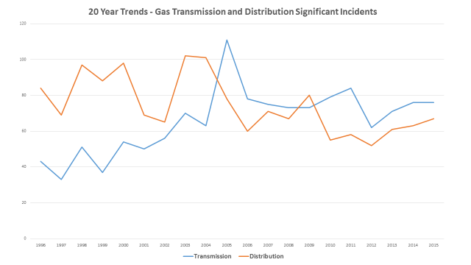

Slide 15
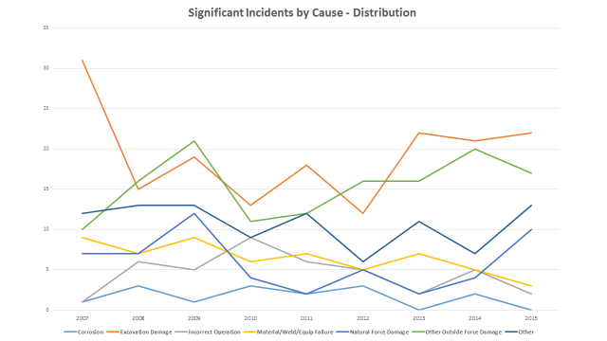

Slide 16
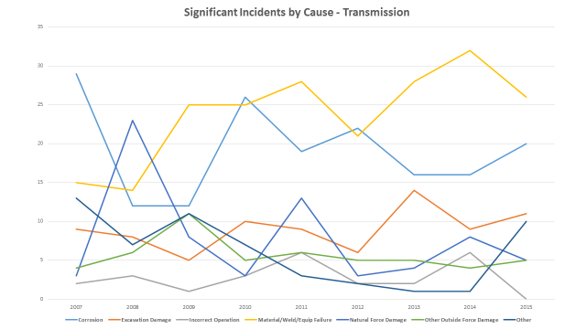

Slide 17
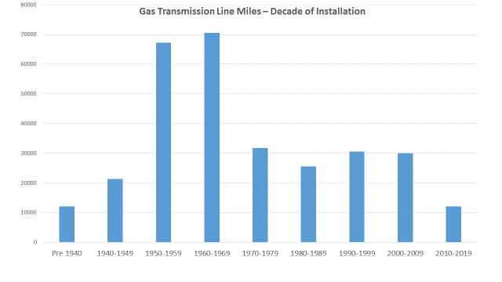

Slide 18
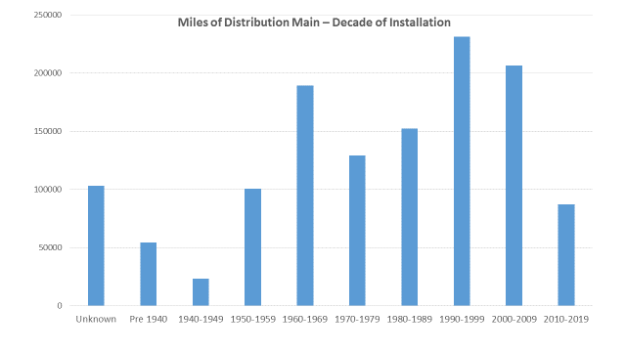

Slide 19
Safety Management Systems (API RP 1173)
Based on approaches from other high hazard industries - nuclear, airline, etc.
“Plan-Do-Check-Act: continuous improvement model
Promotes a “Safety Oriented Culture” – where communication, risk reduction and continuous improvement is part of day to day activities

Slide 20
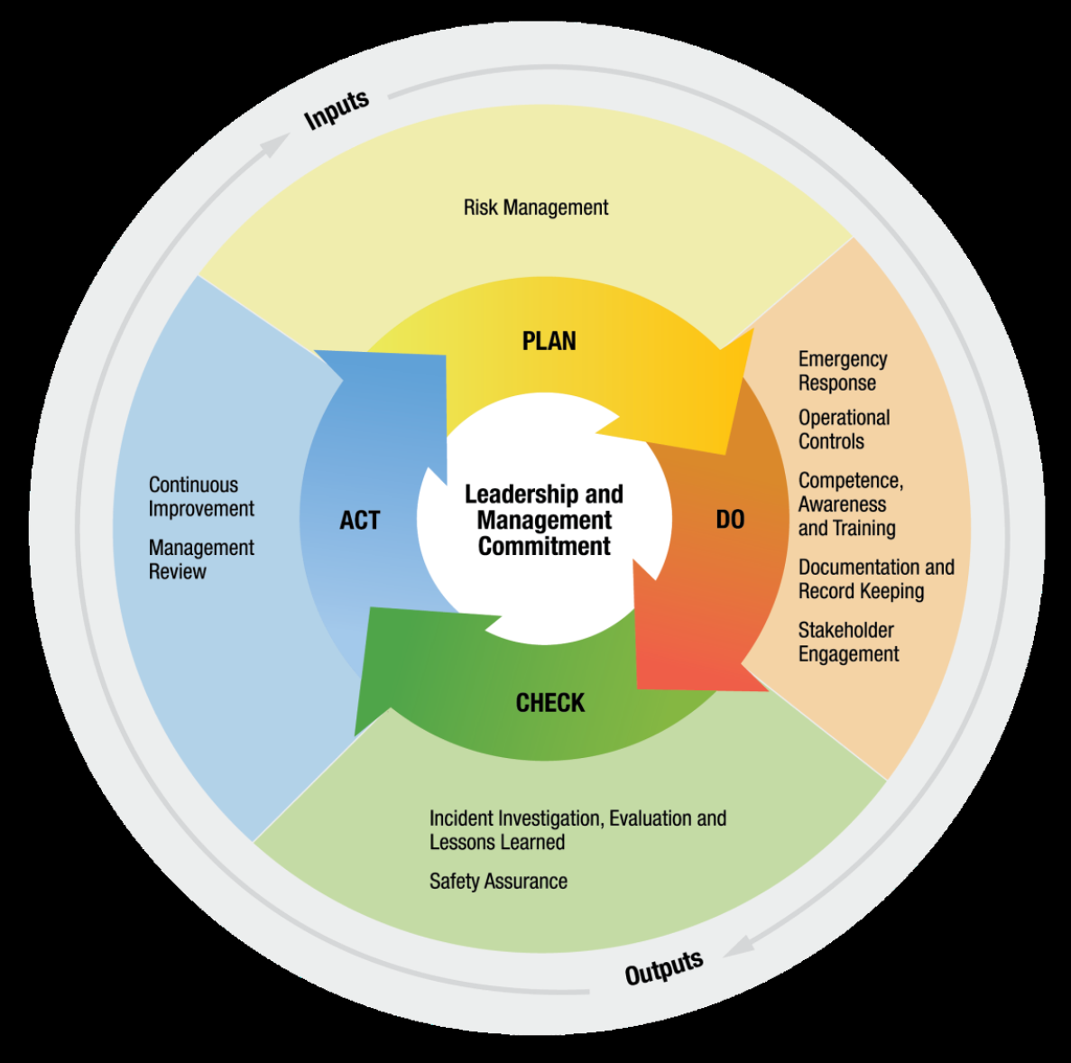

Slide 21
Example
An operator has experienced a number of excavation damages (dig-ins) in the recent past, including one resulting in an Incident.
Checking the data on their PHMSA 7100 report shows a damage per thousand locate ticket rate almost twice the state average.
Need a plan to reduce excavation damage.

Slide 22
Annual Report – Excavation Damages

Slide 23
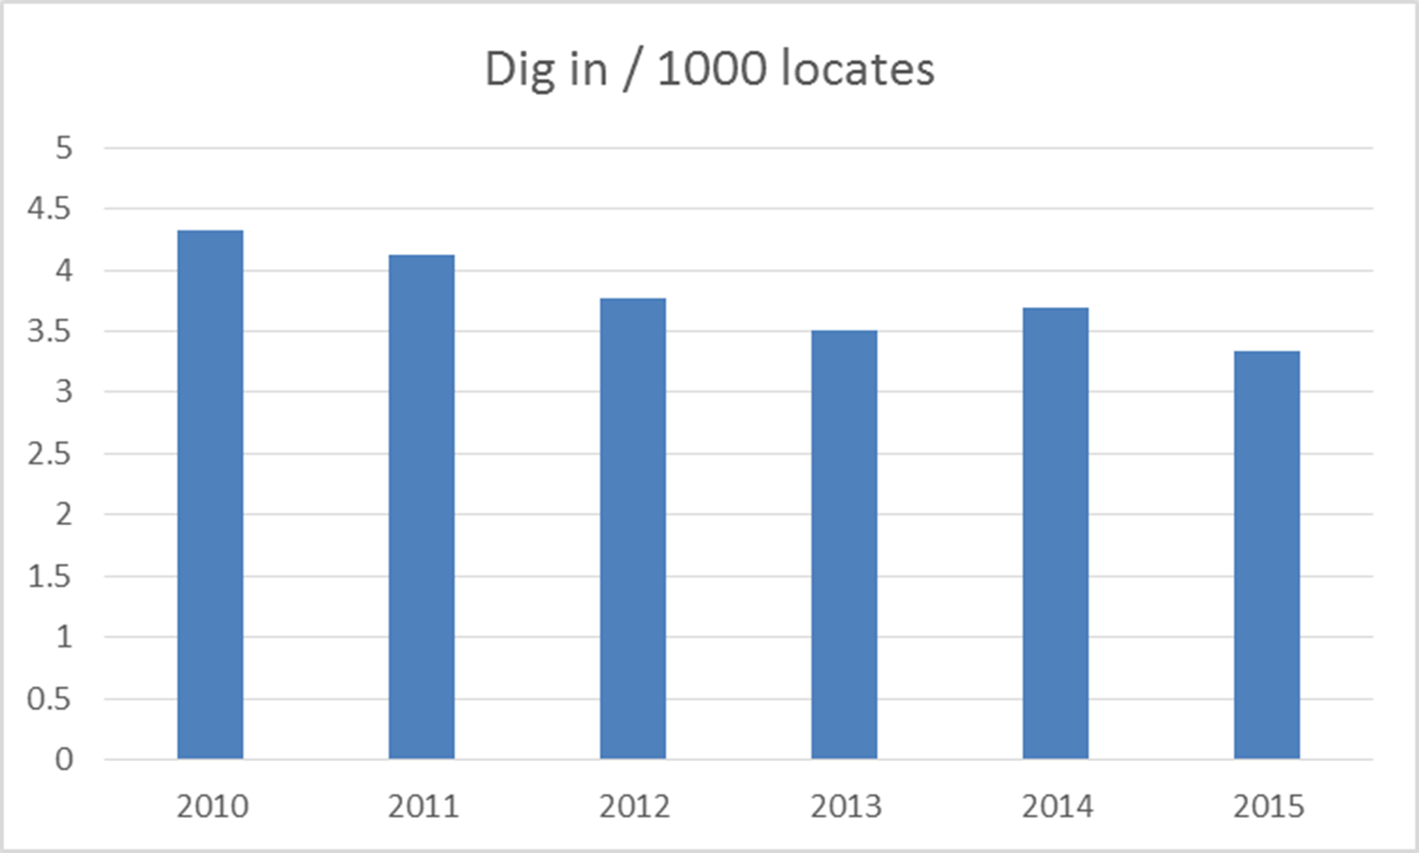

Slide 24
PLAN
Risk Management
  What is the leading cause of dig-ins?
  Review and update locate request procedures
  Establish damage investigation procedures
  Classify damages so the results can tell you something. Example:
    Locating Practices not sufficient. Sub-cause?
      Incorrect facility records / maps
      Facility marking or location not sufficient
      Facility was not located or marked
      Facility could not be found or located

Slide 25
DO
Put the plan into action
Train people on your procedures
“Operational Controls” – check to make sure the procedures are being followed
Investigate failures (damages) for lessons learned
Keep good records so somebody reviewing the records later can understand what happened. Have a quality control process.
“Stakeholder engagement” – Keep everyone (employees, contractors, excavators) involved. Public awareness.

Slide 26
CHECK
Can we use what we learned to get better?
Check to see if your plan is effective (damages per thousand locates)
Review incident investigations and lessons learned. Any patterns?
Ex: for this operator, the most common cause of a dig-in is: Locating practices not sufficient -> Facility marking or location not sufficient
  Further investigation shows the leading cause is that when a locate is done by contractors, no one is informing the excavator when a locate is un-toneable.

Slide 27
ACT
Determine how your plan can be improved, and fix it
Revise your procedures, contracts with third parties, evaluation and oversight, etc. to address the shortcomings identified in the “Check” phase.
For the example: changes to contractor training program, revised contract language, periodic QC inspections of line locate jobs.

Slide 29
What is a “Safety Oriented Culture”?
https://www.youtube.com/watch?v=s0RrhkMk2zY

Slide 30
Questions?
Pete Chace
(614) 644-8983
Peter.chace@puc.state.oh.us

