Slide 1
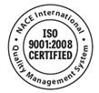
An Update on NACE International’s IMPACT Study
Frank Rampton
Ohio Gas Association Conference
March 17, 2017

Slide 2
NACE International At-A-Glance
155 most specified corrosion standards worldwide 63 technical reports
35,550+ members in
134 countries
419 Corporate Members
2016
1943
218
380
419
825
36,670
47,706
NACE founded by 11 Corrosion Engineers
380 Technical Committees serving every major industry
800+ Training courses held in 2014
50,918+ Active NACE Institute Certification Holders Worldwide

Slide 3
Industry Sectors Serviced by NACE Members Today
Infrastructure
Utilities
Transportation
Production & Manufacturing
Government
Notes:
These industry sectors comprise the majority of the NACE membership.

Slide 4
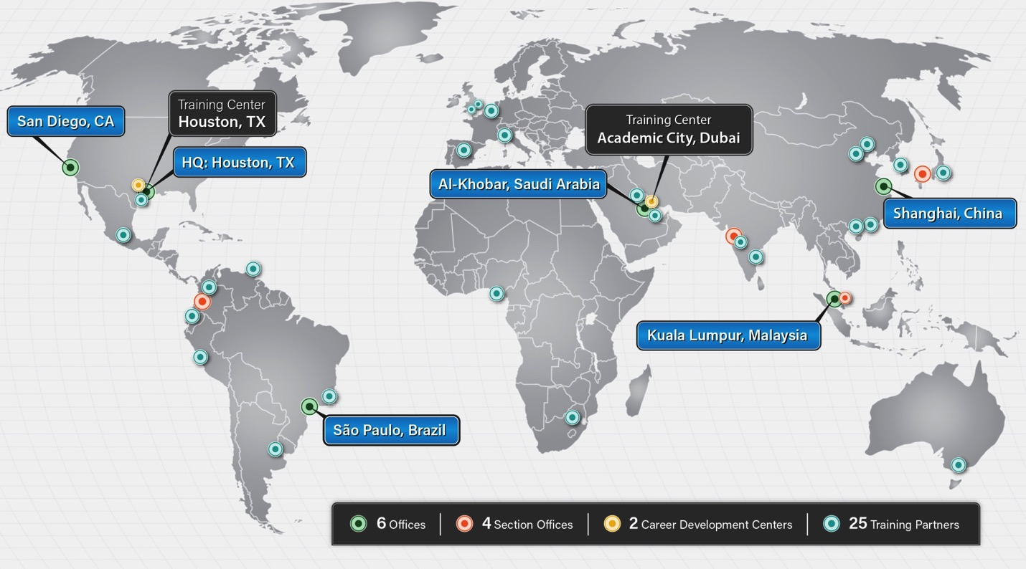
Serving Members Worldwide

Slide 5
Membership
Launched Volunteer Manager
An online system for NACE members to find and volunteer to serve. www.volunteer.nace.org
Implemented a member online Forum
Designed to connect NACE members around the world
Held the inaugural Leadership Development Program.
Established the Corrosion Technology Application Award
Approved a new Section Policy
Assures transparency
Creates new models for members to gather under the NACE banner
Opens opportunities for more members to volunteer

Slide 6
NACE’s Corrosion Industry Support
15 industry events and conferences annually
Including CORROSION, the largest event in the world dedicated to the corrosion industry
30 corrosion courses and training programs
26 NACE Institute certification programs specified worldwide
220 standards and technical committee reports
289 Certified Instructors Worldwide

Slide 7
NACE and its Affiliated Organizations Provide
Forums for Technology Exchange
Symposia & Seminars
Conferences
Internationally Recognized and Specified Technical Standards
Public Affairs
Government relations
Public awareness
Education & Certification
Periodicals & Books
CORROSION Journal
Materials Performance
CoatingsPro
CorrDefense
400 books on corrosion
Local Sections and Leadership Opportunities
Scholarships and Awards

Slide 8
NACE Courses
CIP (Coating Inspector Program) Level 1
CP (Cathodic Protection) 1 Tester
Shipboard Corrosion Assessment Training (S-CAT)
CIP Level 2
CP 2 Technician
Basic Corrosion
CIP Peer Review
CP 2 Maritime
Designing for Corrosion Control
CP 3 Technologist
Internal Corrosion - Basic
CP 4 Specialist
Internal Corrosion - Advanced
For the full schedule go to: http://www.nace.org/Education

Slide 9
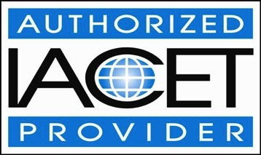
NACE Institute Certifications
NACE is accredited by the International Association of Continuing Education and Training
Certifications are typically awarded through an application process following successful completion of:
required courses and corresponding exams
specified education level
specified work experience
First Certification for CP was awarded in 1971
First Certification for CIP was in awarded in 1982
Certifications must be renewed every three years to remain active
Most Certification classes include OQ tasks relevant to course
Certifications tracked through ISNetworld

Slide 10
Sampling of NACE Institute Certifications
General Corrosion Program
Specialty Program
Corrosion Technician
Corrosion Technologist
Senior Corrosion Technologist
O-CAT Technician
Corrosion Specialist
Chemical Treatment Specialist
Protective Coating Specialist
Cathodic Protection Specialist
Internal Corrosion Specialist
Materials Selection/Design Specialist
General Coatings Program
Protective Coating Technician
Protective Coating Specialist
S-CAT Technician

Slide 11
NACE Institute
Significant investment in our certification program
Launched Computer based testing for Refinery, CIP and CP exams
Rewrite and upgrade to exams
Improved reliability and legal defensibility
Greater student convenience
Launched NIICAP
IMPACT Study.
The Study’s results are meaningful, insightful, and most importantly, being used to have a direct impact on corrosion management practices, globally.

Slide 12
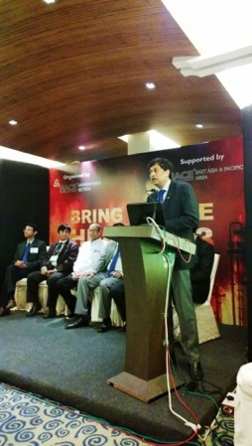
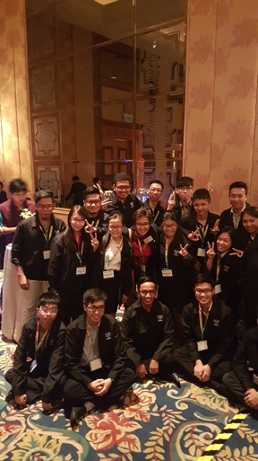
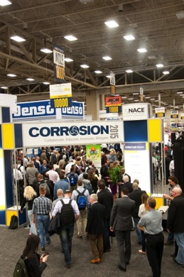
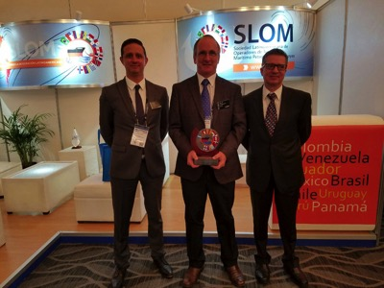
NACE International Events
CORROSION 2017 in New Orleans
Area Conferences
Bring on the Heat Seminars
MR0175/ISO15156 Seminar
Concrete Service Life Extension Conference
Top of the Line Corrosion Conference
Pipeline Integrity Management Seminar
Corrosion Technology Week
CORCON
and more
Notes:
NACE connects corrosion professionals worldwide through conferences and expositions featuring speakers covering the most important topics of the moment.

Slide 13
Publications & Technical Activities
Published more than 30 new and revised standards and reports
Translated 4 more standards into Spanish
Nine technical committee reports
Seven of these being new reports, and two revisions.
Redesigned the CORROSION Journal website.
Published 11 new NACE Press titles
Including diversifying in to the nuclear and wastewater industries.
Some of these books are also available as E-books.
Increased investment in the Maritime industry
Including hiring a Chief Maritime Executive
New Technical Exchange Group in Mining

Slide 14
NACE is Globally Recognized for…
Delivering corrosion solutions, technical exchange, expertise and education
Establishing accredited corrosion control standards
Advancing careers through
Workforce development and certification
Leaderships skills development
Business networking
Increasing policymakers’ attention to corrosion
Building a valued student population – future corrosion subject matter experts

Slide 15
IMPACT Study
“International Measures of Prevention, Application, and Economics of Corrosion Technologies”

Slide 16
Agenda
Background of IMPACT study
Key findings
Keeping the study “evergreen”
What’s next

Slide 17
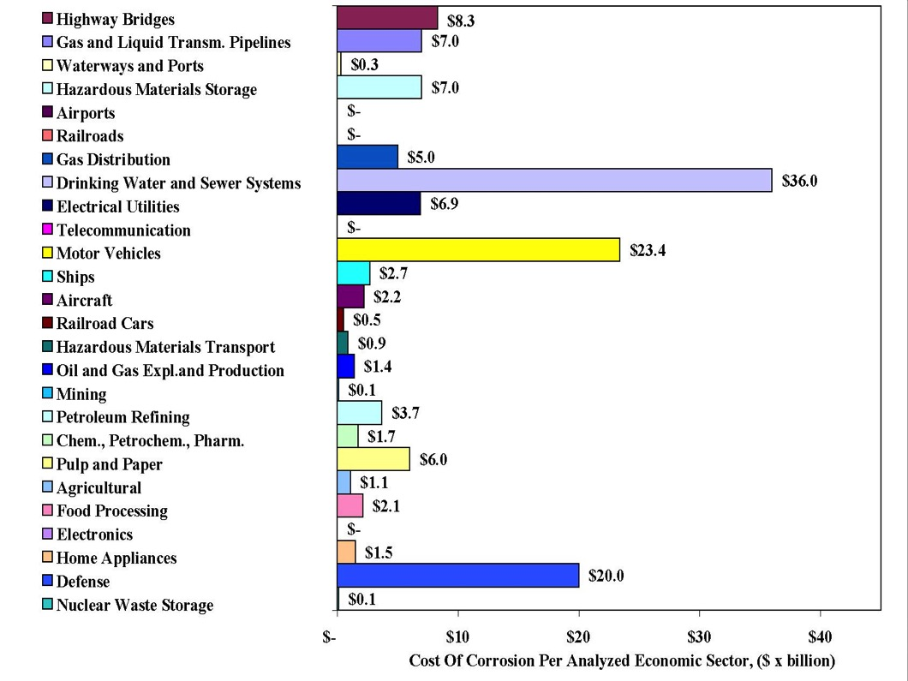
2002 study results-FHWA
Notes:
Updates the global cost of corrosion
Assesses corrosion management practices across various industries and geographies
Provides a template for corrosion management in the form of a corrosion management system framework and guidelines
Provides financial tools that can be used for calculating life-cycle costs and return on investment

Slide 18
IMPACT Study Launched October 2014
The study features in-depth research and resources in these areas:
Updates the global cost of corrosion
Assesses corrosion management practices
Template for corrosion management
Financial tools
Benchmarking
Notes:
Updates the global cost of corrosion
Assesses corrosion management practices across various industries and geographies
Provides a template for corrosion management in the form of a corrosion management system framework and guidelines
Provides financial tools that can be used for calculating life-cycle costs and return on investment

Slide 19
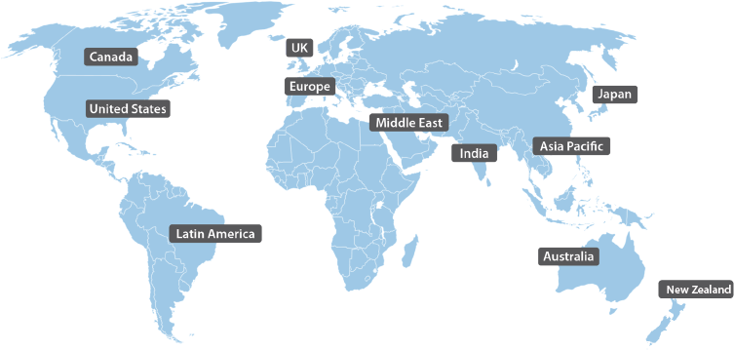
Global Scope

Slide 20
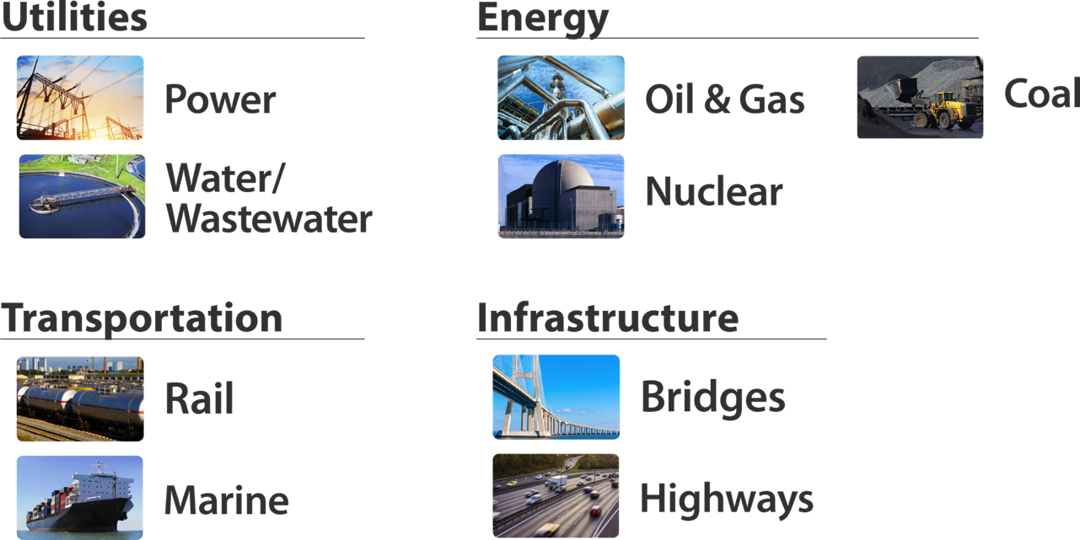
Industry Sectors

Slide 21
Who conducted the study on behalf of NACE International?
DNV, GL
Dublin, Ohio
APQC
Houston, Texas
Elaine Bowman
Project Manager
Technical Advisory
Panel - SMEs

Slide 22
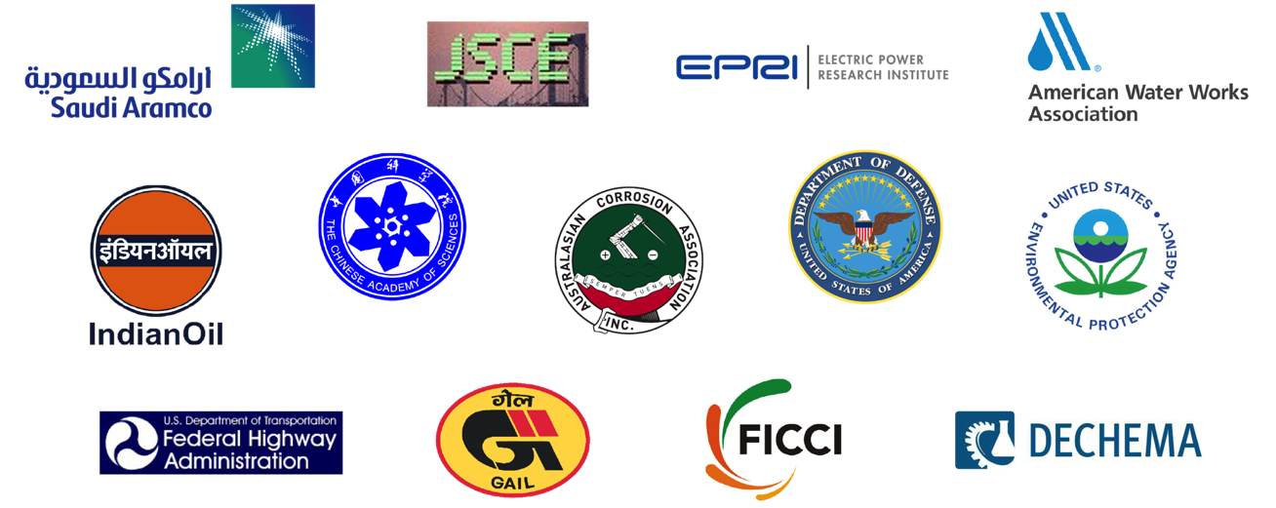
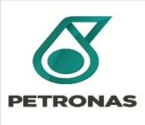
Industry Advocates and Technology Contributors

Slide 23
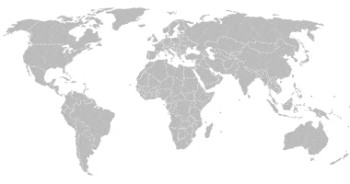
Current Global Cost of Corrosion
US $2.5 trillion, equating to 3.4% of a country’s GDP
Notes:
The cost is estimated to be US $2.5 trillion, which is equivalent to 3.4% of the global Gross Domestic Product (GDP). The IMPACT study estimate was established utilizing publically available studies from around the world.
Considering the world population is 7.3 billion, that means $342 is spent every year for every man woman and child in the whole world for cost of corrosion. These costs do not consider the safety or environmental impacts of corrosion, which
cause high financial, regulatory and legal consequences to an organization.
Just consider one instance that is currently in our news – the water issues in Flint, Michigan. Congressman Dan Kildee who represents which area of Michigan stated that the direct and indirect costs of this one incident caused by corrosion will
Reach $1.5 billion. The total cost for just pipe replacement is estimated to be $55 million.

Slide 24
How much of this cost could be saved using currently available corrosion control practices?
The study determined that savings of between 15 and 35% of the cost of corrosion could be realized, equating to US$375 to $875 billion annually on a global basis.
Notes:
Again, looking at the Flint incident, the cost was $140/day to eliminate the corrosion issue.

Slide 25
Most Critical Finding of IMPACT Study
A change in how decisions are made is required
Continue investment in technology for corrosion control
Justify corrosion control actions by business impact
Corrosion Management System Framework
Notes:
The most critical finding of the IMPACT study is that while it is important to continue
investment in technology and systems for corrosion control, putting this technology into
an organizational management system context and justifying
corrosion control actions by business impact is essential. This can be accomplished by
employing a corrosion management system that is understood and supported in every
level of an organization involved in protecting assets. The Corrosion
Management System Framework is the core deliverable of IMPACT.

Slide 26
Corrosion Management System Framework
A set of policies, processes, and procedures for planning, executing, and continually improving the ability of an organization to manage the threat of corrosion for existing and future assets.
Notes:
Central to the findings and recommendations of the IMPACT study was the development
of the Corrosion Management System Framework. The CMS is an organizational
structure that enables effective corrosion mitigation while providing a
positive ROI. A CMS is a documented set of processes and procedures required for
planning, executing and continually improving the ability of a company to manage the
threat of corrosion for existing and future assets and asset systems.

Slide 27
Interrelation of an Organization Management System
Notes:
This diagram shows the interrelation of a pipeline operator’s organization management system.

Slide 28
Corrosion Management Strategy Pyramid
Notes:
This diagram is the CMS Pyramid, which is central to the findings and recommendations of the IMPACT study.

Slide 29
First Things First
Corrosion Management Practice Model developed
Repeatable framework for assessing structure, approach and features comprising a corrosion management system
70-question self-assessment survey encompassing 9 management system domains
Notes:
When the IMPACT study was launched, a critical component of the research was to
collect data on how organizations in various industries and countries conduct their
corrosion control activities, with emphasis on corrosion management
practices and how they fall within an overall organization’s management system.
First, a Corrosion Management Practice Model (CMPM) was developed to provide a
repeatable framework for assessing the structure, approach, and features that comprise
a corrosion management system within an organization. From there, a
comprehensive 70-question self-assessment survey was developed that encompassed
nine management system domains.

Slide 30
9 Management System Domains
Policy, including strategy and objectives
Stakeholder integration
Organization
Accountability
Resources
Communication
Corrosion management practice integration
Continuous improvement
Performance measures
Notes:
These nine management systems are shown here. Scores for each of these practices
ranged from 0 – 1, with 0 reflecting no capability and 1 reflecting the highest level of
capability based upon the provided answer options.

Slide 31
Example Survey Questions and Answer Set
*Weighting of intermediate answers can vary depending on the question and options.
Notes:
This is an example of a survey question and answer set.

Slide 32
How IMPACT Study was Developed, Conducted and Analyzed
Notes:
The survey was subsequently conducted in a broad spectrum of industries worldwide
that ranged from aerospace and aviation to chemical, petrochemical, oil and gas, and
water and waste water. In addition, focus groups of personnel from
various management and technical levels were organized in several industries and
countries to obtain further insight into their corrosion management philosophies and
practices.
Following data collection, the study team performed a series of analyses.
This flow chart illustrates how the survey was developed, conducted and analyzed.

Slide 33
IMPACT Study Finding
Corrosion management practices vary significantly based on the
type of industry, geography, and organizational culture.
Notes:
The results of the survey and the focus group discussions with industry subject matter
experts demonstrated that corrosion management practices vary significantly based on
the type of industry, geography, and organizational culture.
These practices range from the absence of corrosion management to full incorporation
of a CMS into an organization’s management system. Even within the same organization,
significant differences can exist, depending on local culture and practices.
Following a thorough analysis of the survey results, the researchers identified standard
and best practices and gaps in corrosion management practices, and provided
recommendations of mitigation measures for improvement.

Slide 34
Oil and Gas Industry Benchmarking of IOCs and NOCs
Notes:
This diagram reveals similar trends among the IOCs and NOCs, with continuous improvement and communications having the most variation.
Explain that the scores in general are low across all domains, which means that both IOCs and NOCs have room for improvement
Why is there a difference in communication?
Why is there a difference in organization?
There are some explanations in the IMPACT study

Slide 35
Pipeline Industry
Notes:
Within the pipeline industry, it is well known that corrosion is a major contributing factor to pipeline failures because of the corrosive nature of their contents, which include dry gas, wet gas, crude oil with entrained/emulsified water, and processed liquids.
Appropriate corrosion control technologies and strict monitoring are required to protect these assets, which should be incorporated into a CMS. One benchmarking effort focused on selected onshore pipeline operators in the United States, Canada, and India to observe differences in corrosion management for companies that operate under different regulatory environments.
While the U.S. and Canadian pipeline companies operate under strict national regulations set by the Pipeline and Hazardous Materials Safety Administration (PHMSA) and National Energy Board (NEB), respectively, the Indian companies follow
company standards and regulations that are largely based on internal/local standards and recommended practices. In spite of these differences, all three groups show similar scores for the elements of performance measures, CMP integration,
and accountability, and show a low score for policy and performance measures.
The study concludes that the low scores might indicate an opportunity for improvement by better engaging senior management. The relatively low score for
performance measures indicates that there is an inadequate feedback system or related key performance indicators that measure the status and quality of corrosion management.

Slide 36
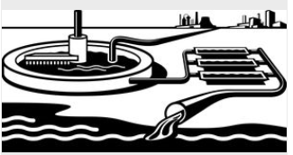
Drinking and Waste Water Industry
Much of the world’s drinking water
infrastructure, with millions of miles of pipe, is nearing the end of its useful life. Nearly 170,000 public drinking water systems are located across the U.S. and there are estimated 240,000 water main breaks per year, most of which are caused by corrosion.
One finding of the study comparing Australian and U.S. potable water systems suggests that on average, this industry has limited corrosion management policies, with the U.S. having better policies in place but needs implementation improvement.
Notes:
Give example of focus groups in L.A.

Slide 37
U.S. Department of Defense
2002 DoD estimated cost of corrosion US $20 billion
Corrosion Policy and Oversight Office
ROI results of 16:1
Notes:
Following the 2002 FHWA cost of corrosion study, the DoD has been in the process of developing and implementing a comprehensive corrosion management program. The 2002 study estimated the cost of corrosion to DoD at approximately US$20 billion, which has been validated through DoD’s cost of corrosion analyses.
One IMPACT study conclusion is the importance of having top-down support for a CMS, which is epitomized by the DoD’s program. The Under Secretary of Defense for Acquisition, Technology and Logistics has been a supporter from the start. The program, which ranges from setting policy to calculating the cost of corrosion of projects, assets, and components, is run by the Corrosion Policy and Oversight (CPO) Office and includes all critical components of a CMS.
The IMPACT report thoroughly covers the strategic plan and organizational structure of the DoD CPO Office and how it is successfully managing corrosion control activities across all of the services. The DoD estimates its composite ROI for protecting assets ranging from vehicles, aircraft, base facilities, and weaponry to be 16:1

Slide 38
Corrosion Management Financial Tools
Cost-adding methodology
Developed by U. S. Department of Defense
Life-cycle costing
Widely used with several methods discussed including Bayesian Network approach
Return on investment
Primarily a performance measure
Constraint and maintenance optimization
Case studies demonstrating this tool
Notes:
Corrosion management includes all activities that are performed through the lifetime of a structure to prevent corrosion, repair its damage, and replace the asset, such as maintenance, inspection, repair, and removal. These activities are performed at different times during the lifetime of the structure.
Some maintenance is a regular activity, characterized by annual cost. Inspections are scheduled as periodic activities, and repair is done as warranted. Rehabilitation may be done once or twice during the lifetime, and the cost is usually high. Applying different corrosion management methods may positively affect the lifetime of a structure of a particular design without increasing the cost.
To meet the corrosion management objectives, tools or methodologies are available to calculate the cost of corrosion over part of an equipment’s or asset’s lifetime or over the entire life cycle. These methods range from cost-adding to life-cycle costing and constraint optimization.

Slide 39
Education and Training
Education and training courses are heavily focused on procedures and
working practices with essentially no content geared for the upper levels
of policy, strategy and objectives. Education and training will play an
important role in the integration of corrosion management into an
organization’s management system.
Notes:
In the next decade a significant transition and turnover in knowledge will occur in the
corrosion community. IMPACT cites workforce studies estimating that approximately
25% of the total workforce in the United States is over 50 years old, and the median age
of NACE International members is 47. In addition to taking advantage of formal internal
and external education and training programs, corrosion management systems must
have a way to effectively transfer institutional knowledge. Specific on-the-job training
and mentoring programs are being used to transfer SME knowledge.

Slide 40
Corrosion Management Strategy Pyramid
Notes:
From the report it is apparent that the education and training course content is heavily focused on the lower levels of the CMS Pyramid; i.e., Procedures and Working Practices shown here, and there is essentially no content geared for the upper levels of Policy, Strategy, and Objectives.
Education and training will play an important role in the integration of corrosion management into an organization’s management system. In addition, these programs must prepare corrosion professionals to better communicate to those outside of the profession.
Corrosion professionals should not expect outsiders to learn their technical language. In addition, corrosion professional societies must emphasize business strategy and/or public policy when advocating positions to those outside of the corrosion profession.
The study states that using the principles of a CMS will make these arguments more persuasive.

Slide 41
Strategies for Successful Corrosion Management
Requires more than technology
Integration of corrosion decisions and practices
within an organizational management system
Corrosion practices need to be translated into the
language of the broader organization
Notes:
Realizing the maximum benefit in reducing corrosion costs (both direct and consequential) requires more than technology; it requires integrating corrosion decisions and practices within an organizational management system. This is enabled by integrating a CMS within system elements that range from corrosion-specific procedures and practices up through organizational policy and strategy; i.e., all levels of the CMS Pyramid. This figure is central to the IMPACT study goal and is shown throughout the IMPACT report.
It is essential that traditional corrosion management procedures and practices (lower levels of the pyramid) be expressed to policy setters and decision makers (higher levels of the pyramid) in the form and terminologies of organizational policies.
Simply, corrosion practices need to be translated into the language of the broader organization. The organization as a whole must commit to ownership of the CMS activities and processes. This means buy-in at all levels.

Slide 42
Buy-in of a Corrosion Management System
Notes:
Purposes given for buy-in of a CMS at different levels in an organization are shown on this chart. Without buy-in from the top, initiatives have little chance of getting off the ground. To ensure the message is effective, organizations require a business case that includes a clear statement of the problem, outlines its impact on the organization, lists the required resources, and includes the outcome in terms of cost reductions, increased productivity, improved quality, and/or decrease in risk (environmental, safety,
business interruption, public relations, etc.).
IMPACT provides tools and examples to help facilitate business communications between corrosion professionals and senior management, leading to integration of a CMS throughout an organization’s management system.
The U.S. DoD is an excellent example of an organization that affected a cultural change and a commitment to innovation that permitted corrosion management practices to be institutionalized into an entity of its size and diversity. Industries and governments
worldwide will benefit by studying and implementing this model of success.

Slide 43
What’s New, What’s Next
What’s New:
Continuous new information being gathered utilizing the original survey format
Webinars
Video
Door Opener
Notes:
What’s New
Continuous new information being gathered utilizing the original survey format:
India-focused impact study will add at least 150 new survey responses. Many of these responses will be in industries not covered in the original study such as agriculture and fertilizer industry. This study will also include Focus Group sessions (6 planned) during CorCon.
October 2016 Focused Groups planned for Mexico City to gather survey data for Latin America.
Marine-specific survey planned for late 2016 which will deliver survey content in an industrial sector not previously covered
Webinars:
Webinar to train section, area leaders to present the IMPACT study results
Webinar Q&A presented by IMPACT study Advisory Panel members, Project Manager and NACE Executive Leadership
Potential webinars focused on specific economic tools described in the study
Video:
Just completed video for use by sections, areas and other groups as introduction to the study
Door Opener:
The study has increased our ability to gain access with higher level management in a way NACE has never been able to do before. Examples: National Energy Board; Alberta Energy Regulators; Minister of Transportation (Canada); BP C-suite; Saudi Aramco C-suite; PEMEX C-suite; Enbridge C-suite. Development underway to parlay this new C-suite accessibility into a strategic approach for ensuring maximum benefit from this new visibility.

Slide 44
Since IMPACT Launch March 2016
Magazine articles, webinars, university presentations
Over 50 presentations have been made around the world sharing study results
Presentations to other technical societies, governments and asset owner companies in more than 12 countries
Specific IMPACT study launched for India
Notes:
In less than a year since the launching of this benchmark study for our corrosion industry, we have been extremely busy communicating the study findings.
It is estimated that 15 – 20,000 people have personally heard presentations of the findings. This number does not count those who participated in webinars or read about the study in publications. Think about the changes this type of communication effort could bring to our corrosion community - #1 change is the clear understanding that better corrosion management throughout the life-cycle of an asset will mean improved ROI, longer asset life, fewer safety and environmental incidences.
One interesting example of the interest generated by the IMPACT study was the implementation of a country specific study for India.

Slide 45
India Specific IMPACT Study
Supported by the Indian government with multi-industry support
Goal is to have over 3000 survey participants
Study partners: FICCI, PaintIndia; Minister of Agriculture; Fertilizer Association of India
Notes:
This country specific study is being sponsored by the government of India and coordinated by NACE members along with industry and association partners. The goal is to have over 3000 survey participants with participation from a broad-base of industries: oil and gas; fertilizer, petrochemicals; power; infrastructure; marine and railways.
Major study partners include The Federation of Indian Chambers of Commerce and Industry (FICCI); PaintIndia which is a major association with members from the oil and gas, power, infrastructure, marine and railways industries; Fertilizer Association. In addition to these technical and trade associations, the Minister of Agriculture is also a major partner for the study.
How does a study like this happen? Driven by committed NACE members, first of all. This group of members secured sponsorship money from partner organizations as well as industry companies.

Slide 46
IMPACT Study Opportunities
Canada: Presentations with NEB and CEPA as well as major asset owners
Mexico: Major energy industry companies to participate in focus group sessions for benchmarking internal corrosion management programs
German university students participated in webinar
Notes:
We met with both the Canadian regulator for federal pipelines, NEB and CEPA which represents the Canadian Energy Producers.
During our LatinCorr event, we met with four major pipeline organizations in Mexico, who now plan to follow up with a national study.
The German student session was a result of Thomas Ladwein setting up the opportunity for over 40 engineering students who were engaged in conducting their own corrosion management study with municipal water groups in Germany. We encouraged the students to share their findings so the information could be incorporated into IMPACT study updates.

Slide 47
What’s New, What’s Next
What’s Next:
If you had a tool that would allow you to:
Measure where you currently are with your corrosion management system (CMS)
Apply a maturity model that would rank your CMS against your industry peers
Utilize a knowledge base of information to help you advance the maturity of your CMS
Would this be a useful tool?
Notes:
Explain what is next by posing a question.
If you had a tool that would allow you to:
Measure where you currently are with your corrosion management system (CMS);
Apply a maturity model that would rank where your CMS is with respect to your industry peers or the entire corrosion industry;
Utilize a knowledge base of information to help you advance the maturity of your CMS
Would this be a useful tool?
This is precisely the type of tool NACE is investigating as the next step towards helping the corrosion industry achieve a comprehensive CMS tool.

Slide 48
IMPACT Portal
The IMPACT Portal is a set of online asset management tools designed to reduce and mitigate the effects of corrosion to improve asset safety, integrity, lifespan and ROI. It is based on 3 key elements:
Corrosion Framework
Industry framework specific to corrosion
Corrosion Management Maturity Model – CM³
Standardized model by which companies can gauge their level of corrosion asset management
Consists of 5 levels and spans 10 domains
IMPACT Portal
Online tool that combines all IMPACT portal resources for ease of use
Notes:
Both the Corrosion Framework and Corrosion Management Maturity Model were developed by corrosion subject matter experts as part of a Technical Advisory Panel and Technical Review Panel. These groups worked several months as volunteers to ensure the completeness of these two powerful corrosion management assessment tools. There were also pilot tests of the maturity model tool with asset owner companies.

Slide 49
IMPACT Portal Architecture
Resource Library
APQC content
Corrosion Framework
NACE content
Interface
(MosaiQ)
Participant Input
3rd party web site
CM³
3rd party content

Slide 50
Next Steps
Complete pilot assessments of maturity model with asset owners
Complete initial data population of maturity model with asset owners at Corrosion 2017
Corrosion Process Framework to be published by APQC 1st quarter 2017
Complete Impact Portal launch 4th quarter 2017

Slide 51
Keeping the Study Evergreen
impact.nace.org
Notes:
Check this website often for updates to the study starting in April 2016. Updates to include case studies, additional findings, new benchmarks and new tools

