Slide 1
Integrity Management: Assessing & Dealing with Pipeline Road Crossings
2017 OGA Technical Seminar
Brad Leonard

Slide 2
DISCUSSION FORMAT
Types of Pipeline Installations at Crossings
Problems
Current Technologies used for Integrity Assessments
Pros & Cons
Conclusions
Open Discussion

Slide 3
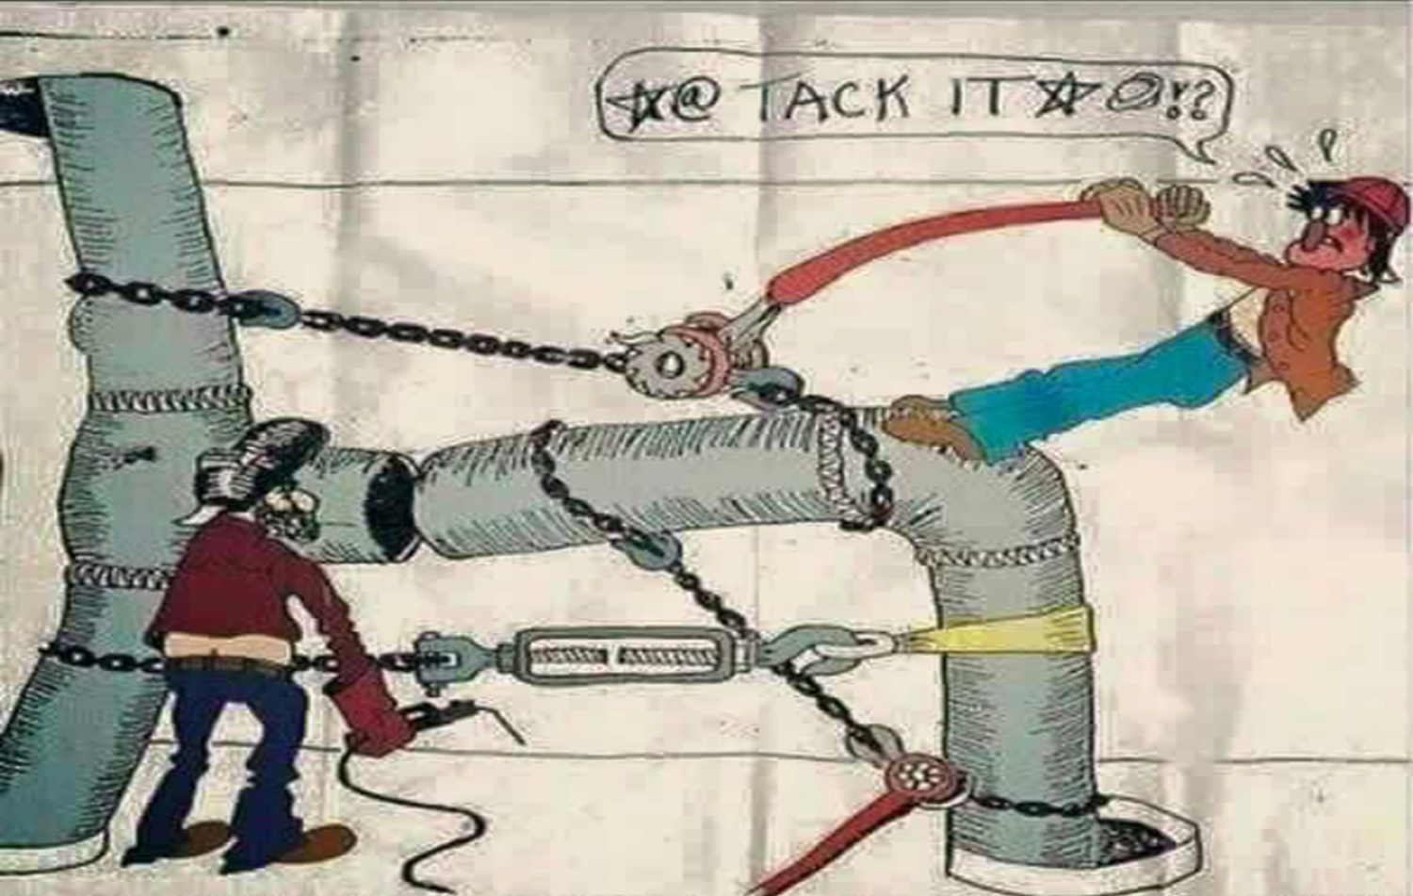

Slide 4
ROAD CROSSING HISTORY
Casing, Heavy Wall Pipe, & Horizontal Directional Drill (HDD) installation began for the following:
Potential for stress damage to the pipeline caused from heavy loads, trains and trucks.
Unstable soils
Corrosion caused by oxygen concentration cells because of road building processes
Access Issues (HDD)
Ease of removal and replacement of pipelines (casings)
Venting of dangerous gasses away from road side (casings)

Slide 5
ISSUES AT CROSSINGS
Traffic, Population Dense Areas
Locating ends of crossings
Other Utilities typically share easements
High Resistant Overburdens
Depth
Permitting (other easements / issues to consider)
Accessibility to piping
More conducive to corrosion due to road salts and other constituents (i.e. herbicides, insecticides etc…)

Slide 6
HISTORIC CASING PRACTICES
Common Practice started w/ RR Crossings
Highway requirements came later
End Seal Types
Concrete or Enamel w/ Rope
Today: Wraps, Shrink Sleeves and Link Seal types
Spacer Types
Metallic
Concrete coated pipe
Wooden
Today: Plastics

Slide 7
CASED CROSSING – MAJORITY OF ROAD CROSSINGS IN HCAs
NACE SP0200-2014 DEFINITIONS
Carrier Pipe: The pipe or piping that is pushed through the casing or sleeve.
Casing: A metallic pipe (normally steel) installed to contain a pipe or piping.
Metallic Short: Direct or indirect metallic contact between two metallic structures.
Electrolytic Contact: Ionic contact between two metallic structures via an electrolyte (water).

Slide 8
NACE SP0200 - 2014
1.1 Steel casings are used to install and maintain pipeline crossings such as those at road and railroad rights of way. This standard details acceptable practices for the design, fabrication, installation, and maintenance of steel-cased pipelines.
1.2 Use of cased crossings should be avoided unless required by load considerations, unstable soil conditions, or when their use is dictated by sound engineering practices.
1.3 This standard does not imply that utilization of casings are mandatory or necessary.

Slide 9
NACE SP0200 - 2014
3.2.3 Uncoated casing pipe is normally used. The use of coated or nonmetallic casing pipe is not recommended, due to potential shielding problems.
3.2.4 Vent pipes should be installed on both ends of a casing.
3.2.5 The casing vent hole should be at least one-half the diameter of the vent pipe (25 mm [1.0 in] minimum). The casing vent pipe should be a minimum of 50 mm (2 in) in diameter.
3.2.6 The casing and carrier pipe shall be properly supported for the entire length of the pipe, especially near the ends, to prevent sagging, metallic contact, and to avoid carrier pipe stress. Refer to Paragraphs 4.3 and 4.4.
3.2.7 Properly designed casing end seals shall be installed to prevent ingress of water and debris.
Of course this rarely happens!

Slide 10
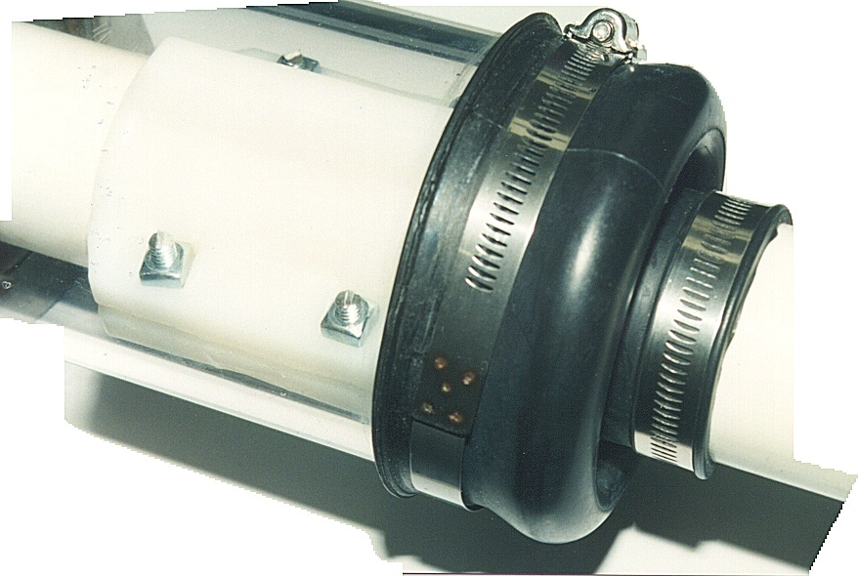
END SEAL – BOOT TYPE
*Note the metal banding

Slide 11
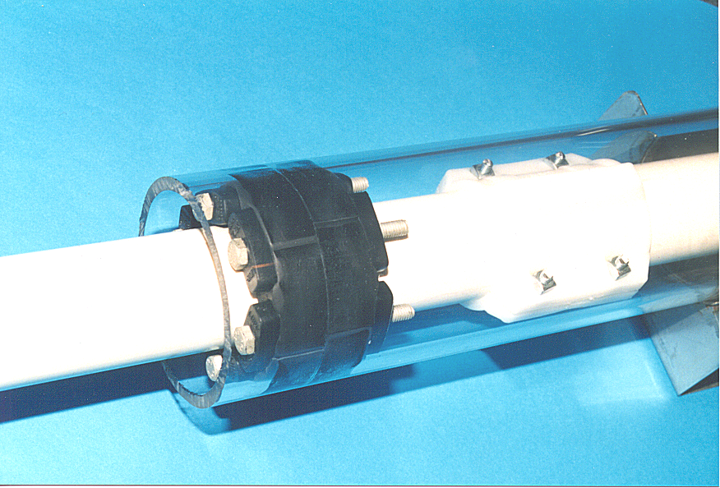
END SEAL – LINK SEAL
*Note the metal bolts

Slide 12
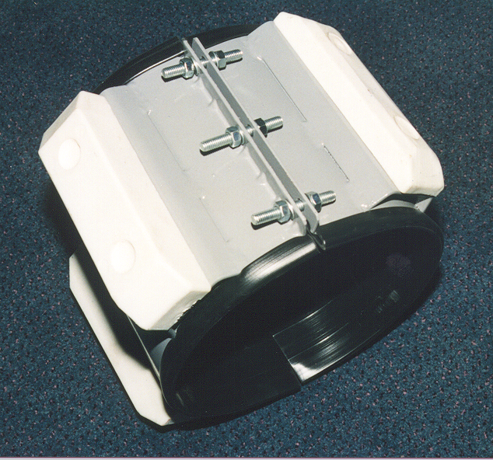
SMALL CASING SPACER
*Note the metal bolts and the black coated metal

Slide 13
LARGE CASING SPACER
*Note the metal

Slide 14
PROBLEMS WITH CASED PIPELINES
Once water enters a casing:
Corrosion can develop
Even if the casing is not electrically shorted, the Cathodic Protection (CP) current may not be enough to adequately protect the pipe.
Any CP current passing through the casing will only provide some protection to that part of the pipe immersed in the water.
No way to properly monitor the CP potentials inside the casing.

Slide 15
PROBLEMS WITH CASED PIPELINES
Corrosion occurs on the external surfaces of pipelines inside casings whether the casing is shorted to the pipe or not!
US Department of Transportation agrees that there are almost as many leaks in un-shorted casings as in shorted casings.

Slide 16
CASING SHORTS TO PIPE - CAUSES
End seals crush or deteriorate allowing water to enter
Pipe spacers crush or wrong type used such as metal or metal components
Test leads make contact in the test station
Vent pipes connected to the pipeline or supported on the pipeline
Other possible problems such as metal tools left inside the pipe.

Slide 17
SHORTED CASING
A high percentage of shorted casings occur at the ends allowing the pipe to contact the casing causing an electrical (metallic) short.
Vent Pipe
Casing
Isolating Spacers

Slide 18
CURRENT INTEGRITY MANAGEMENT ASSESSMENTS
Pressure Testing
Typically conducted as a hydrostatic or nitrogen test on larger segments of piping, not just road crossing
Modifications to piping for testing
Environmental Concerns, permitting
Removal of pressure test constituents
Disposal of constituents
Inline Inspection
Modifications to piping for launching and receiving tools
Direct Assessment
High Resistance Overburdens
Accessibility to Piping
Crossing more than often cased
Other Technologies – dependent on application utilize

Slide 19
DIRECT ASSESSMENT:
The four steps for assessing casings using Direct Assessment
Pre-Assessment, Indirect Inspection, Direct Examination, Post Assessment
Pre-Assessment
Use Historical data to develop a scenario
Coating Type
Quality of Pipe
Water Table
Filled or not
etc…
Feasibility for Indirect Inspection – not always conducive
Region Identification - for casings can be problematic
PHMSA has developed guidelines (exhibit B of Guidelines for Integrity Assessment of Cased Pipe for Gas Transmission Pipeline in HCA’s rev 0, 2010) for assuring that all casings in a single region are sufficiently similar, as specified in NACE SPO0502-2010, while allowing flexibility to allow the grouping of casings into a single region.

Slide 20
DIRECT ASSESSMENT
Indirect Inspection – PHMSA Guidelines for Integrity Assessment of Cased Pipe for Gas Transmission Pipelines in HCA’s rev 0 – March 1, 2010
Methodologies: Exhibit A of Guidelines for guidance on tool selection

Slide 21
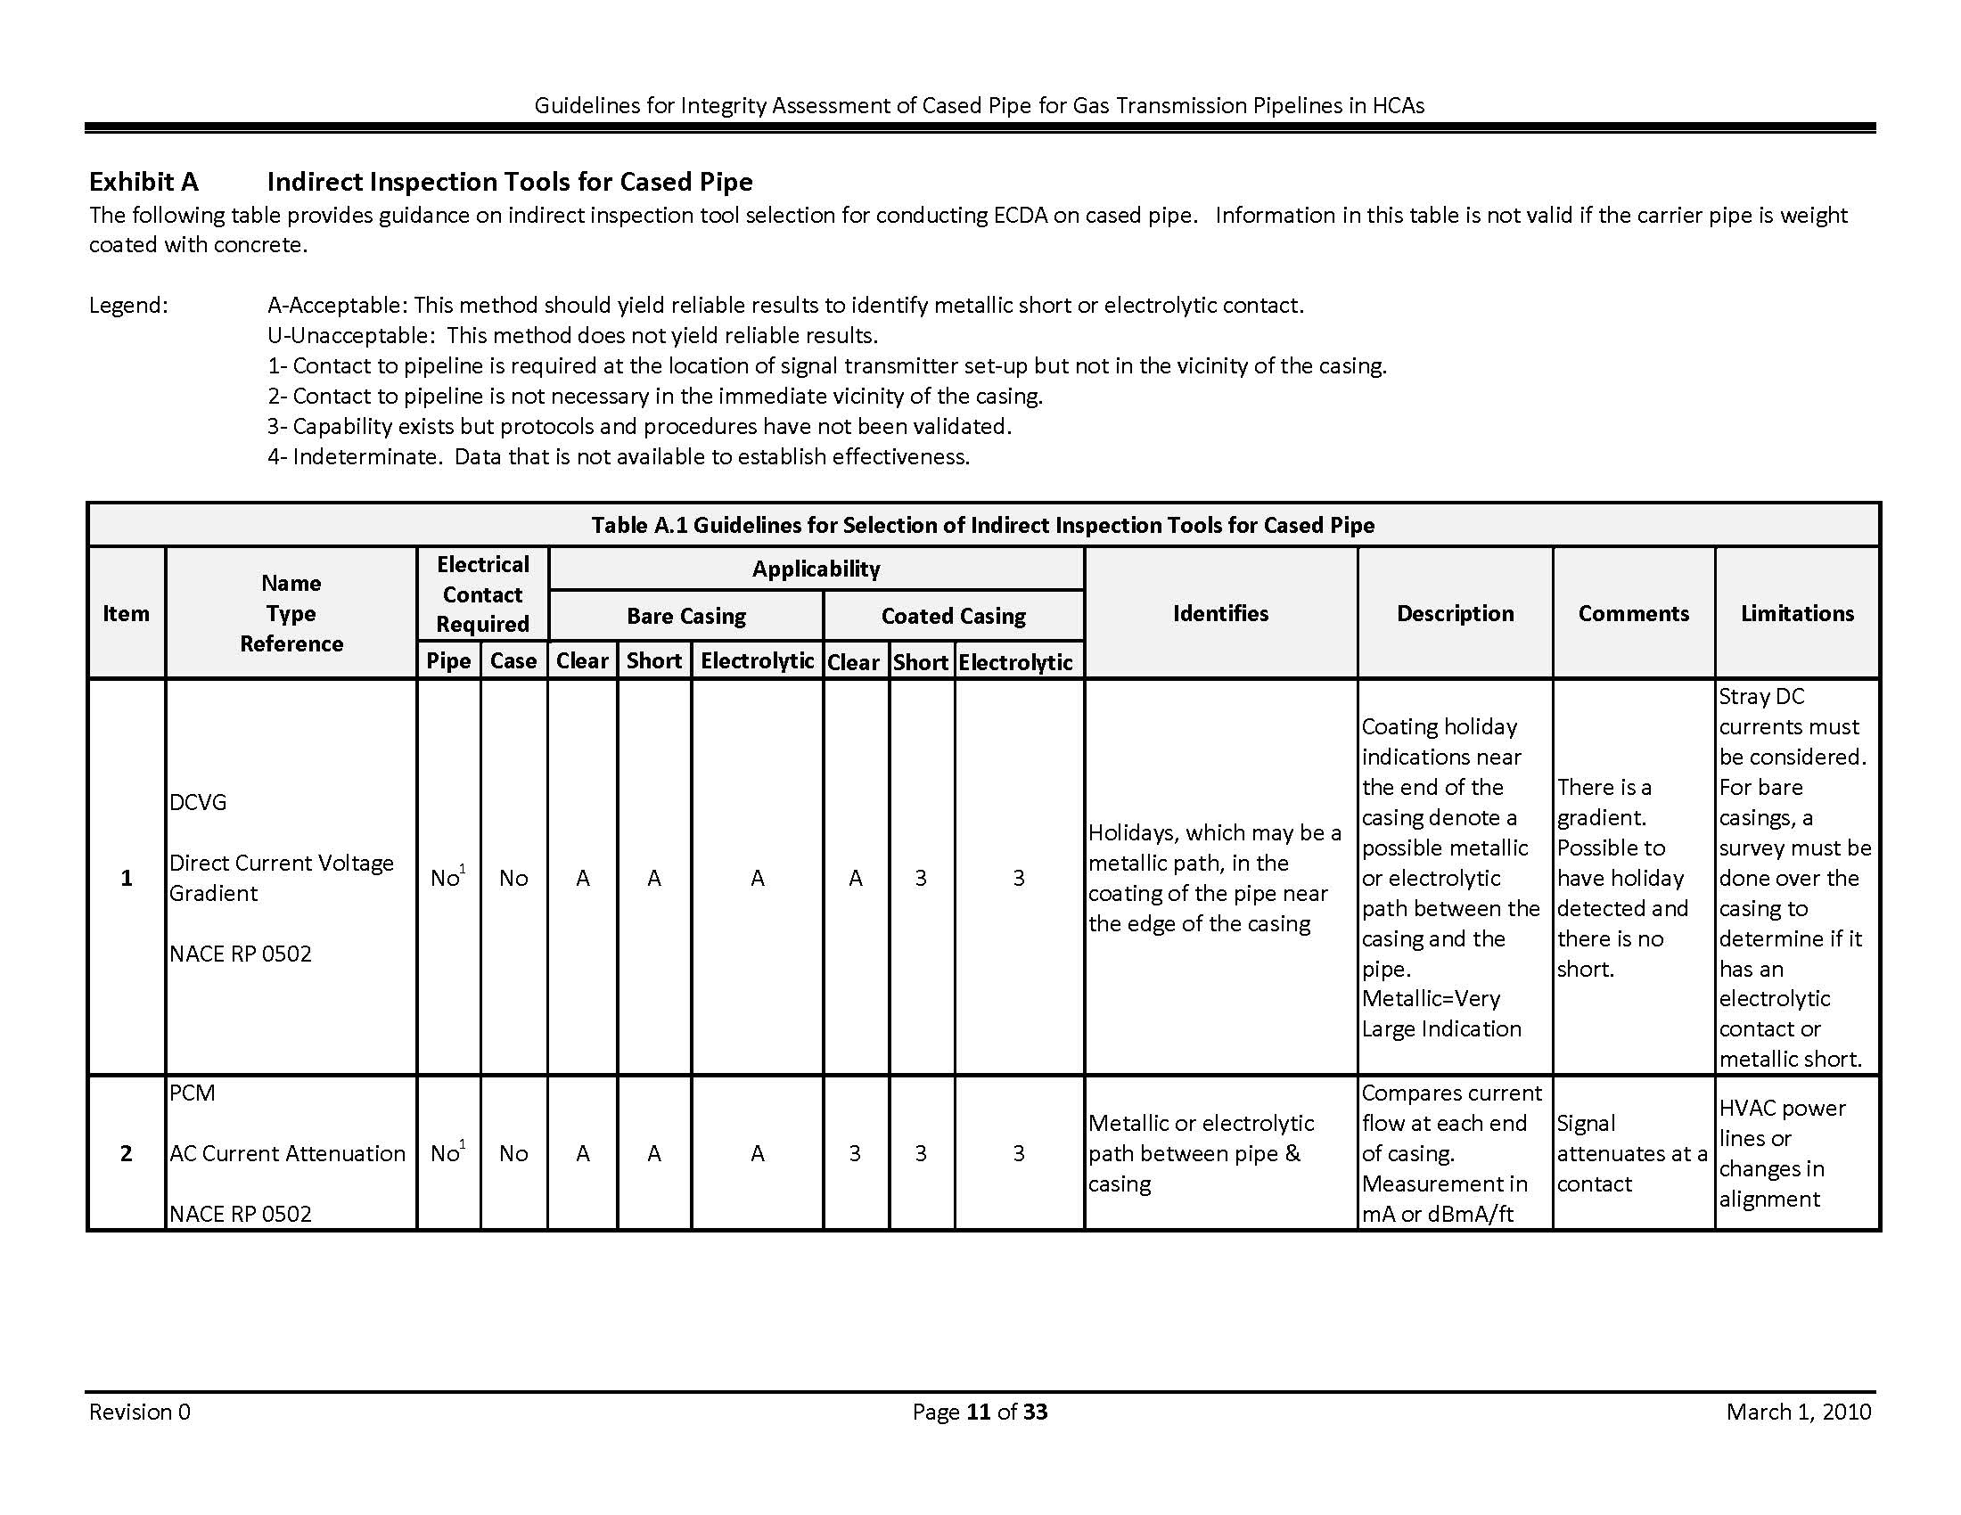

Slide 22
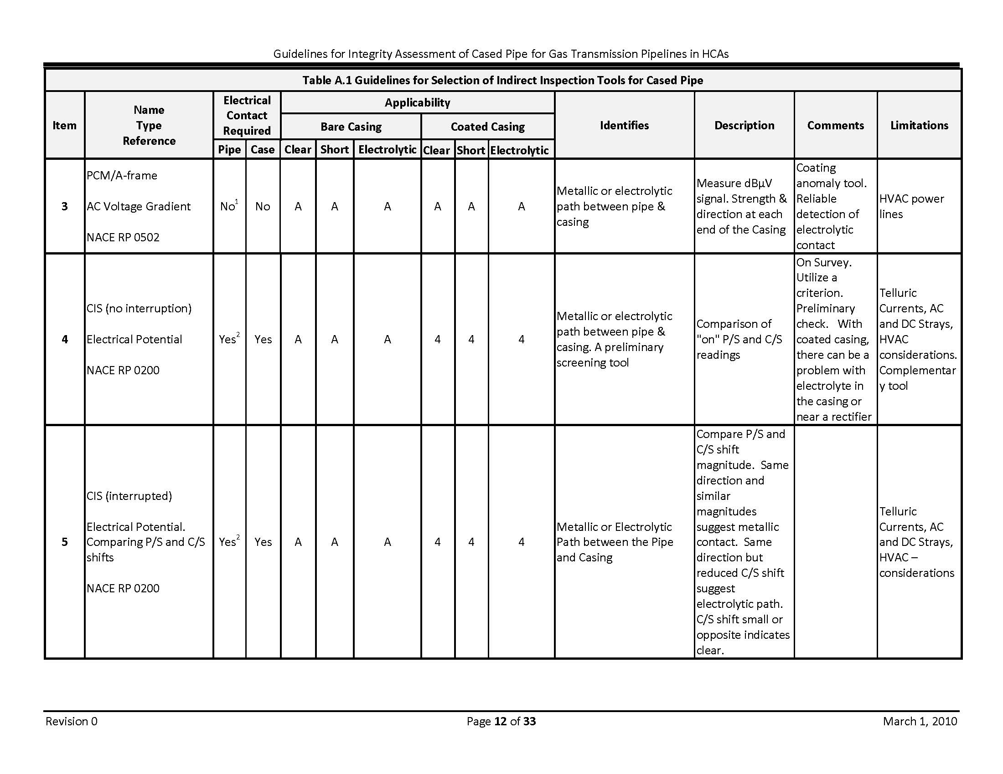

Slide 23
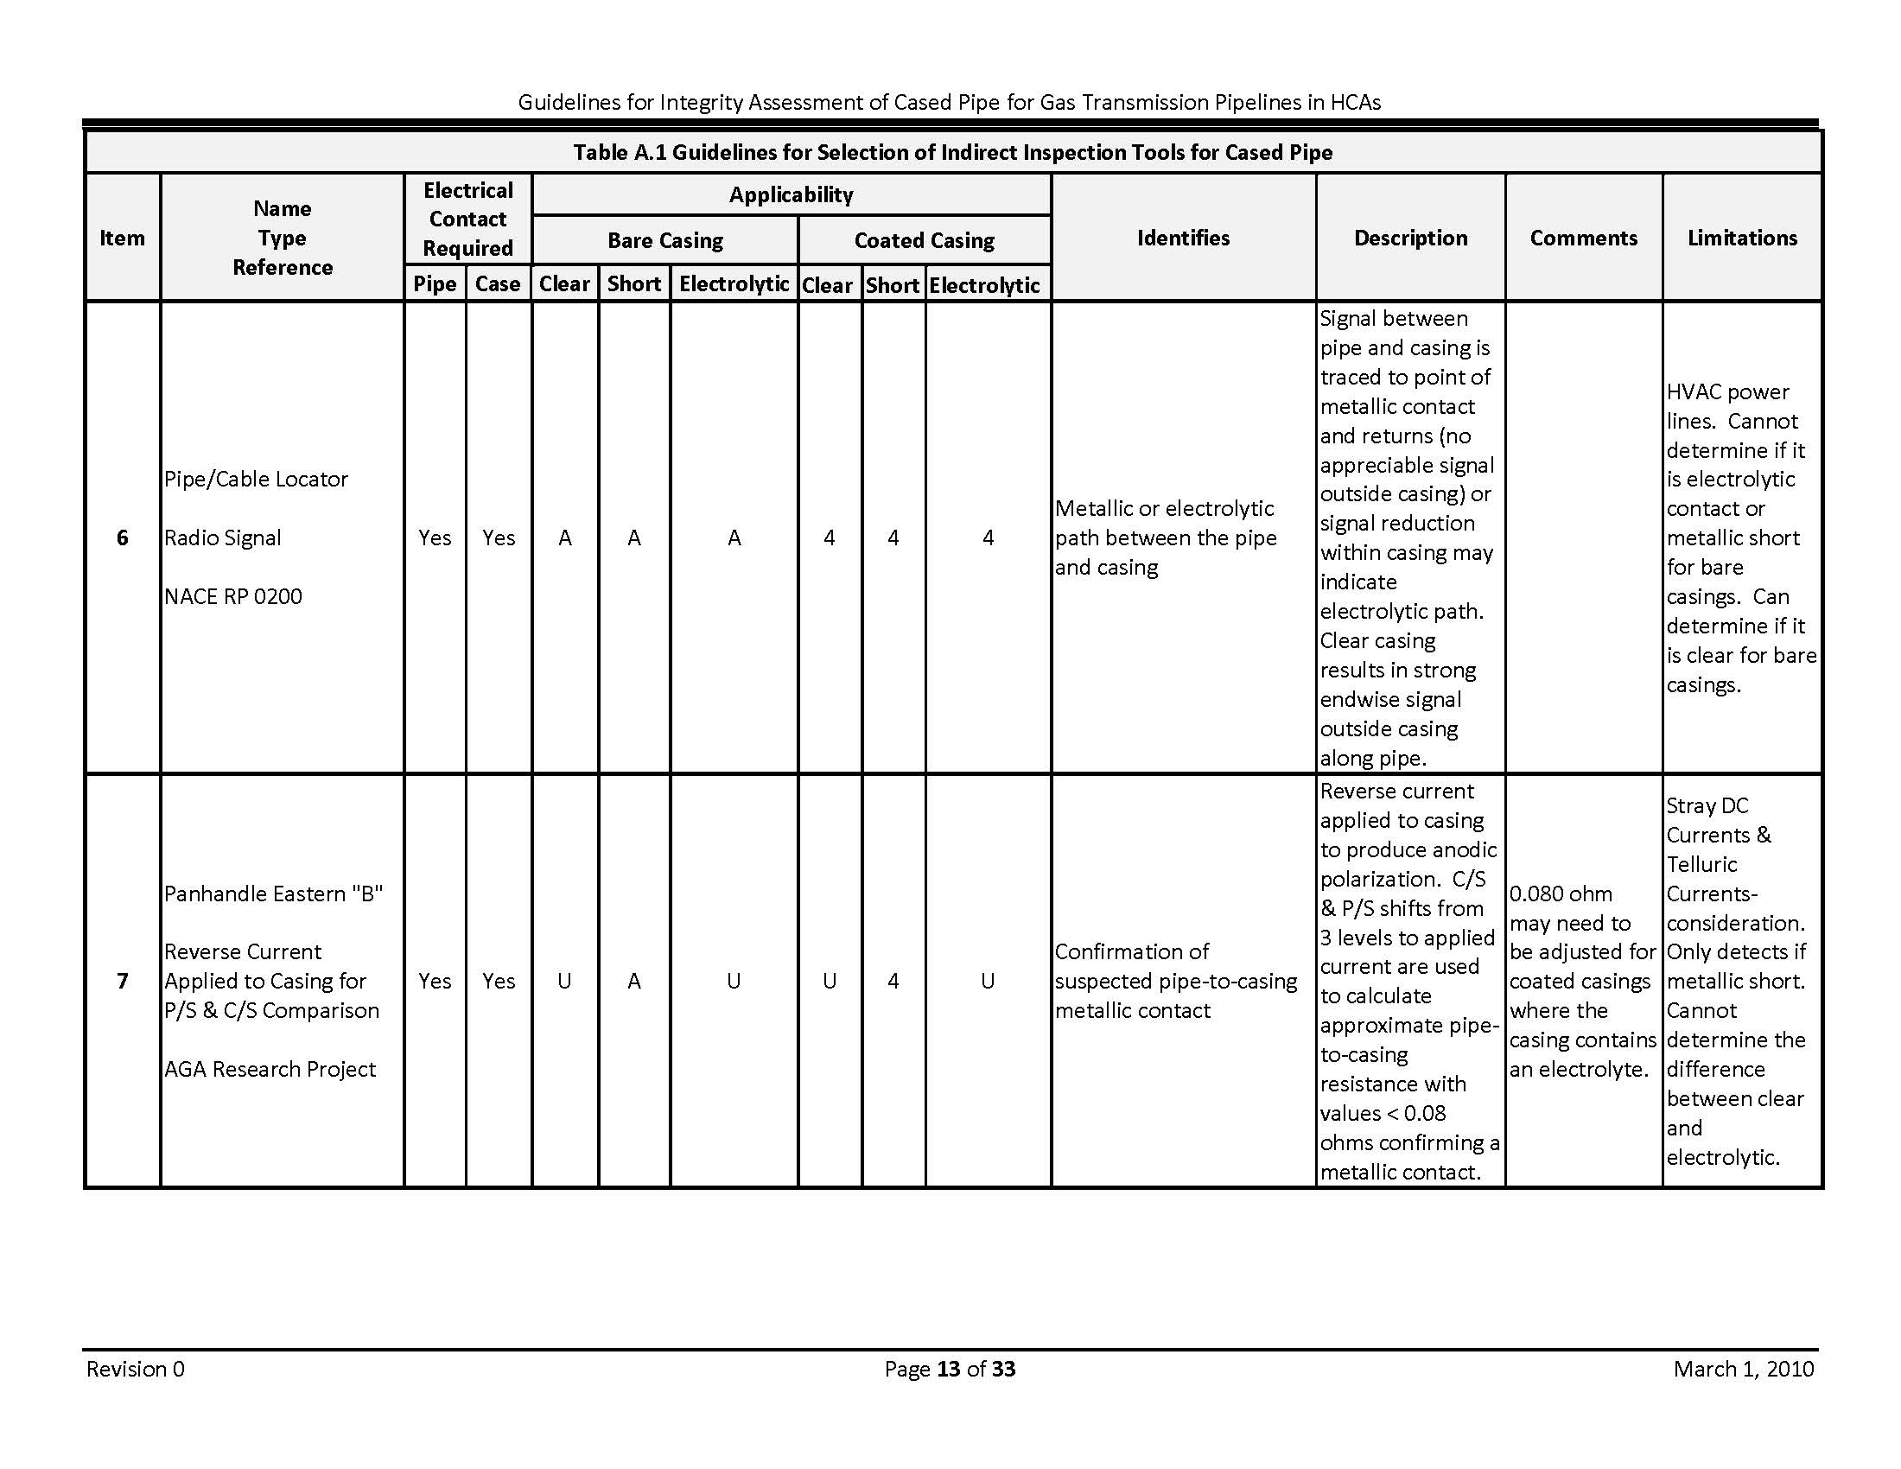

Slide 24
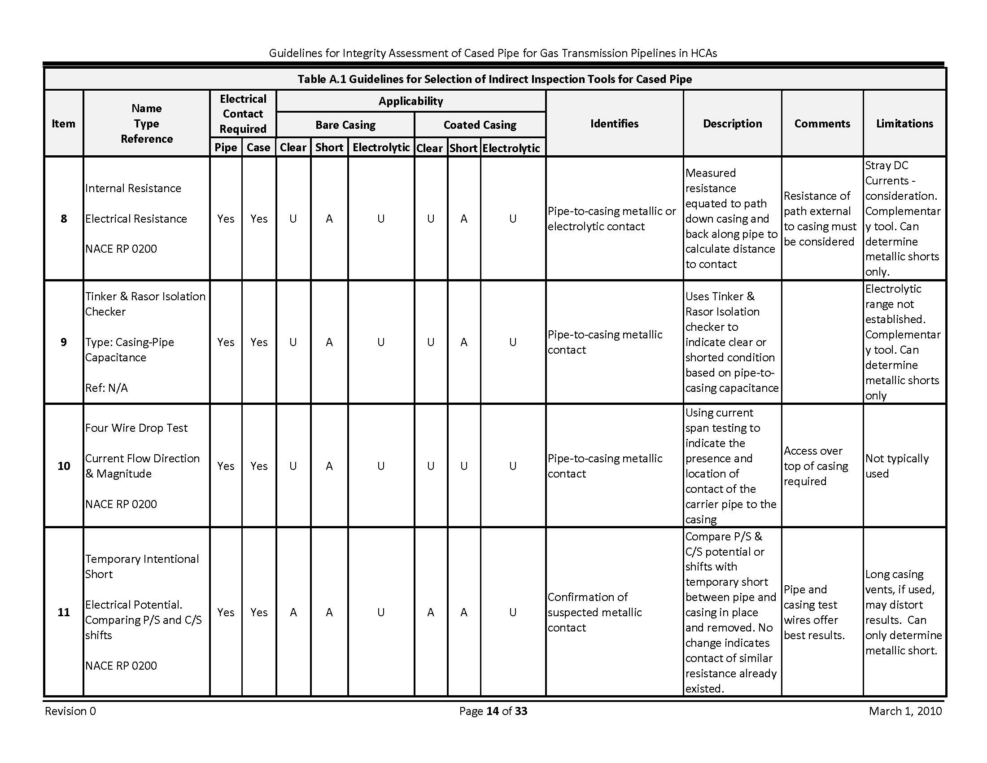

Slide 25
DIRECT ASSESSMENT
Direct Examination
Dig up casing for further inspection - problematic
There are various ways to verify condition of pipe
Guided Wave
This method use torsional data as well as compressional wave modes to detect cracks, metal loss and other defects on a carrier pipe inside a casing.
In Line Inspection or Tethered Pigs
ILI is used to determine the presence or absence of pitting-corrosion damage on carrier pipe inside a casing.
Hydrostatic Test (Go-no-Go Type Test)
Video of annulus between pipe and casing (only identifies, no quantification of severity of anomalies)

Slide 26
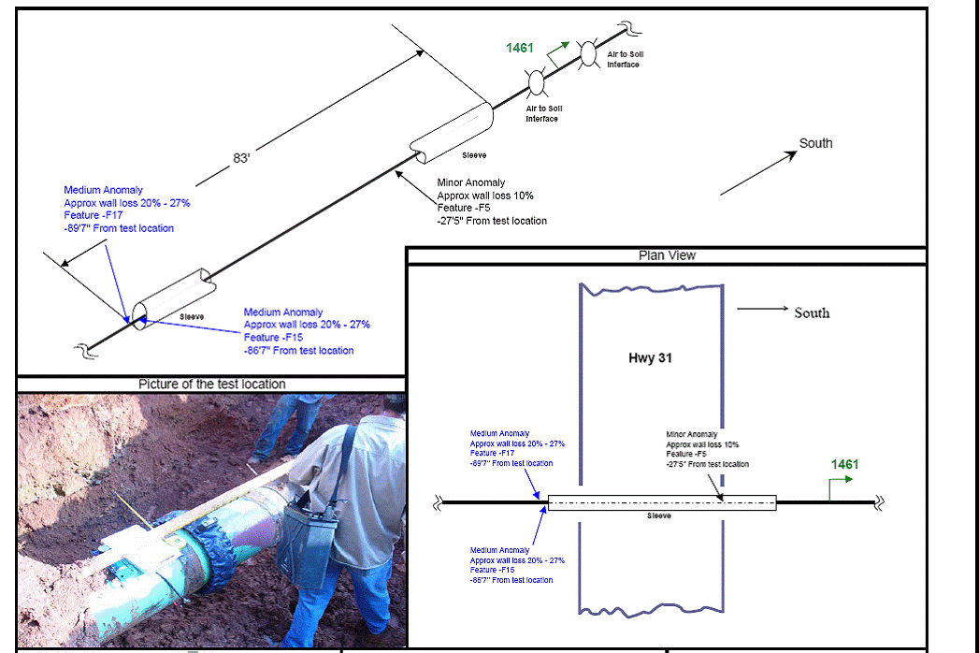
GUL – SHORTED CASING
Notes:
26

Slide 27
WHAT TO DO WHEN THE CASING CAN NOT BE REMOVED
Correct shorted casing when possible
Most casings are shorted at the end(s) where the end seals or supports have collapsed.
Inspect the test lead wires. They may be shorted to the vent pipes or to each other.
Make sure vent pipes are not welded to the pipe.
Reposition the pipe and replace the end seals.

Slide 28
WHAT TO DO WHEN THE CASING CAN NOT BE REMOVED
OR
Clean and fill the casing with a wax type filler
Make sure vent pipes have sufficient (2”) openings to the inside of the casing in the proper configuration for best fill.
Clean out casing using air, power washer, or suction truck.
Remove old End Seals to assist the cleaning, then replace with new seals.
Pressure Test Seals with minimum 5psi. In one vent and out the other to ensure quality fill.

Slide 29
PHMSA 192.467
“Except for unprotected copper inserted in ferrous pipe, each pipeline must be electrically isolated from metallic casings that are a part of the underground system. However, if isolation is not achieved because it is impractical, other measures must be taken to minimize corrosion of the pipeline inside the casing.”
20

Slide 30
TYPES OF CASING FILLERS
Hot applied Wax based materials with corrosion inhibitors
Cold Applied Wax based materials with corrosion inhibitors
Gels with corrosion inhibitors
Inert gas (casing must be sealed to provide positive pressure). Practical?
Inject vapor and or water based type inhibitor in annulus. Practical?

Slide 31
REQUIREMENTS FOR FILLING A CASING
Diameter and length of casing and carrier
Location of casing(s)
Access to reach vents
Preparation of casing including:
Evaluation of vents to be set up in best configuration for successful fill
New End Seals with 170F temperature rating if using a Hot Wax Casing Filler (Most Shrink Sleeves do not meet the temp requirement)
Air pressure test of 5 psi, no spacer blockage, no vent blockage

Slide 32
CASING FILL PREPARATION
The lower side of the casing should have the opening at the bottom to allow cleaning and placement of casing filler material.
Vent Pipe
Casing
Isolating Spacers

Slide 33
CASING FILLERS
The majority of Casing Fillers are a blend of petroleum wax and corrosion inhibitors. These hot materials are pumped into the casings by custom, heated trucks with meter controls and experienced personnel.
Cold Applied Casing fillers come in barrels and use a mastic pump for installation. This system is good for smaller projects utilizing in-house labor.
Notes:
Other fillers are installed without heating. Casing filler should
displace any water and prevent corrosion should water penetrate.

Slide 34
INSTALLATION OF NEW CASING AND PIPE
Do not install casing unless absolutely necessary.
If installation is required, be sure to install properly coated pipe with enough supports to keep the pipe separate from the casing.
Insure the end seals are properly installed.
Attach vent pipes of proper size and location to provide installation of casing filler.
Using fillers within annulus of cased piping doesn’t allow for the use of continual Indirect Inspection methodologies.

Slide 35
Direct Assessment
Post Assessment
No current guidelines via PHMSA other than encouragement for operators to consider a rigorous implementation of a post assessment process similar to that utilized for mainline piping as prescribed in NACE SP0502-2010.
PHMSA expects operators to have and maintain a strong DA effectiveness strategy
Continual improvement of DA program for cased pipe as operators learn more about their systems and as the industry develops improving technologies

Slide 36
CONCLUSIONS
All pipeline road crossings are a problematic.
Data and frequency of data collection are necessary for monitoring
Remove casings when possible, shorted or not.
When you must install a new casing, collect baseline indirect inspection data as a milestone
Corrosion occurs almost as often in non-shorted casings as in shorted casings.
Water is present in nearly all casings
Filling a casing will remove the electrolyte / water from the equation and stop any further corrosion but limits future monitoring via indirect inspection techniques for future assessments

Slide 37
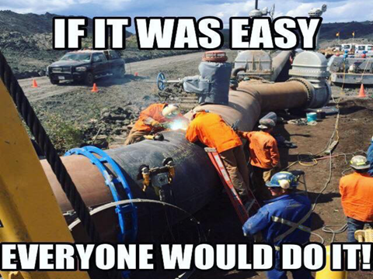

Slide 38
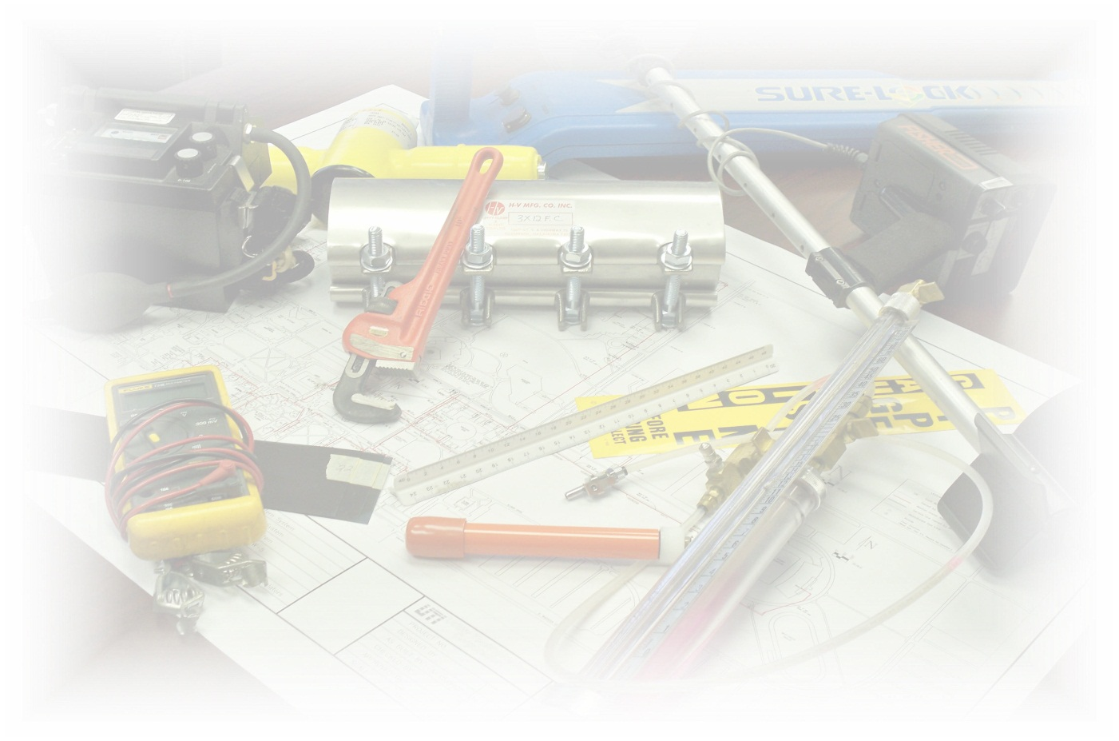
TOTAL CAPABILITIES IN THE PIPELINE INDUSTRY
QUESTIONS?
UTILITY TECHNOLOGIES INTERNATIONAL CORPORATION
www.uti-corp.com

