Slide 1
Gas Pipeline Safety
Federal Regulatory Update
Pete Chace
Public Utilities Commission of Ohio
Gas Pipeline Safety Program Manager

Slide 2
Federal Rulemaking Process
Legislation – Congress passes a law that prescribes general goals for the agency.
Advance Notice of Proposed Rulemaking (ANPR) – agency publishes initial analysis of legislative intent and asks for public comment (optional).
Notice of Proposed Rulemaking (NPRM) – agency publishes proposed rule language after review by Federal Office of Management & Budget (OMB), with a public comment period.
Final Rule – published with response to issues raised by public comment, subject to judicial review

Slide 3
Federal Rulemaking Process
2017 – executive order stating that for every new regulation created, two have to be withdrawn.
“Total incremental cost of all new regulations, including repealed regulations, to be finalized this year shall be no greater than zero”.
This restriction applies across the entire DOT, cuts could be made to PHMSA regulations to justify new regulation elsewhere or vice versa.

Slide 4
Recent Rule Amendments
1/1/2016 – Excavation Damage Prevention (created 49 CFR 196 – Federal enforcement)
1/18/17 – Underground Natural Gas Storage (interim final rule – current stay of enforcement)
3/24/17 – Operator Qualification, Cost Recovery, Accident and Incident Notification, Misc.
4/14/17 – Excess Flow Valves for Multi-person Dwellings (EFV’s for multi-person dwellings, curb valves or EFV’s for services over 1,000 SCFH, customer notification)

Slide 6
Operator Qualification, Cost Recovery, Incident Notification
Portion of the rule covering OQ was removed for a future rulemaking (the proposed “two part test”)
Incident reporting time of 1 hour after “confirmed discovery”.
Within 48 hours of confirmed discovery, revise or confirm the initial telephonic notice.
Telephonic notices do not need to be retracted. Only 30 day reports do.
1-844-OHCALL1 (1-844-642-2551)

Slide 7
OQ, Cost Recovery, Incident Notification – Farm Taps
Farm Tap = a service line supplied from a Transmission, Gathering, or Production line
Rule excludes farm taps from DIMP while requiring regulator inspection and testing at least once every 3 years under 192.740.
First inspection and testing cycle 3/23/20.
New 192.740 requirements very similar to 192.739 requirements for district regulators.
PHMSA developing FAQ’s, stay of enforcement?

Slide 8
Notes on OQ
How are your contractors qualified? Do you have confidence in how they are evaluated?
Span of control – non OQ workers can perform a covered task “if directed and observed by an individual who is qualified”. How many workers are being observed at once?
Management of change – significant changes communicated to individuals and to the state agency [192.805(f), (i)]. For GPS you can inform us during inspection

Slide 9
What changes to OQ need to be communicated?
Changes to procedures
Use of new equipment
Changes to Regulations (federal or state)
Changes to Standards incorporated by reference
New information from equipment or product manufacturers
Newly identified tasks
Findings from incident investigations

Slide 10
Gas Transmission / Gathering – In Development
NPRM released 3/15/2016
PHMSA received over 400 comments
Rule is under review and may be heavily modified
Will likely focus strictly on the congressional mandates in the 2006 PIPES act (evaluation of whether IM requirements should extend beyond HCA’s, potential MAOP validation, automatic shutoff valve requirements).

Slide 11
Gas Transmission / Gathering – High Level Summary
Require IM assessments for non-HCA’s (new 192.710 defining Moderate Consequence Area, 14/10 year initial/upkeep surveys)
Strengthen Transmission repair criteria (711, 713 – moving the immediate and scheduled repair concept to non-IM covered segments)
Strengthen requirements for assessment methods (ICDA, SCCDA, Guided Wave, ILI)
Clarify requirements for validating and integrating pipeline data (establish minimum attributes)

Slide 12
Gas Transmission / Gathering – High Level Summary
Clarify functional requirements for risk assessments (codifies some of B31.8S)
Clarify requirement to apply knowledge gained through IM
Strengthen corrosion control requirements (DCVG/ACVG gradient survey for new construction, CIS for low reads, interference surveys around HVAC power lines, internal corrosion monitoring)
Add requirements for selected preventative and mitigative measures in HCA’s to address internal and external corrosion (provide examples)
Add management of change for IM
Require pipeline inspection following extreme external events
Include 6 month grace period to 7 year reassessment interval

Slide 13
Gas Transmission / Gathering – High Level Summary
Add requirements for selected preventative and mitigative measures in HCA’s to address internal and external corrosion
Add management of change for IM
Require pipeline inspection following extreme external events
Include 6 month grace period to 7 year reassessment interval

Slide 14
Gas Transmission / Gathering – High Level Summary
Require reporting of MAOP exceedance
Incorporate provisions to address seismicity
Add requirements for safety features on pig launchers and receivers
Gathering lines – require reporting for all types, and some regulatory requirements
“Grandfather clause” / inadequate records – Integrity Verification Process

Slide 15
Incident Trends
What do incident trends tell us about pipeline safety threats?
  Excavation Damage is the top threat for Distribution piping
  Time dependent threats (Material, weld or joint failure, corrosion) are the top threats for Transmission lines
  Damage Prevention programs appear to have some effect reducing damages

Slide 16
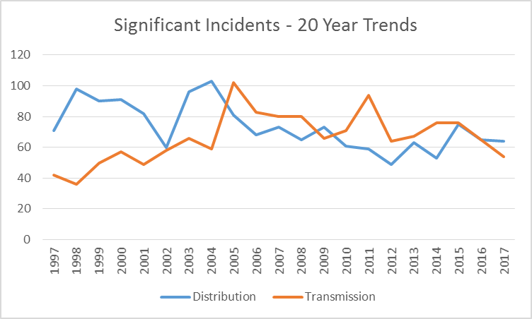

Slide 17
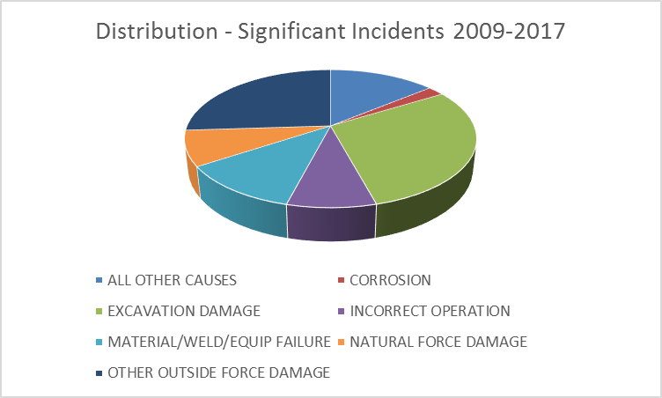

Slide 18
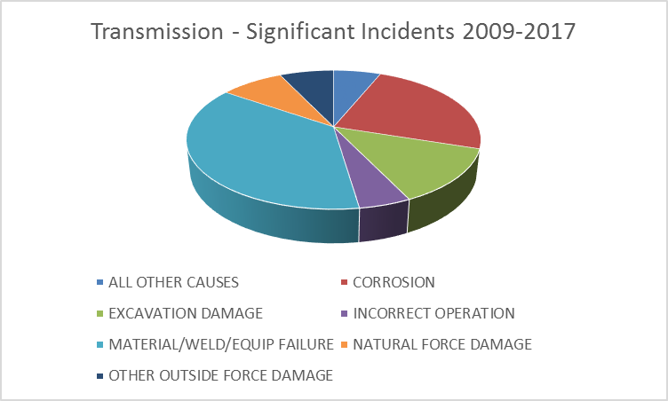

Slide 19
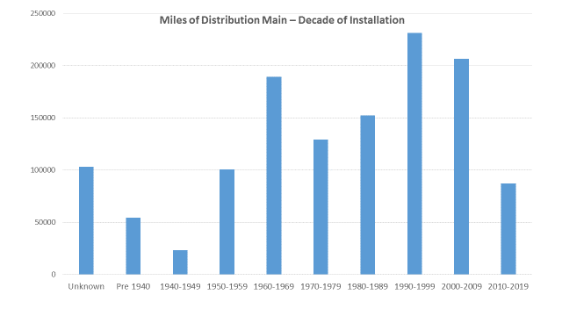

Slide 20
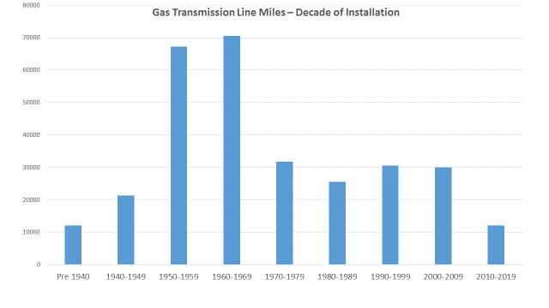

Slide 21
Annual Report – Excavation Damages

Slide 22
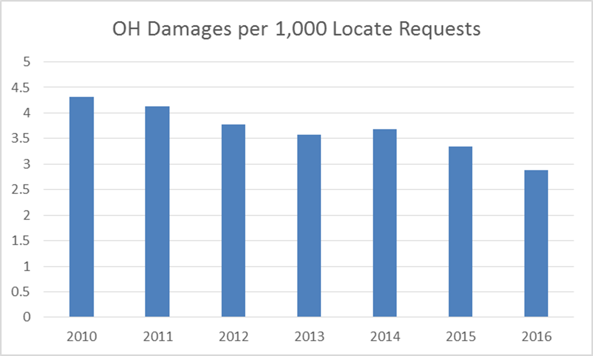

Slide 23
Mechanical Coupling Failure Reports
Leading leak cause is Equipment Failure (more than all others combined)
Service-to-service the most common leak location
Numbers of 7100 reports can vary wildly from operator to operator

Slide 24
Mechanical Coupling Failure Reports
“Operators must report failures which result in a hazardous leak during the calendar year that are associated with mechanical fittings.”
“The reporting requirements apply to failures in the bodies of mechanical fittings, failures in the joints between the fitting and the pipe, indications of leakage from the seals associated with the fitting, and partial or complete separation of the pipe away from the fitting.”

Slide 25
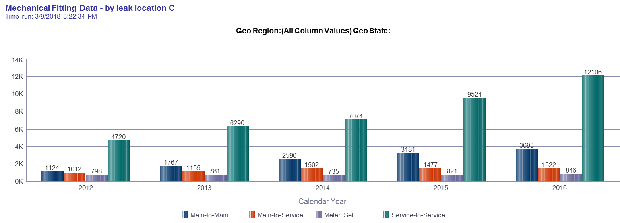
Mechanical Fitting Data –leak location

Slide 26
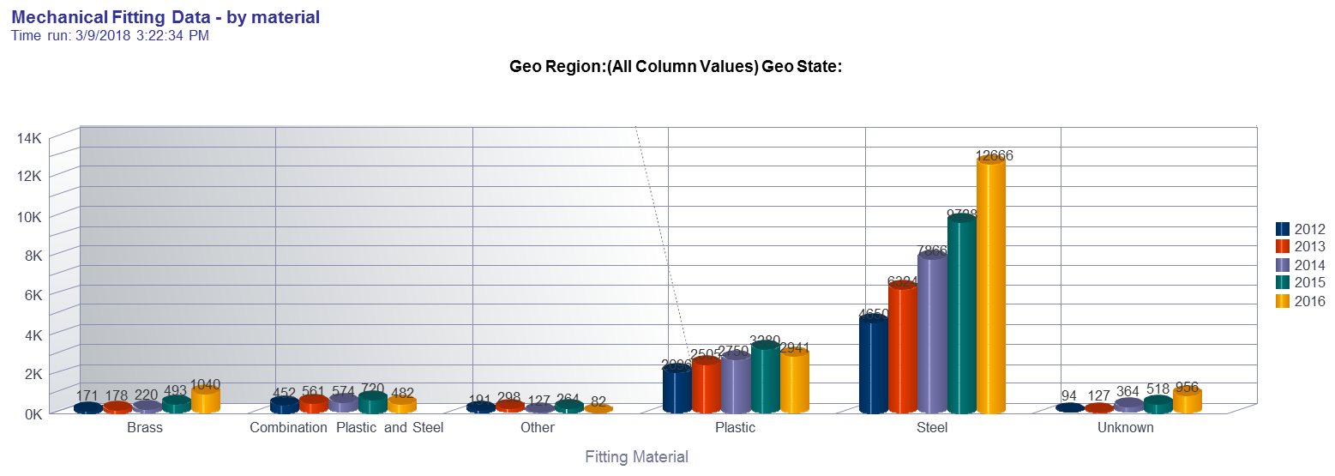
Mechanical Fitting Data – fitting material

Slide 27
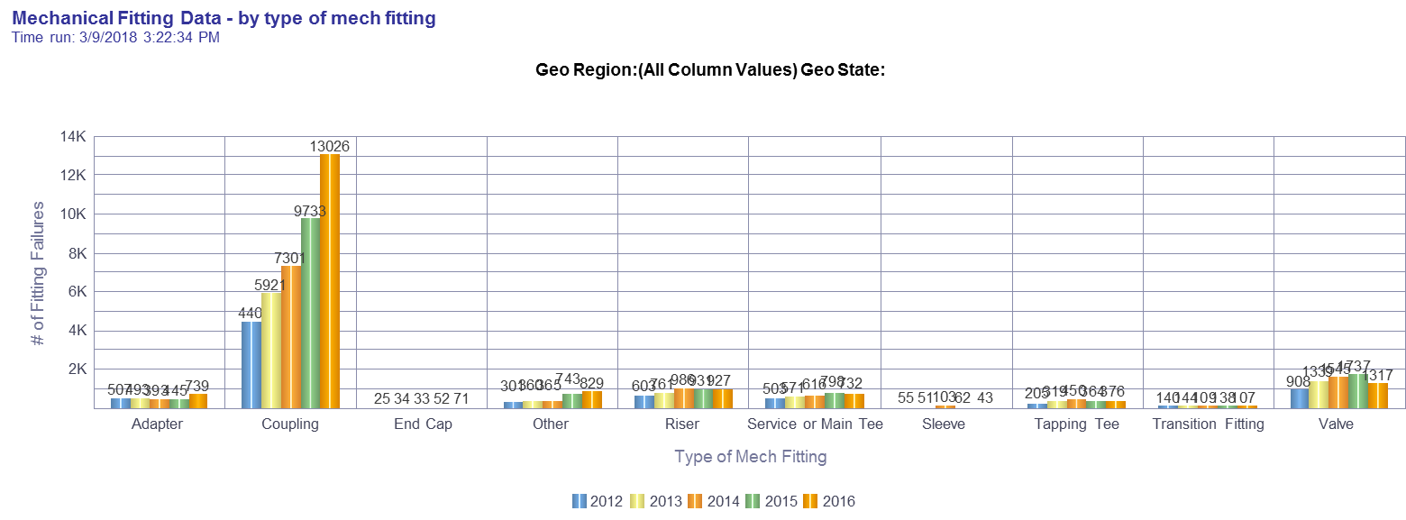
Mechanical Fitting Data – type of fitting

Slide 28
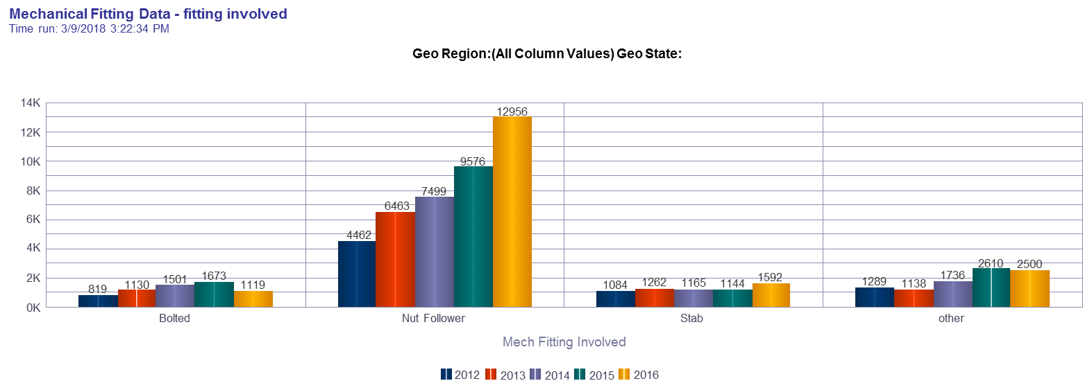
Mechanical Fitting Data – fitting construction

Slide 29
DIMP – Leak Management
Leaks - 2015
Leaks - 2017
System leaks: 105
Are trends in this system going in the right direction?
System leaks: 90
https://www.youtube.com/watch?v=VRrMu7B1L2I

Slide 30
DIMP – Leak Management
Leaks - 2015
Leaks - 2017
Area 1 25 | Area 2 25
Area 3 35 | Area 51 20
Area 1 25 | Area 2 15
Area 3 10 | Area 51 40

Slide 31
Safety Management Systems (API RP 1173)
Based on approaches from other high hazard industries - nuclear, airline, etc.
“Plan-Do-Check-Act: continuous improvement model
Promotes a “Safety Oriented Culture” – where communication, risk reduction and continuous improvement is part of day to day activities

Slide 32
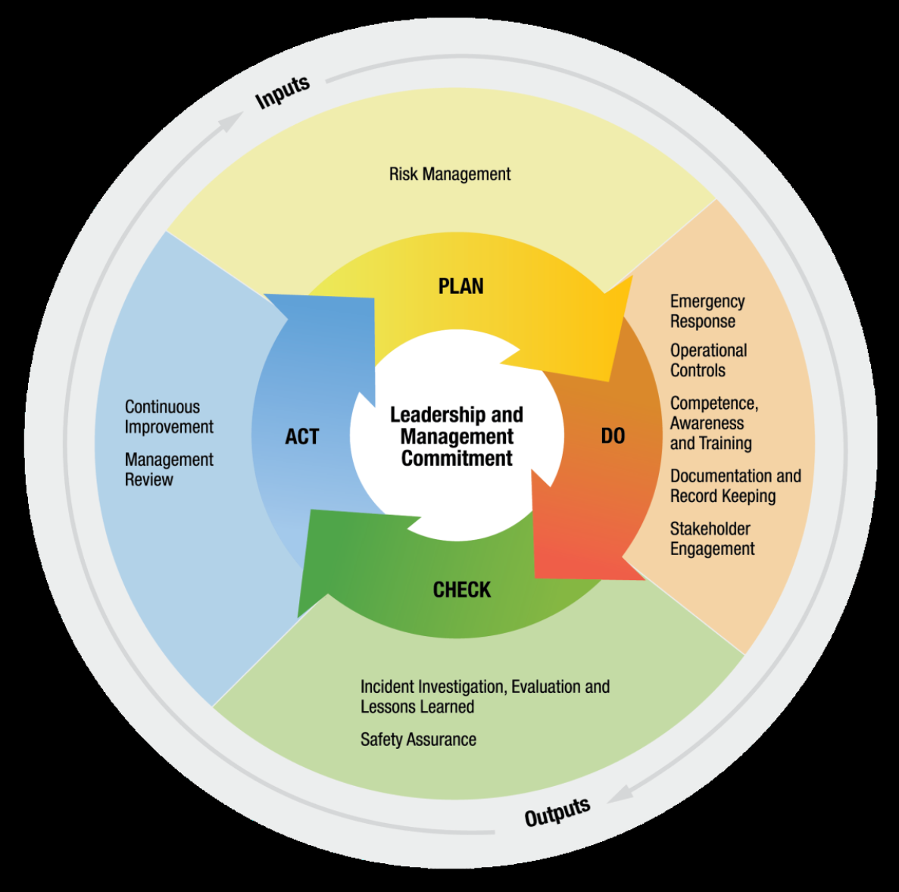

Slide 33
Example
An operator has experienced a number of excavation damages (dig-ins) in the recent past, including one resulting in an Incident.
Checking the data on their PHMSA 7100 report shows a damage per thousand locate ticket rate almost twice the state average.
Need a plan to reduce excavation damage.

Slide 34
PLAN
Risk Management
  What is the leading cause of dig-ins?
  Review and update locate request procedures
  Establish damage investigation procedures
  Classify damages so the results can tell you something. Example:
    Locating Practices not sufficient. Sub-cause?
      Incorrect facility records / maps
      Facility marking or location not sufficient
      Facility was not located or marked
      Facility could not be found or located

Slide 35
DO
Put the plan into action
Train people on your procedures
“Operational Controls” – check to make sure the procedures are being followed
Investigate failures (damages) for lessons learned
Keep good records so somebody reviewing the records later can understand what happened. Have a quality control process.
“Stakeholder engagement” – Keep everyone (employees, contractors, excavators) involved. Public awareness.

Slide 36
CHECK
Can we use what we learned to get better?
Check to see if your plan is effective (damages per thousand locates)
Review incident investigations and lessons learned. Any patterns?
Ex: for this operator, the most common cause of a dig-in is: Locating practices not sufficient -> Facility marking or location not sufficient
  Further investigation shows the leading cause is that when a locate is done by contractors, no one is informing the excavator when a locate is un-toneable.

Slide 37
ACT
Determine how your plan can be improved, and fix it
Revise your procedures, contracts with third parties, evaluation and oversight, etc. to address the shortcomings identified in the “Check” phase.
For the example: changes to contractor training program, revised contract language, periodic QC inspections of line locate jobs.

Slide 39
What is a “Safety Oriented Culture”?
https://www.youtube.com/watch?v=s0RrhkMk2zY

Slide 40
Questions?
Pete Chace
(614) 644-8983
Peter.chace@puc.state.oh.us

