Slide 2
Fatigue Risk Management for Pipeline Control Rooms Ohio Gas Association Technical Conference March 2018 Charles Alday

Slide 3
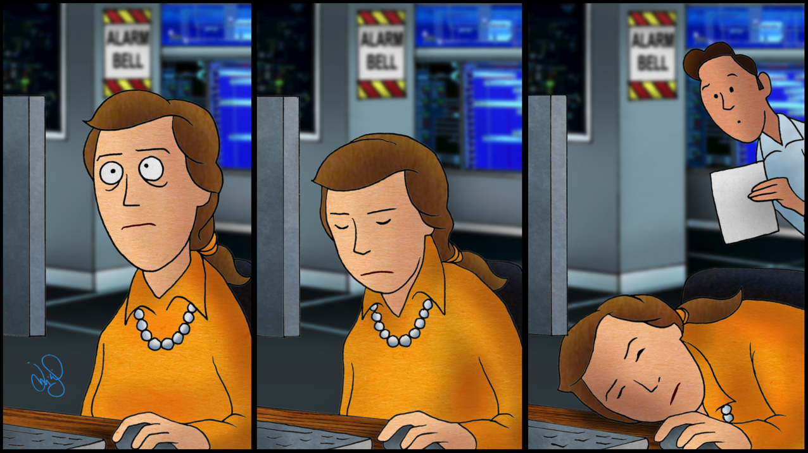
Reduce Risks of Fatigue

Slide 4
Fatigue Mitigation
The Pipeline and Hazardous Materials Safety Administration (PHMSA) of the United States Department of Transportation issued safety regulations in 2011 that required pipeline control rooms to implement methods “to reduce the risks associated with Controller fatigue that could inhibit a Controller’s ability to carry out the roles and responsibilities the operator has defined.”

Slide 5
Control Room Management
Alarm Management
Fatigue Mitigation
Change Management
Shift Change
Operating Experience
SCADA
Training
Roles and Responsibilities
General
Compliance

Slide 6
Regulatory Language
CFR § 192.631(d) and CFR § 195.446(d) Fatigue mitigation.
Each operator must implement the following methods to reduce the risk associated with Controller fatigue that could inhibit a Controller’s ability to carry out the roles and responsibilities the operator has defined:

Slide 7
Regulatory Language
Establish shift lengths and schedule rotations that provide Controllers off-duty time sufficient to achieve eight hours of continuous sleep
Establish a maximum limit on Controller hours-of-service, which may provide for an emergency deviation from the maximum limit if necessary for the safe operation of a pipeline facility

Slide 8
Regulatory Language
Educate Controllers and Supervisors in fatigue mitigation strategies and how off-duty activities contribute to fatigue
Train Controllers and Supervisors to recognize the effects of fatigue

Slide 9
That is Straightforward
Time Off
Opportunity for Eight Hours of Sleep Between Shifts
Maximum Limits on Hours of Service
Training and Education
Fatigue Mitigation Strategies
Effects of Off-Duty Activities
How to Recognize Fatigue Effects

Slide 10
People are Unpredictable!
“
People are unpredictable creatures, they invent rules which they break incessantly and they follow impulses which they later cannot explain.
“
Notes:
I was reading this mystery a few weeks ago. It is an accurate statement about people, I think. This is why we say, “I can’t control what the people do when they’re off. How do I know whether they sleep or not?”

Slide 11
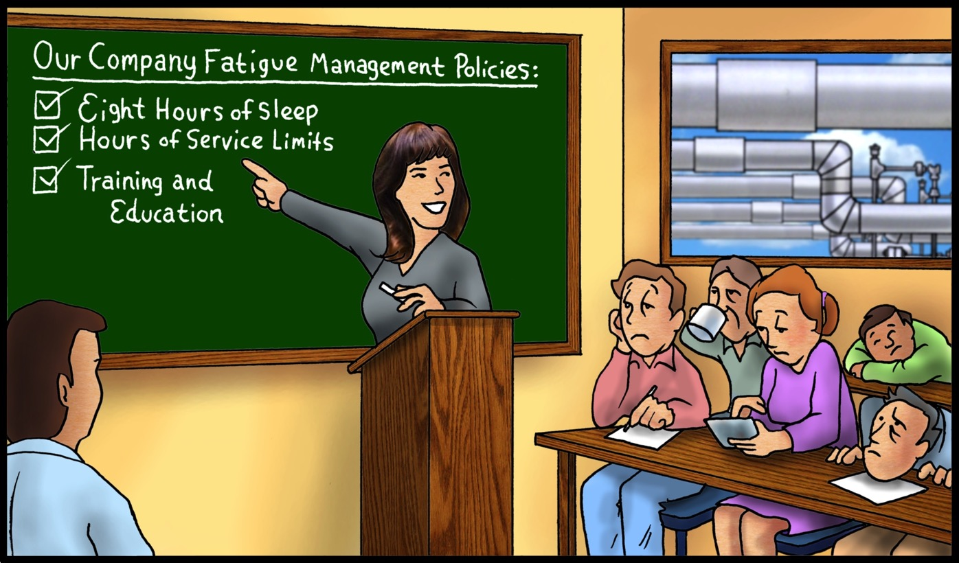

Slide 13
Other Relevant Documents
PHMSA CRM FAQs (1-16-18)
PHMSA CRM Inspection Questions (3-20-12)
Advisory Bulletin: Countermeasures to Prevent Human Fatigue in the Control Room (August 2005)
Staffing of Regular, Cyclic 24/7 Operations (James Miller, June 2011 White Paper)
Investigating the Possible Contribution of Fatigue to Pipeline Mishaps (James Miller, June 2011 White Paper)
Shift Plans with Seven Consecutive Shifts (James Miller, April 2012 White Paper)

Slide 14
What is an FRMS?
FAQ D.09. PHMSA promotes the use of a fatigue risk management system (FRMS) as a tool for implementing fatigue mitigation

Slide 15
FRMS Should Include:
Hours of Work Diagnostic
Fatigue Hazard Analysis
Scientific Research
Roster Design & Workforce Planning
Policies & Procedures
Contingency Planning
Training & Education
Compliance & Audit

Slide 16
Information and Tools
Fatigue Modeling Software (FAID)
Fatigue Hazard Analysis Software (GRAID and HAZAID)
Human Factors & Control Room Assessments
Workload Assessments
Information from Other Transportation Modes

Slide 17
Risk Exposures & Safeguards

Slide 18
FRMS Statements – Reduce Risks

Slide 19
FRMS Statements – Reduce Risks

Slide 20
FRMS Document Components
FRMS Responsibilities by Job Function
Shift Length, Start and Start Times
Schedule Rotations
Staffing Analysis
Commute Time Analysis

Slide 21
Sliding 65 Hour Guidance

Slide 22
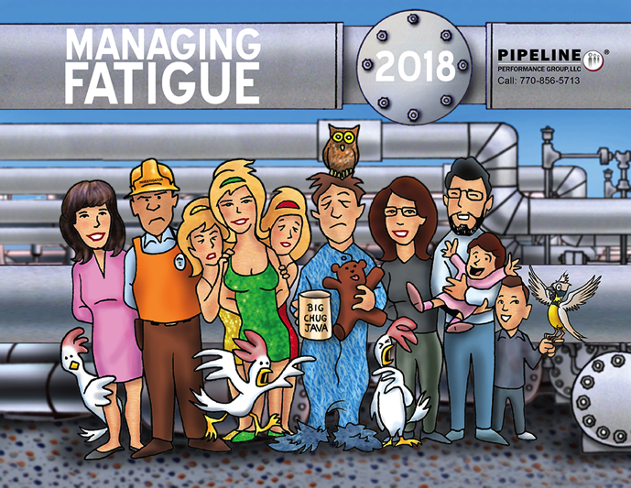
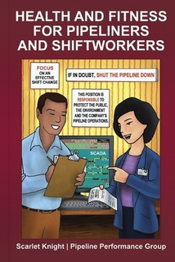
FRMS Document Components
Fatigue Training
Fatigue Education

Slide 23
FRMS Document Components
Environmental and Ergonomic Factors
Fatigue Countermeasures during Shifts
Maximum Hours of Service (HOS)
Emergency Deviations from HOS

Slide 25
FRMS Document Components
Incident Investigation for Fatigue
Fatigue Self Reporting
Observations for Signs of Fatigue
Employee Issues that Affect Alertness
Evaluation of FRMS
Evaluation of Fatigue Training Program

Slide 26
What Is New Since 2011-2012?
Related to the “fatigue mitigation” of the CRM rule, there are no changes in the regulation, FAQs, or inspection questions.
The NTSB still has “Reduce fatigue-related accidents” on its “Most Wanted List” for all modes but pipelines.
No pipeline accidents investigated by the NTSB since 1996 cite human fatigue as a contributing factor.

Slide 27
What Is New Since 2011-2012?
Fatigue (and other human factors) are more often cited in automobile, trucking, railroad, marine, and aviation accidents
Some of the other human factors include:
Distractions
Complacency
Stress
Workload Pressure

Slide 28
But Fatigue is a Human Problem

Slide 29
What Is New and Helpful

Slide 30
Conclusion
Satisfying the regulations should not be difficult you have adequate staffing to avoid excessive overtime and regular traiing and education is provided
Implementing and maintaining a FRMS requires regular attention by someone who is interested in identifying the specific fatigue risks

Slide 31
Conclusion

