Slide 1
OHIO GAS ASSOCIATION SECURITY AND THREAT INTELLIGENCE MARCH 2018
Lisa Wallace
Technical Director
lwallace@microsolved.com
Twitter - @TheTokenFemale

Slide 2
ABOUT MSI
Founded in 1992
Security Services
Threat Intelligence
Innovation Services
Lisa Wallace
Security Services
eDiscovery
Digital Forensics
Incident Response

Slide 3
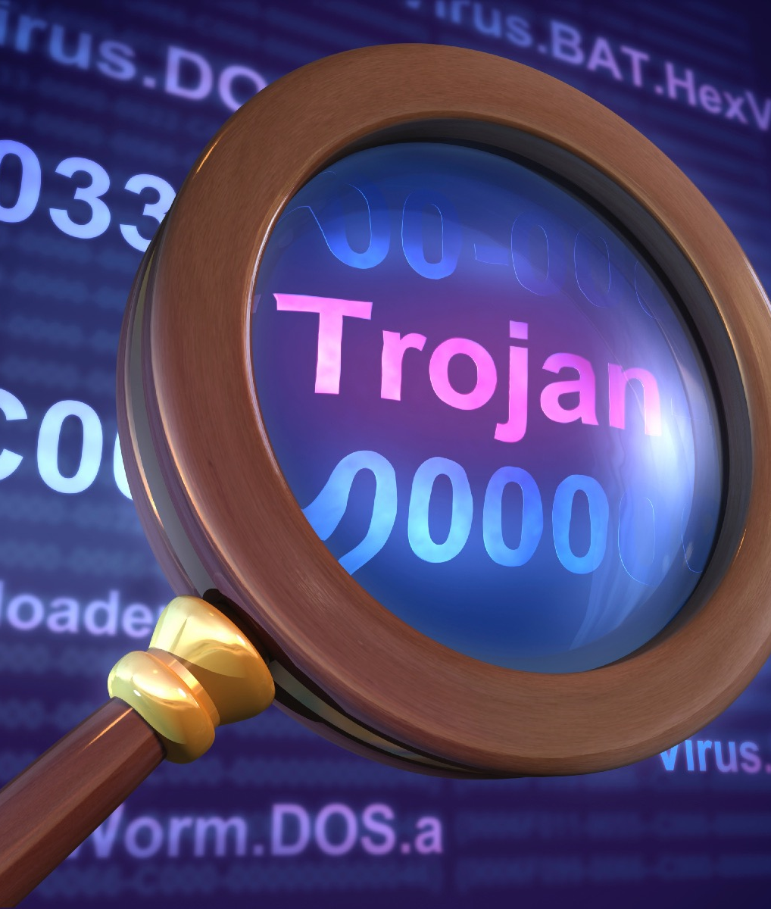
RECENT CAMPAIGNS & RESEARCH ISSUES
In 2016, ICS-CERT Incident Response Team responded to 290 incidents
Spear phishing = 26% of these attacks
Malware disguised as ICS/SCADA software
Bluetooth vulnerabilities – Recent uptick in “plug and play” tools for compromise

Slide 4
RANSOMWARE
Peyta/NotPeyta
WannaCry
Primary immediate threat for ICS, Healthcare systems, any perceived “high value” targets
Worldwide – not US-centric
LBWL incapacitated for a month

Slide 5
REMEDIATION AND PROTECTION
Less than 10% of ransom payments result in unlock
If you suspect anything, PULL THE PLUG!
Segment – even corporate networks
Backups, backups – keyword, inaccessible
Protect your most valuable intellectual capital!

Slide 6
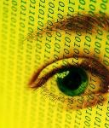
DARKNET INDICATORS
AlphaBay and Hansa shutdown
Fragmentation of markets
Nation state affiliated groups
Hactivists
Organized crime
The endgame shifting from access to data!

Slide 7
LET’S GET PHYSICAL
Cameras –Evaluate
Defaults – First thing out of the box!
Drones – Strategy?
Brute force alive and well
Remote site challenges

Slide 8
BACK TO THE BASICS
Accurate inventory challenges
Default configurations & authentication is everywhere
Plain text protocols abound, making small access -> HUGE
Many organizations pay little attention to relevant intellectual property & focus on control
Insider threats

Slide 9
YOUR MOST VALUABLE RESOURCE
TRAINING – Widgets can’t replace people
Corporate culture
Practice – Phishing exercises
Tabletop exercises
Security in life

Slide 10
QUESTIONS?
Lisa Wallace
lwallace@microsolved.com
Twitter - @TheTokenFemale
Stateofsecurity.com
Microsolved.com

Slide 11
QUESTIONS?
Lisa Wallace
lwallace@microsolved.com
Twitter - @TheTokenFemale
Stateofsecurity.com
Microsolved.com

