Slide 1
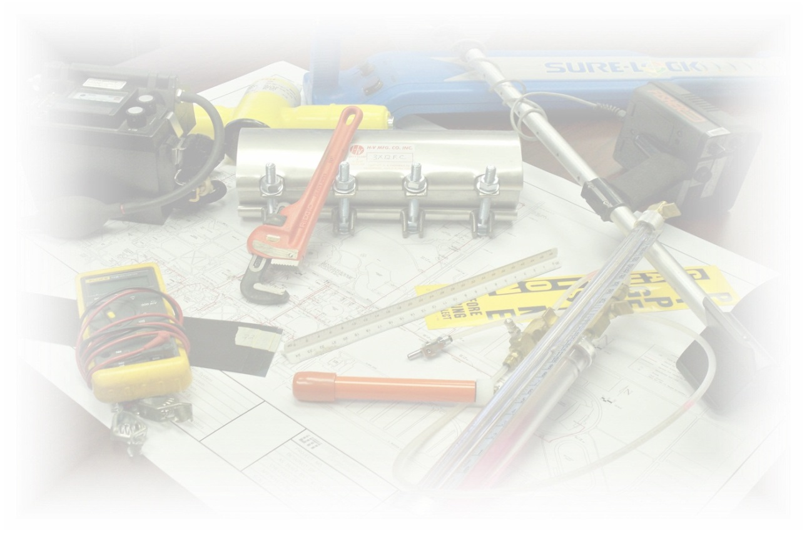
TOTAL CAPABILITIES IN THE PIPELINE INDUSTRY
Utility Technologies International
4700 Homer Ohio Lane
Groveport, OH 43125
614-482-8080
www.uti-corp.com

Slide 2
The Evolution of Integrity Management:
Qualifications, Identifying Threats, Preventative & Mitigative Measures and Program Effectiveness

Slide 3
Integrity Management Process Review
Gas Transmission Integrity Management (GT IM)
49 CFR Part 192, Subpart O-specifies how pipeline operators must identify, prioritize, assess, evaluate, repair and validate the integrity of gas transmission pipelines that could, in the event of a leak or failure, affect High Consequence Areas (HCAs). Operators were given until December 17, 2004 to write and implement their IM programs.

Slide 4
Integrity Management Process Review
Once your program was established, the next step was to implement what your program dictates to assess the integrity of your pipeline.
Baseline Assessment
Appropriate Assessment Method
Reassessment Intervals
Confirmatory
Full reassessment

Slide 5
Integrity Management Process Review
Assessment Method Selection
Use pipeline data, pipeline construction and operational information to determine the best fit assessment method
Document the reasons for the method selection
Document your assessment process

Slide 6
Integrity Management Process Review
All assessment methods are 4 step processes
Pre-Assessment
Data Gathering
Feasibility
Indirect Inspection
Selection of tools
Setting parameters for test/survey
Conducting test/survey
Identification of indications
Direct Examination
Excavations to investigate indications from predicted areas of concern or discovered indications
Measurements taken, observations made and all data documented
Remediation performed
Post Assessment
Analysis of data
Calculations
Recommendations

Slide 7
Integrity Management Review Process
ILI/ Pigging
Specialized service that requires a 3rd party contractor
May not require pipe to be out of service
Limits due to pipe construction (piggable vs. non-piggable)
Direct Assessment
Uses above ground tools, operator knowledge of the pipeline and experience to predict trouble spots
Does not require the pipe to be taken out of service
Number of excavations may vary based on the extent of corrosion
Pressure Testing
Uses water or inert gas
Test pressure based on MAOP and SMYS of pipe
Elevation of pipe must be considered
Requires pipe to be removed from service

Slide 8
UTI’s Integrity Management Thought Process
UTI follows a conservative approach to its Integrity Management thought process.
Use guidance to dictate the flow of the process
PHMSA/Part 192
NACE Guidance
ASME Guidance
Determine the best methodology for each pipeline system
Ensure the data supports the choice/methodology for assessment
Document the process
Pre Assessment (data gathering)
Indirect Inspection (tool selection)
Direct Examination (what was observed/found, measurements, etc.)
Post Assessment (recommendations, remaining life/strength, etc.)

Slide 9
Integrity Management Process: Lessons Learned
Initial Audits
Interpretation of the regulatory requirements and their application
Assessments
Information used to determine best assessment method for pipeline
Intervals
Proper reassessment intervals met and timeline for next reassessment based on type of assessment selected
Confirmatory
Full reassessment
Data Interpretation
From electrical survey to dig site selection to discovered condition of pipe based on survey
Remediation

Slide 10
Integrity Management Process: Lessons Learned
Audit Trends
More recently, the audits have focused on:
The Integrity Program process
Procedures
Documentation
Data analysis

Slide 11
The Evolution of Integrity Management
Qualifications
Identifying Threats
Preventative and Mitigative Measures
Program Evaluation

Slide 12
Qualifications (192.915)
“This rule, in part, established requirements for supervisory and other personnel with IM program functions. PHMSA has recognized inconsistencies in how the requirements have been implemented by operators and is issuing this Advisory Bulletin to remind operators of their responsibility to include qualification requirements for IM personnel, as required by PHMSA regulations and discussed in the American Society of Mechanical Engineers (ASME) ASME B31.8S–2004.”
DATES: April 10, 2017

Slide 13
Qualifications
It requires operator personnel involved in the IM program to be qualified for their assigned responsibilities, including the following:
Personnel qualification requirements must be identified for anyone involved in the IM program.
This applies to both operator and contractor personnel (contractors, suppliers, vendors, etc.)
Qualification criteria must include minimum requirements for experience or training in order to verify individuals have the knowledge and skills necessary to perform IM-related tasks
The operator must determine whether qualifications are current.
The rule requires operators to verify that the personnel who execute activities within the IM program are qualified in accordance with the quality assurance process required by § 192.911(l).
Documentation of qualification must be maintained in accordance with the operator’s IM program.

Slide 14
Qualifications
IM Personnel
Supervisory Personnel
Persons who carry out assessments and evaluate assessment results
Persons responsible for preventative and mitigative measures
Notes:
When IM program was first introduced, general qualifications were established for those who would be responsible for the management of an Integrity Program.

Slide 15
Qualifications
Supervisory Personnel
Section 192.915(a)—‘‘Supervisory Personnel’’ The regulation covers qualification and training requirements for supervisory personnel with responsibilities in an IM program.
This rule requires operators to verify that the IM program requires supervisory personnel to have the appropriate training or experience for their assigned responsibilities, including the following:
Personnel with supervisory authority that relates to the operator’s IM process must meet documented qualification requirements for the aspects of the IM program that fall under their authority

Slide 16
Qualifications
Supervisory Personnel
Tracking of qualification deficiencies and requalification requirements is essential to verify that individuals in supervisory positions are qualified.
Qualification requirements must include minimum requirements for experience or training to verify individuals have the knowledge to perform IM-related tasks

Slide 17
Qualifications
Persons who Carry out Assessments and Evaluate Assessment Results
Section 192.915(b)
Covers qualification requirements for personnel performing certain IM tasks related to the conduct of integrity assessments, analysis of integrity assessment results, and the decisions on actions to be taken based on integrity assessments.
Requires operators to verify the IM program requires qualification of personnel who carry out assessments and evaluate assessment results, including the following:
Personnel who carry out or evaluate assessment information must meet documented qualification requirements—this applies to both operator and contractor personnel.

Slide 18
Qualifications
Persons who Carry out Assessments and Evaluate Assessment Results
Qualification requirements must include minimum requirements for experience or training to verify that individuals have the knowledge and skills necessary to perform IM-related tasks, including analysis, data integration, integrity assessments, and assessment results evaluation.
Qualification requirements must be established for all tasks necessary to carry out integrity assessments and evaluate assessment results, including:
Performing the integrity assessment;
Evaluating the results of the integrity assessment;
Integrating any other available information or data gathered in accordance with § 192.917(b) that is applicable to the covered segment being assessed;
Deciding on actions to be taken based on these assessments.
The operator is responsible for verifying the qualifications of contractor personnel who conduct essential tasks in performing or evaluating assessments.

Slide 19
Qualifications
Persons Responsible for Preventive and Mitigative Measures
Section 192.915(c)—
The regulation covers qualification requirements for personnel who implement preventive and mitigative measures and who supervise excavation work carried out in conjunction with an integrity assessment.

Slide 20
Qualifications
Persons Responsible for Preventive and Mitigative Measures
This rule mandates that operators verify their IM program requires qualification of personnel who participate in implementing preventive measures and mitigative measures, including:
Personnel who mark and locate buried structures,
Personnel who directly supervise integrity assessment excavation work, and
Other personnel who participate in implementing preventive measures and mitigative measures.
Applying risk assessment results to determine what additional preventive measures and mitigative measures need to be implemented for the covered segment being assessed in accordance with § 192.917(c).

Slide 21
Qualifications
Persons Responsible for Preventive and Mitigative Measures
Personnel who implement preventive and mitigative measures may hold a range of job positions, including (but not limited to):
Management and technical personnel, risk evaluators, operators, excavation crews, welders, and pipeline safety engineers.
With respect to these personnel, the rule requires that operators:
Define the roles and responsibilities of personnel implementing preventive and mitigative measures
Define the qualification requirements as they relate to implementing preventive and mitigative measures

Slide 22
Qualifications: Lessons Learned
UTI has established an Integrity Management Committee
Engineering
Chris Lanka (VP Engineering)
Brad Leonard (Integrity Services Manager)
NACE CP III
Operations Management
Jason Julian (VP of Operations)
John Johnson (Director of Operations)
Jeff Maynard (Project Manager)
Nicole Washington (Compliance Manager)
NACE
Direct Assessment
ILI
Pipeline Integrity Management
Field Personnel
OQ

Slide 23
Qualifications: Lessons Learned
Committee meeting discussions include:
Processes and procedures that may need to be improved
Determination if additional documentation is needed
Review of new requirements that may impact the success of the program.
Recommendations from audits that may be pertinent to other pipelines and/or clients
Conversations with other operators
Lessons learned from previous assessments
Identifying Threats
Preventive and Mitigative Measures
Program Improvement/Evaluation
Notes:
These last 3 items are significant to the success of an IM program. Identifying your threats, Preventive and Mitigative Measures and Program Improvement or Program Evaluation. Let’s look at these…

Slide 24
Identify Threats (192.917)
Identifying threats to pipeline integrity and use the threat identification in the integrity program.
Annual review must precede planning of any IM work
Review threat identification documentation
Data Gathering and Integration
Review the risk assessments to verify prioritization
Plastic transmission pipeline
HCA Regions
Verify PIR calculation
Check the mapping and limits of HCA based on PIR
Field inspect to determine if areas still meet criteria to be an HCA (add/remove)
All of this information will be used to determine the appropriate assessment method for the integrity of your pipeline

Slide 25
Identify Threats: Lessons Learned
Review your High Consequence Areas and the Identified sites to make sure the information is still relevant
Google Maps/Google Earth
Field Visit
Review this info during Leak Surveys and document any changes
Make sure there is a procedure/process in place for accurate determination of what is an HCA, what constitutes a “change”, and follow up.
Document

Slide 26
Additional Preventive and Mitigative Measures
192.935 (c) Automatic Shut-off Valves (ASV)/Remote Control Valves (RCV)
Federal pipeline safety regulations require operators to install in-line sectionalizing valves (“block valves”) on natural gas transmission pipelines at prescribed intervals in order to completely shut off the flow of gas for both routine maintenance activities and emergency response.
One of the existing provisions of the Transmission Integrity Management Program (TIMP) rule is for operators to evaluate if the use of ASVs or RCVs would be an efficient means to add protection to High Consequence Areas (HCAs) in the event of a natural gas release.

Slide 27
Additional Preventive and Mitigative Measures
ASV Benefits
Will automatically close when the pressure sensors near the valve detect a pressure drop that meets predetermined operating criteria
Normally closes more rapidly than a manually operated valve that requires operating personnel to travel to the valve location
Response Time
ASV Challenges and Issues
Possibility of an unintended valve closure and related consequences.
False closure of a transmission block valve under peak load conditions may subject the operator to widespread customer outages, customer product losses and safety impacts
Possible for an ASV to malfunction and partially or completely close
Cost

Slide 28
Additional Preventive and Mitigative Measures
RCV Benefits
Allows a control room operator to execute a signal to close a line valve when an incident occurs
Allows a line valve to be operated sooner than a manually operated valve
Potential time savings
Provides added protection to an HCA or in certain remote locations
RCV Challenges and Issues
Does not ensure immediate valve closure during an incident
Requires personnel to evaluate system conditions
Anomaly?
Routine event
Any equipment failure could have severe adverse consequences to the public
Cost
Notes:
Gas controller must evaluate whether an apparent anomaly in operating conditions constitutes an incident or emergency, requiring an immediate valve closure, or whether the unusual condition is based on a routine event, such as a high flow condition due to peak cold weather system flow rates, the start-up of a major industrial customer, or simply instrumentation malfunction.

Slide 29
Additional Preventive and Mitigative Measures: Lessons Learned
System risk analysis for ASV/RCV
Conduct a risk assessment that provides a thorough investigation into the need of added protection using ASV or RCV’s
Things to consider and include in risk assessment:
Swiftness of leak detection
Pipe shutdown capabilities
Type of gas being transported
Operating pressure
Rate of potential release
Pipeline profile
Potential for ignition
Location of nearest response personnel
All of these must be documented

Slide 30
Integrity Management Program Evaluation and Effectiveness (192.945)
Areas of consideration for the evaluation and evolution of your Integrity Management Program
Internal Audits
Continuous Improvement
Data Evaluation, Tracking/Trends
Number of miles of pipeline inspected
Number of immediate repairs completed
Number of Scheduled repairs
Number of leaks, failures and inspections

Slide 31
Integrity Management Program Evaluation and Effectiveness: Lessons Learned
Records (192.947)
Management of Change
Thorough documentation using proper form to notify the appropriate entities of significant changes to the program or plan
Appropriate communication of the change to those impacted and other stakeholders
Annual Records Review
Compliance deadlines
Review recommendations to ensure that all suggested time lines for follow-up are completed prior to expiration of the timeframe.
Procedures
Review procedures to ensure this documentation is in alignment with current equipment, qualification criteria, tools and technology.
Review to ensure all assessment techniques that require procedures have them.

Slide 32
Summary Integrity Management Process
Initial Audits focused on
Interpretation of the regulatory requirements and their application
Assessments
Information used to determine best assessment method for pipeline
Intervals
Proper reassessment intervals met and timeline for next reassessment based on type of assessment selected
Confirmatory
Full reassessment
Data Interpretation
From electrical survey to dig site selection to discovered condition of pipe based on survey
Remediation

Slide 33
Summary Integrity Management Process
Audit Trends
More recently, the audits have focused on:
The Integrity Program process
Procedures
Documentation
Data analysis

Slide 34
Summary Qualifications
UTI has established an Integrity Management Committee
Engineering
Chris Lanka (VP Engineering)
Brad Leonard (Integrity Services Manager)
NACE CP III
Operations Management
Jason Julian (VP of Operations)
John Johnson (Director of Operations)
Jeff Maynard (Project Manager)
Nicole Washington (Compliance Manager)
NACE
Direct Assessment
ILI
Pipeline Integrity Management
Field Personnel
OQ

Slide 35
Summary
Identify Threats
Review your High Consequence Areas and the Identified Sites to make sure the information is still relevant
Google Maps/Google Earth
Field visit
Review this information during leak surveys and document any changes
Make sure there is a procedure/process in place for accurate determination of what is an HCA, what constitutes a “change”, and follow up.
Document

Slide 36
Summary
Preventative and Mitigative Measures
System risk analysis for ASV/RCV
Conduct a risk assessment that provides a thorough investigation into the need of added protection using ASV or RCV’s
Things to consider and include in risk assessment:
Swiftness of leak detection
Pipe shutdown capabilities
Type of gas being transported
Operating pressure
Rate of potential release
Pipeline profile
Potential for ignition
Location of nearest response personnel
All of these must be documented

Slide 37
Summary
Integrity Management Program Evaluation
Records (192.947)
Management of Change
Thorough documentation using proper form to notify the appropriate entities of significant changes to the program or plan
Appropriate communication of the change to those impacted and other stakeholders
Annual Records Review
Compliance deadlines
Review recommendations to ensure that all suggested time lines for follow up are completed prior to expiration of the timeframe.
Procedures
Review procedures to ensure this documentation is in alignment with current equipment, qualification criteria, tools and technology.
Review to ensure all assessment techniques that require procedures have them.

Slide 38
Questions?

Slide 39
Utility Technologies International
4700 Homer Ohio Lane
Groveport, OH 43125
614-482-8080
www.uti-corp.com
Jeff Maynard
Project Manager
jmaynard@uti-corp.com
Nicole Washington
Compliance Manager
nwashington@uti-corp.com

