Slide 1
Gas Pipeline Safety
Federal Regulatory Update
Pete Chace
Public Utilities Commission of Ohio
Gas Pipeline Safety Program Manager

Slide 2
Low Pressure Systems
Recent accident in Andover MA resulting in over-pressurization of approximately 6,000 customers, one fatality.
Cause was isolation and depressurization of a segment of the LP system connected to the regulator station control lines.

Slide 3
LP Systems – PUCO action
Developed a LP System Survey to inventory Ohio LP systems and assess design, operation & maintenance practices.
Relied on in-house knowledge and AGA Recommended Best Practices for LP systems to develop the Survey
Approximately 920,000 Ohio customers served by LP systems
Rule revision considerations.

Slide 4
LP Systems – Preliminary NTSB Recommendations
Require a professional engineer’s seal on public utility engineering drawings. (P-18-005)
Revise the engineering plan and constructability review process across all of your subsidiaries to ensure that all applicable departments review construction documents for accuracy, completeness, and correctness, and that the documents or plans be sealed by a professional engineer prior to commencing work. (P-18-006)
Review and ensure that all records and documentation of your natural gas systems are traceable, reliable, and complete. (P-18-007)

Slide 5
LP Systems – Preliminary NTSB Recommendations
Apply management of change process to all changes to adequately identify system threats that could result in a common mode failure. (P-18-008)
Develop and implement control procedures during modifications to gas mains to mitigate the risks identified during management of change operations. Gas main pressures should be continually monitored during these modifications and assets should be placed at critical locations to immediately shut down the system if abnormal operations are detected. (P-18-009)

Slide 6
What is “Management of Change”?
The objective of a Management of Change (MOC) program is to ensure all changes to a process are properly reviewed and hazards introduced by the change are identified, analyzed, and controlled prior to resuming operation.
A MOC program must specify what types of changes are to be managed, for example, physical alterations to equipment or new operating procedures.
Procedures for managing these changes should be written and regularly reviewed.
Employees, as well as maintenance and contract workers whose work will be affected by the change, must be informed and trained on the new equipment, process or whatever the change includes.

Slide 7
Recommended Best Practices Station Design
GPS Staff believes the best way to prevent LP system over-pressurization is to install backup relief valves on each LP system.
Other options to consider:
  Additional monitoring regulation
  Slam shut valves
  Customer service regulation
Review and standardize design templates, with approval from subject matter experts.

Slide 8
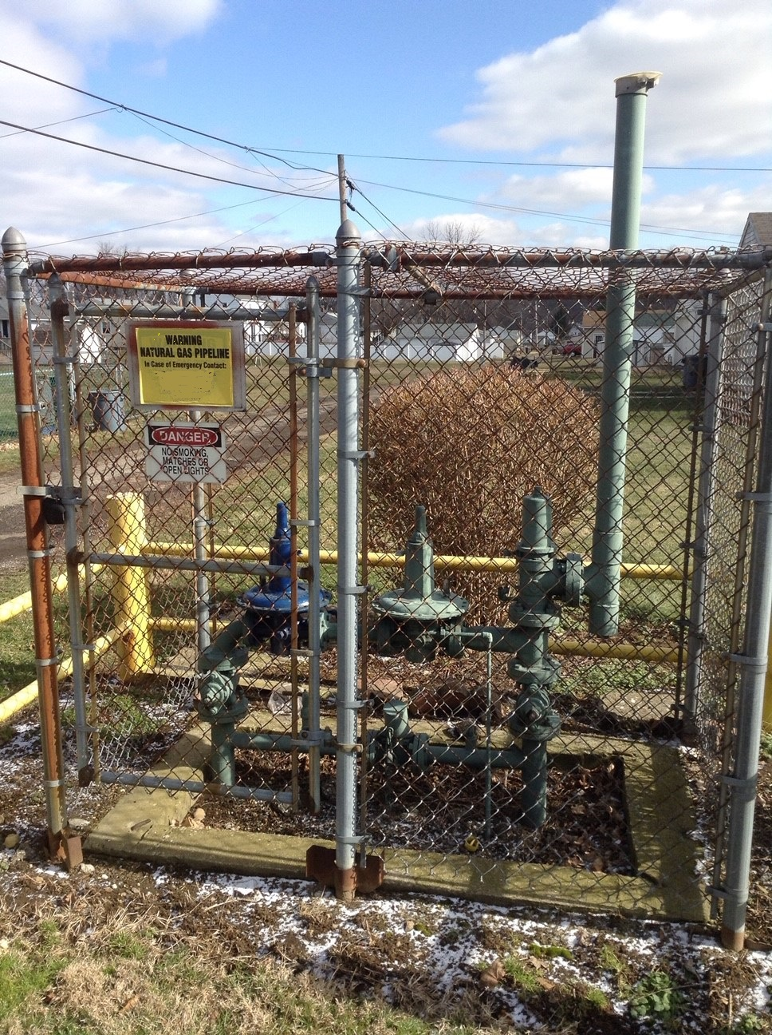

Slide 9
Recommended Best Practices Station Design
Design systems to minimize response time. Consider system design that allows for remote control.
Design to minimize possibility of common failures:
  Protect sensing lines
  Design to minimize possible vent line and relief valve obstructions
  Mitigate possible gas contamination / fluids

Slide 10
Recommended Best Practices Operations & Maintenance
Complete records and drawings should be retained and documented. Know where your buried control lines are.
Remote monitoring and alarms are nice but may not allow you to react quickly enough.
Excavation in the vicinity of buried control lines should be identified as a higher priority call ticket.
Additional precautions when planning and performing tie-ins and uprates.

Slide 11
Recommended Best Practices Operations & Maintenance
Written procedures for maintenance tasks. Training should explain why the procedures say what they say. Procedures should be followed.
Monitor pressure during procedures
Ensure valves are in working order prior to beginning work
Conduct a pre-job briefing
Be aware of work that could create debris
Consider a lock-out/tag-out program

Slide 12
Recommended Best Practices Construction
Projects should be planned, reviewed by a qualified person with knowledge of the system.
Employees with system expertise should attend design/construction prep meetings when appropriate.
Verify correct location of control lines, services and mains, mark the work site
Keep projects to a manageable size
Clear delineation of authority during work – who is in charge of what?

Slide 13
Recommended Best Practices Records Management
Have a documented process for creation, collection, identification, distribution, and storage of records.
Precise location information is important
Update maps and records in a timely fashion for both as-built markups and field changes
Make maps and records available for engineering, construction, and maintenance personnel

Slide 14
LP Systems – Past Incidents
Burlington IA – excavation damage to control lines
Gary IN – Improper operation of a separation valve between a LP and a MP system.
Centralia MO – excavation damage to control lines

Slide 15
LP Systems – Past Incidents
East Boston MA – regulator failure when a vault filled up with water.
Chicago IL – no one was monitoring downstream pressure during a regulator inspection.
Fairport Harbor OH – regulator failure due to pipeline fluid buildup in monitor regulators.

Slide 16
Upcoming PHMSA Rule Amendments
Transmission / Gathering Rule expected to be released this year. Broken into 3 parts.
NPRM – Valve installation and Minimum Rupture Detection Standards (NPRM projected date 8/7/19)
NPRM – Gas Pipeline Regulatory Reform. Amend Regulations to ease regulatory burdens on construction and operation of pipeline systems. Pub date 8/14/19, comment period till 10/14/19

Slide 17
Upcoming PHMSA Rule Amendments
ANPRM for Class Location Requirements – perform IM measures when class location changes instead of reducing pressure, pressure testing, or replacement. Comments in 10/1/18
Plastic Pipe rule – current stay of enforcement
Farm Taps – potential stay of enforcement
Underground Storage Facilities – goal for final rule is publish 7/2/19, effective 8/2/19
Enhanced Emergency Order Procedures – final rule effective date 4/19/19

Slide 18
Gas Transmission / Gathering – In Development
Response to Congressional mandates in the 2011 Pipeline reauthorization act.
NPRM released 3/15/2016
PHMSA received over 400 comments
Rule went through a period of revision and modification
PHMSA is breaking the rule into 3 parts

Slide 19
Gas Transmission / Gathering – Part 1 (expected July 2019)
Expanded record requirements
MAOP reconfirmation
Material verification
Expansion of IM assessments outside of HCA’s and other related issues

Slide 20
Gas Transmission / Gathering – Part 1: Records Requirements
Operators must acquire and retain for the life of the pipeline the original steel pipe manufacturing records – for yield strength, tensile strength, and chemical composition of materials.
Operators must make and retain for the life of the pipeline records documenting pipe design to withstand external pressures and loads in accordance with 192.103 and determination of design pressure in accordance with 192.105.

Slide 21
Gas Transmission / Gathering – Part 1: MAOP Reconfirmation
Piping without records needed to establish MAOP per 192.619 (a) through (e) must reconfirm MAOP if it is in a HCA or Class 3, 4 location.
Pipe segments with a past pressure test meeting Subpart J and records demonstrating compliance with 192.619(a)(2) do not require reconfirmation.
Methods are pressure reduction, pressure testing, “engineering critical assessment”, pipe replacement
Less restrictive pressure reduction criteria specified for low stress piping.
Covered in a new 192.624.

Slide 22
Gas Transmission / Gathering – Part 1: Material Verification
Applies to same piping as MAOP reconfirmation
Should be an “opportunistic sampling approach”
Verify material properties as opportunities present themselves during the course of normal operations and maintenance
Allows for non-destructive testing where feasible
Covered in a new 192.607

Slide 23
Gas Transmission / Gathering – Part 1: IM Expansion
Expansion of risk assessment obligation to include areas in non-HCA’s and Moderate Consequence Areas (MCA).
MCA includes a Potential Impact Radius (PIR) containing 5 or more residences, or an Occupied Site.

Slide 24
Gas Transmission / Gathering – Part 1: other changes
6 month grace period for 7-calendar year IM reassessment intervals
Consideration of seismicity for IM assessments
MAOP exceedance reporting
Codifies some of the risk modeling requirements in B31.8S
Provides guidance on Guided Wave Ultrasonic Testing (GWUT).

Slide 25
Gas Transmission / Gathering – Part 2 (December 2019)
Adjustments to repair criteria for pipelines in HCA’s and non-HCA’s.
Inspections following extreme weather events
Corrosion control improvements (DCVG/ACVG gradient survey for new construction, CIS for low reads, interference surveys around HVAC power lines, internal corrosion monitoring)
More detail to Internal Corrosion control requirements.

Slide 26
Gas Transmission / Gathering – Part 2 (December 2019)
Safety features on in-line inspection launchers and receivers
Management of change requirements as outlined in ASME B31.8S
Other IM clarifications and increased assessment requirements

Slide 27
Gas Transmission / Gathering – Part 3 (December 2019)
Reporting requirements for Gathering lines
MAOP and leak repair for all Gathering
Safety regulations extended to some gas gathering lines in Class 1 locations. Requirements are basically the same requirements as in the Ohio Gas Gathering rule. Type of piping it applies to may be different (focusing on pipe diameter and pressure)
Gathering related definitions

Slide 28
Plastic Pipe Rule
Originally effective Jan 22, 2019
AGA requested a stay of enforcement due to concerns about the availability of certain components and for time to develop procedures for weak links, plastic pipe storage and handling, and pipe fusion equipment maintenance & upkeep
Rule will be phased in over the next year

Slide 29
Plastic Pipe Rule
Highlights
PE pipe can have a design pressure of up to 125 psig, PA-11 and 12 pipe up to 250 psig for certain manufacture dates, pipe size, wall thickness, material specification.
Design requirements for plastic risers.
Requirement that mechanical joints and fittings be able to resist pullout force (“category 1”)
Pipe pulled through the ground must use a “weak link”

Slide 30
Plastic Pipe Rule
Highlights
May not use mechanical leak repair clamps as a permanent repair on plastic pipe
Must have written procedures for the storage and handling of plastic pipe
Have to maintain joining equipment in accordance with written procedures and/or manufacturers recommendations.

Slide 31
Findings from Field Inspections
Most common violations found:
  192.13(c)/605 Not following procedures in the field.
  192.805 Operator Qualifications
  192.479/481 Atmospheric Corrosion
  Various code sections associated with External Corrosion monitoring and prevention
Other items for discussion:
  Fusion joint documentation
  DIMP requirement for system knowledge
  Drug & Alcohol

Slide 32
Notes on OQ
Findings from the NY state program regarding East Harlem explosion in 2014:
  Operator accountability lacking for all individuals working on their system (i.e. operators don’t know what some their contractors are being taught).
  OQ training does not focus on the performance of covered tasks using specific operator procedures and operator equipment.
  Too much reliance on written examinations, inadequate operator oversight of exams.
Our environment is different, but we can learn some things from their experience.

Slide 33
Incident Trends
What do incident trends tell us about pipeline safety threats?
  Excavation Damage is still the top threat for Distribution piping. Other Outside Force Damage (i.e. cars) are close behind.
  Material/weld/joint failure and Corrosion are the top threats for Transmission lines
  For Transmission lines in eastern Ohio, soil shifting and landslides are a significant risk.

Slide 34
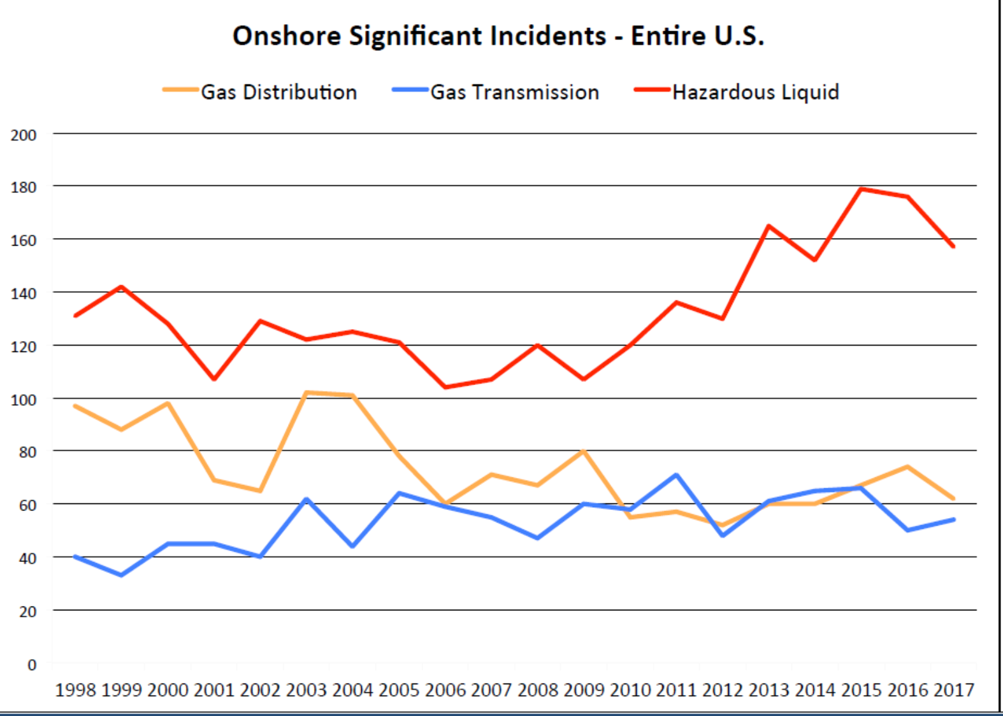

Slide 35
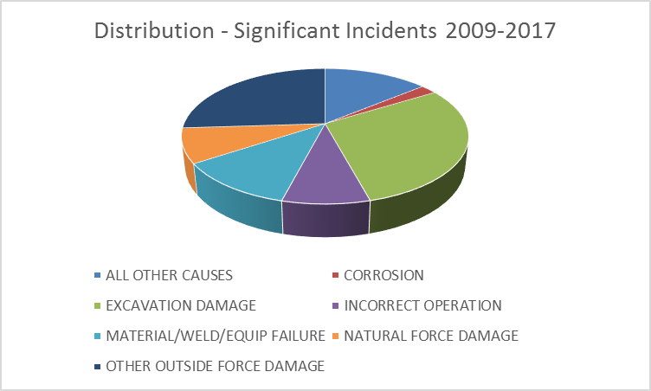

Slide 36
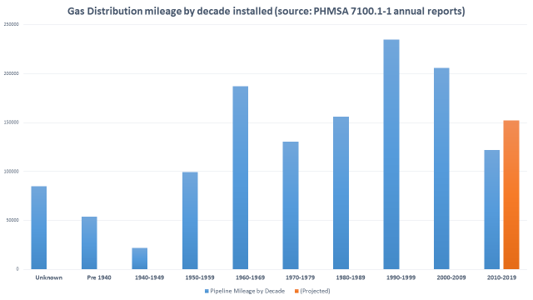

Slide 37
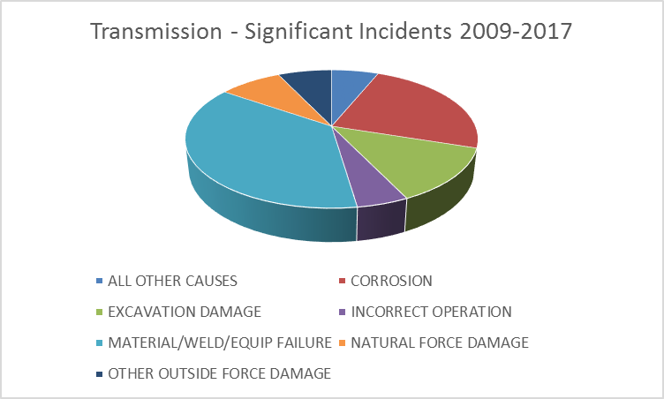

Slide 38
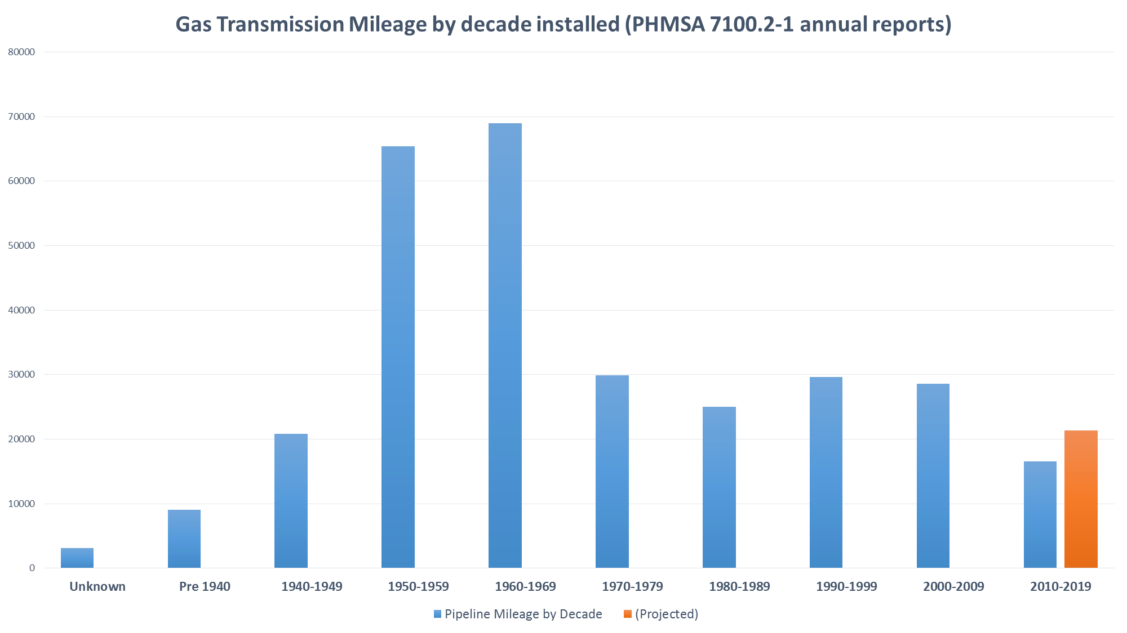

Slide 39
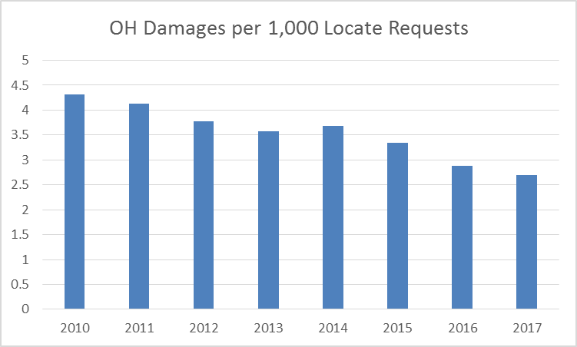

Slide 40
Annual Report – Excavation Damages

Slide 41
Statewide Trends
Statewide root causes (2015-2017):
  One Call practices not sufficient 23%
  Locating practices not sufficient: 35%
  Excavation practices not sufficient: 36%
  Other: 6%
Categories can and should be broken down more finely. Ex: Common Ground Alliance DIRT report.

Slide 42
From DIRT Field Form

Slide 43
Questions?
Pete Chace
(614) 644-8983
Peter.chace@puc.state.oh.us

