Slide 1
Natural Gas 101 & Market Update
OGA Technical Conference
Columbus, OH
March 21, 2019

Slide 2
© Copyright 2019 CenterPoint Energy
The material contained in this report is provided to recipients for general information purposes only and is not intended to provide advice to, or suggest action by, any recipient.
CenterPoint Energy makes no representations or warranties with respect to the accuracy, validity or suitability of purpose of the information contained herein.
CenterPoint Energy assumes no liability for any errors or omissions in content, or for any actions taken in reliance thereon.
Recipients are strictly prohibited from photocopying or distributing this report or the information contained in it to third parties without the express written permission of CenterPoint Energy.
CenterPoint Energy, P.O. Box 2628, Houston, Texas 77252-2628.
disclaimer

Slide 3
Natural Gas 101 & Market Update – Key Topics
Natural Gas 101
Review of the 2018 – 2019 Winter and Current Storage Update
Supply Overview
Demand Overview and Outlook
2019 Summer Outlook
Natural Gas Price Update and Outlook
Notes:
Review of the 2018 – 2019 Winter and Current Storage Update
What impact did the storage deficit and regional market area deliverability issues have on NG prices this winter?
Supply Overview and Status Update on Pipeline Projects
How high is the domestic production ceiling?
A plethora of pipeline projects prepares production for a pathway home, but will postponements in construction prop up prices?
Demand Overview and Outlook
This is the dawning of the Age of Exports
2019 Summer Outlook
Record production will battle summer weather and growing demand (exports) for market supremacy
Natural Gas Price Update and Forecasts
Will NG Futures escape from the captivity of a range bound market?

Slide 4
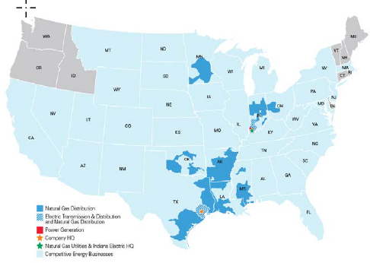



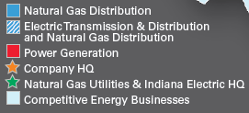
CenterPoint Energy is one of the largest combined electric and natural gas delivery companies in the U.S.
CenterPoint Energy is one of the largest combined electric and natural gas delivery companies in the U.S.
Asset portfolio (2019)
Electric transmission and distribution
Natural gas distribution
Pipeline and field services partnership
Competitive natural gas sales and services
CNP Footprint
  7 million metered gas and electric customers
  Regulated operations in 8 states
  Natural gas sales and service in over 40 states
  Nearly 14,000 employees
  $29 B assets (2019), $9.6 B revenue (2017)
  Investment grade ratings – Moody’s, Fitch, S&P
  NYSE: CNP – Dow Jones Utilities Index
  Headquartered in Houston, TX
  Website: www.CenterPointEnergy.com
Notes:
First, I will provide a brief overview of CenterPoint Energy Services
We are a wholly owned subsidiary of Houston based CenterPoint Energy, one of the largest combined gas and electric utilities in the U.S.
CNP serves more than 7 million gas and electric customers across 8 states and has more than $29 B in assets.
CES serves more than 33,000 commercial, industrial, utility and power generation customers and 60,000 + residential in 40 states.

Slide 5


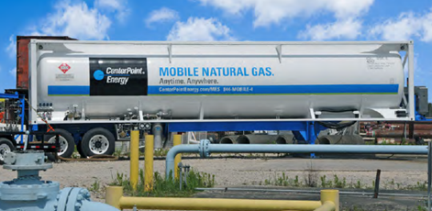
Our Energy Services
Natural Gas Supply
Pipeline Construction & Infrastructure
Mobile Energy Solutions®
CenterPoint Energy Services (CES)
CenterPoint Intrastate Pipelines (CEIP)
Mobile Energy Solutions (MES)
  Transports 1.2 Tcf/year across more than 90 pipelines to more than 175 gas utility systems
  Proud recipient of the 2018 Mastio Quality Award.
  Operates 68 pipeline laterals, delivering 55 Bcf/year to 178 delivery points
  Provides turnkey engineering, construction, maintenance & financing for pipeline projects
  Avoid natural gas supply interruptions with CNG or LNG
    Planned pipeline outages
    Emergency outages
    Curtailment/Peak demand
*2018 Mastio Customer Satisfaction Survey
Notes:
Mobile Energy Solutions, Inc. – a sub-entity of CES – is a turnkey service provider of temporary natural gas services.
MES operates trailer-mounted gas supply for both emergency and planned natural gas outages with the ability to go anywhere in the United States.
MES provides natural gas using compressed natural gas (CNG) or liquefied natural gas (LNG).
This service is valuable when aging natural gas infrastructure needs repair or testing. It also can be used for winter peak supply, equipment and facilities commissioning, and more.
MES customers include residential, utilities, commercial/industrial facilities, pipelines, natural gas equipment manufacturers, building and construction industry.

Slide 6


CES receives 2018 Mastio Quality Award
CenterPoint Energy Services
Ranked #1 Major Natural Gas Supplier
This achievement is awarded for excellence in :
Reliability of supply
Customer service
Account Management
Exceeding Industry Benchmarks and overall Customer Satisfaction

Slide 7
Natural Gas 101

Slide 8
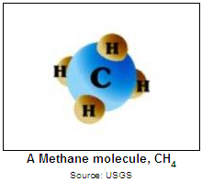


What is Natural Gas?
Webster’s defines Natural Gas as gas issuing from the earth’s crust through natural openings or bored wells especially a combustible mixture of methane and other hydrocarbons used chiefly as a fuel and raw material.
Natural gas is a colorless, odorless, shapeless gas in pure form.
Composed primarily of methane, it can also include ethane, propane, butane, and pentane.
Natural gas is believed to have formed from the decomposition of plants and animals
It is the cleanest and most efficient fossil fuel.

Slide 9
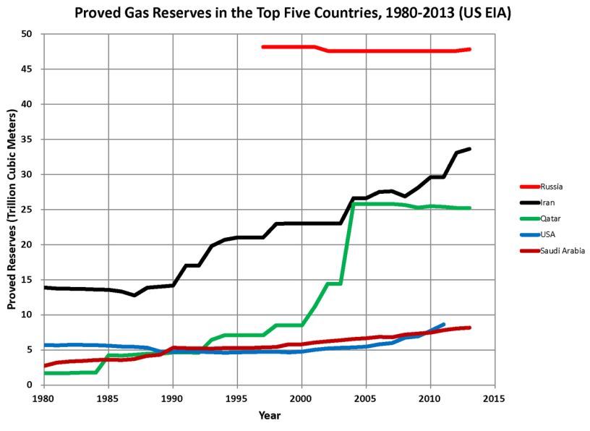
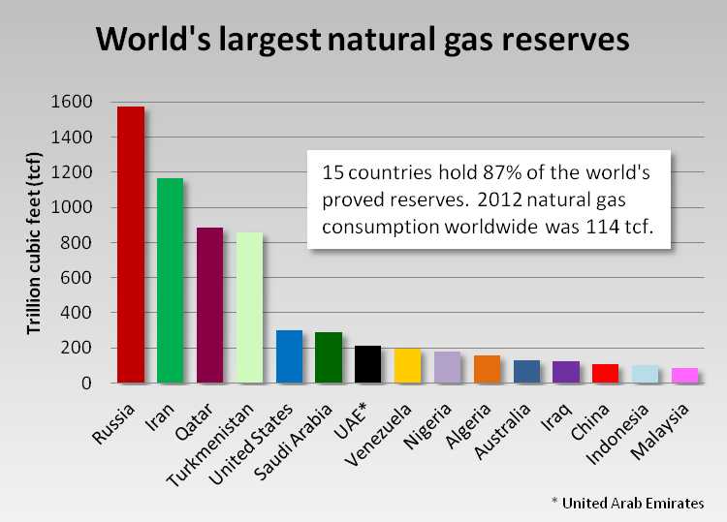
Where does natural gas come from?
Gas reserves are estimated quantities of natural gas that are recoverable in future years.
The major supply regions in the U.S. include the Gulf Coast, Permian, San Juan, Rocky Mountain, Mid-Continent, Pacific Coast, Eastern, and Appalachian in the U.S. and the Western Canada and Scotian Shelf (Southwest of Nova Scotia) in Canada.
Natural Gas supply in the United States comes from off-shore (traditional) drilling, on-shore drilling, shale production, LNG imports, Canadian imports as well as methane extraction from landfills.

Slide 10

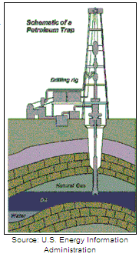
Gas Extraction
Once a reservoir has been discovered, a decision has to be made regarding whether or not it is economically feasible to tap into the particular reservoir.
The actual drilling itself is performed by driving a metal bit through the ground and if this does in fact come into contact with natural gas deposits, the well is developed to allow for the extraction of gas.
Equipment is thus installed to meter the flow of gas to the surface.

Slide 11
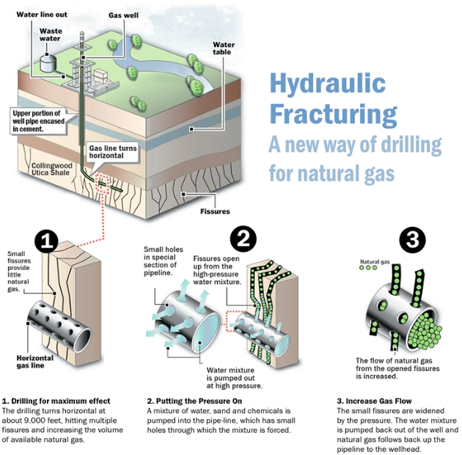
Gas Extraction-Fracking
Fracking is the process of drilling down into the earth before a high-pressure water mixture is directed at the rock to release the gas inside. Water, sand and chemicals are injected into the rock at high pressure which allows the gas to flow out to the head of the well.
Fracking dates back to the 1860’s, when Colonel Edward Roberts filed a patent for the “Exploding Torpedo”
Over the years, numerous innovations pushed fracturing forward, but it took George P. Mitchell in the 90’s to bring about what we know today as Modern Fracking.
Mr. Mitchell combined hydraulic fracturing with horizontal drilling to create the Shale Revolution.
Notes:
I remember around 2008 or so I attended an OGA conference and one of the speakers said that this shale gas thing might end up being something…

Slide 12
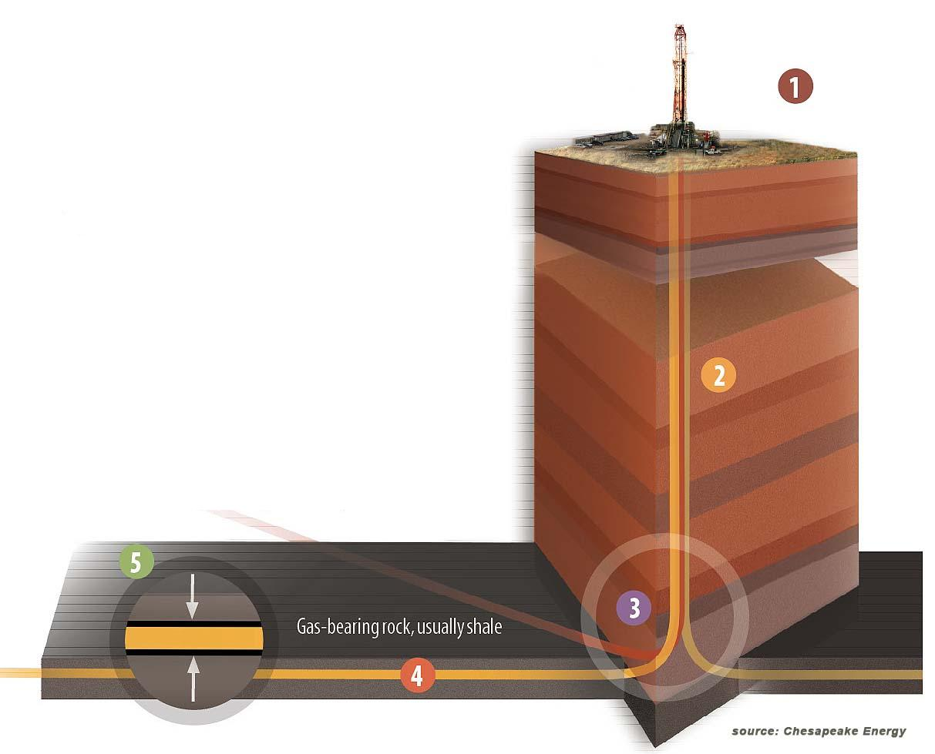
Gas Extraction-Fracking
1
Prepare drill site
2
Drill vertical portion of well using conventional methods.
3
Drill curved section with the use of a motor mounted above the bit.
4
Drill horizontal wellbore
5
High pressure fluid injected into shale formation – “fracking”

Slide 13
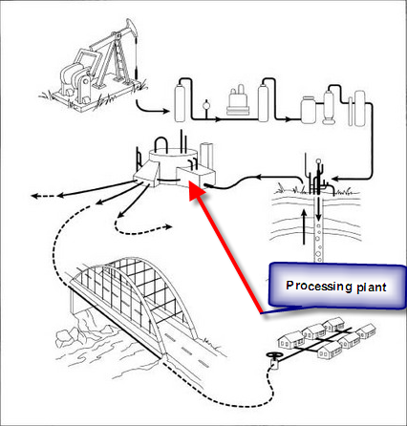

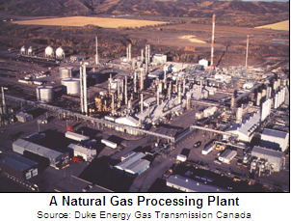
Processing
After gas flow has been established, the processing must begin.
Because natural gas underground is much different than that found in our homes and businesses, it must then be piped via gathering pipelines to a processing plant where various fluids and additional hydrocarbons are removed.
After gas is purified and the natural gas liquids (NGL’s) are removed, the gas can then move on to the transmission system.

Slide 14
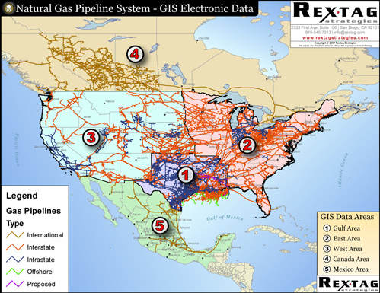
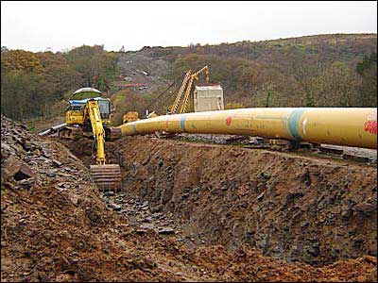
Gas Transmission Pipelines
The transmission system is responsible for moving large quantities of gas over long distances.
This system is composed of a complex network of pipelines that are designed to take natural gas to areas of high demand.
There are intrastate pipelines that simply carry gas within a state, but the interstate pipeline system carries gas across the country.
Pipelines can measure anywhere from 6 to 48 inches in diameter.
There are over 300,000 miles of transmission lines.

Slide 15
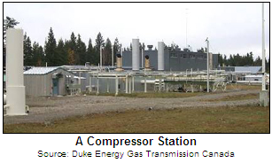
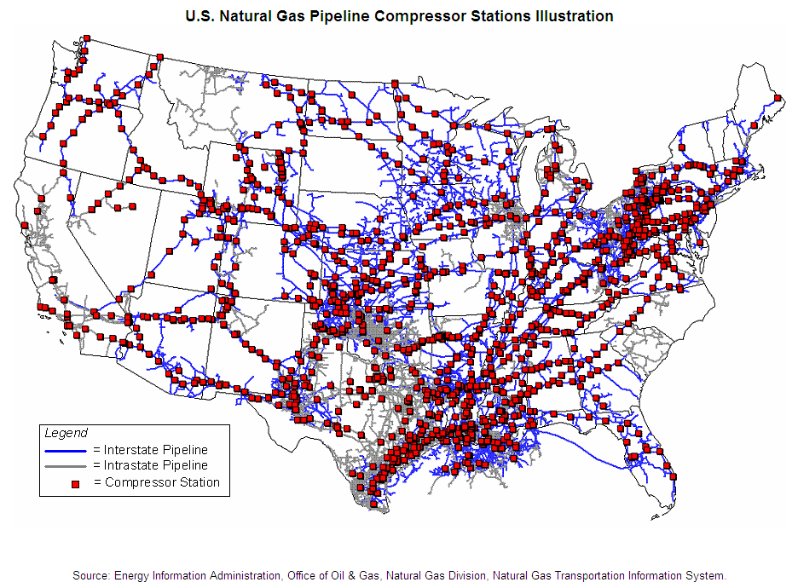
Compression
Natural gas is highly pressurized as it travels through an interstate pipeline; generally between 600 and 1,200 psi.
Pressures range from 60 psi to ¼ psi as it reaches a home or small business.
To accomplish this, compressor stations are located along the pipelines where gas enters and is compressed either by a turbine, motor, or engine.

Slide 16
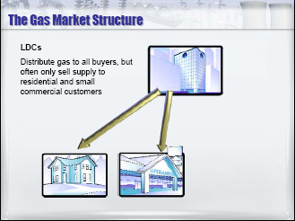
Local Distribution Companies (LDCs)
Your Utility, Municipal System, or Local Distribution Company (collectively referred to as LDC) moves gas supply from supply sources to your burner-tip/plant.
Traditionally, LDCs have offered bundled service which is a combination of transportation and purchasing price.
LDC’s subscribe/contract with pipelines for capacity (space in the pipe) to move gas and storage (space in the ground) to store gas. Contracts for capacity/storage are long-term contracts (normally 5, 10, or 15 year contracts).
There are about 1,200 natural gas distribution companies in the U.S.

Slide 17

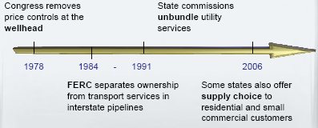
Gas Deregulation
Deregulation refers to the restructuring of rates and rules regulated companies to allow competitive forces to come into play.
Gas sales to retail customers have been opened to competition.
Deregulation has resulted in unbundling of services.
Distribution and commodity services are split into two separate and distinct services that can be provided by different entities.

Slide 18
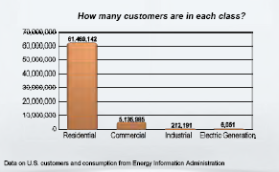
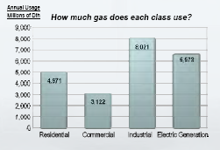
End Users
  Residential
    Including houses, condos, apartments and mobile home parks
  Commercial
    Including stores, offices, schools, restaurants, hospitals, clinics, and most government facilities
  Electric Generation
    Power plants that use natural gas as a fuel to generate electricity
  Wholesaler Customers
    Customers such as Utilities and Marketers who don’t consume gas themselves, but repackage it to provide services to their customers

Slide 19
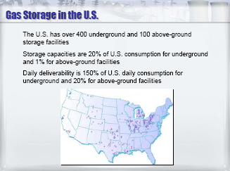
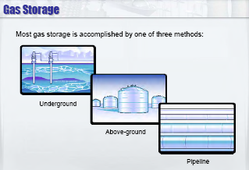
Gas Storage
Reasons for storing gas include:
  Demand and prices vary over time
  More efficient to produce and transport steady quantities
  Market area demand peaks can be served
Gas may be stored in either the supply region or the market region
  Supply area storage allows producers to balance production with pipeline capacity and demand.
  Market area storage allows gas utilities and marketers to match customer demand to cost effective transportation and supply alternative.

Slide 20
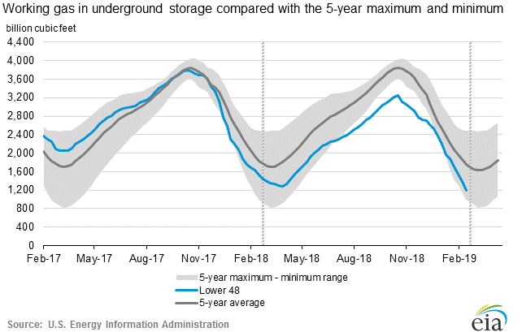
Gas Storage

Slide 21
Gas Demand
Historically, demand in the gas industry is driven by weather and the general industrial business cycle.
  For many end users, the demand is seasonal with higher demand in the winter due to colder temperatures.
Other drivers of demand include:
  Gas Fired Generation
  LNG Exports
  Mexico Exports

Slide 22
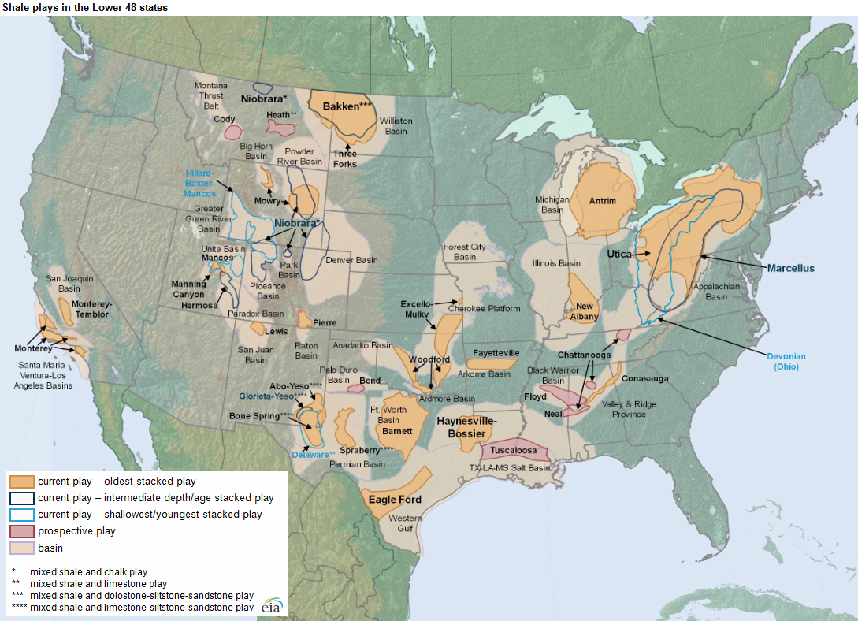
Marcellus & Utica
Marcellus/Utica

Slide 23
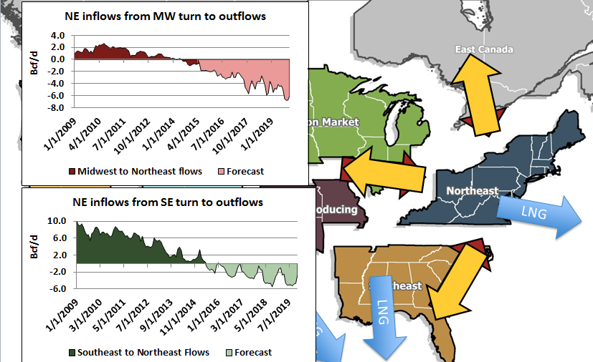

Gas Supply - Shift in Physical Gas Flows
Notes:
The key to this slide is the flow of gas has been turned upside down with the onset of fracking and the shale revolution

Slide 24
Gas Pipeline Transportation
Pipeline Services
  Firm Transportation (FT)
  Interruptible Transportation Services (IT)
  Storage
  No-Notice Balancing
Pipeline Transportation Contract Rates Structures
  Demand or Reservation Charges
    Billed on a monthly basis in order to reserve capacity on the pipeline. This charge is billed regardless of the contract’s actual usage.
    Charged on the Maximum Daily Quantity for the particular month, season, or year.
  Fuel Charges
    Part of a pipeline’s rates that requires an additional volume of gas to be purchased at the receipt zone in order to fuel the pipeline compressor stations for delivery downstream.
  Commodity Charges
    Portion of the pipeline charges that are incurred as the space is used.

Slide 25
Gas Pipeline Transportation
Scheduling, Balancing, and Nominations
  In order to move and transport natural gas from one point to another, a variety of coordinated activities must be undertaken. Pipelines need to be notified daily of expected volumes at receipt and delivery meters via electronic bulletin boards.
  Pipelines have multiple restrictions on the logistics of natural gas flows on their systems which require strict adherence to avoid scheduling and balancing penalties.

Slide 26
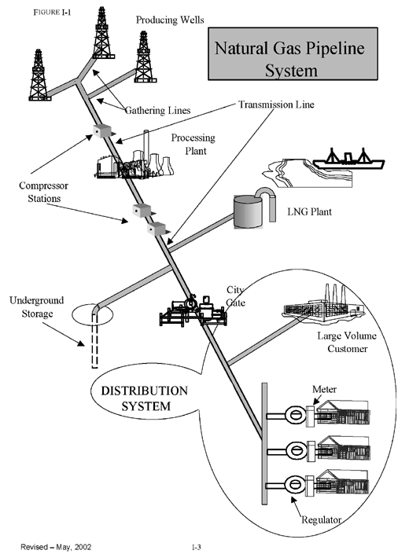
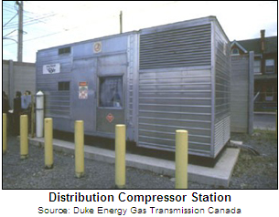
Distribution
Distribution is similar to transmission, but involves smaller volumes at lower pressures, to a great number of end-users
The distribution systems are joined to transmission pipelines at an interconnect
The system consists of pipe, small compressors, regulators, valves to control flow, metering units to measure flow, and a system that allows for the monitoring and control of the various components
There are 1.9 million miles of local utility distribution pipes

Slide 27
Pricing
Various factors influence the price of natural gas at any given location.
Generally speaking, the price is determined by supply and demand including perceptions of the future balance of supply and demand.
Key factors also include: number of buyers, projections for future supply and demand, weather, the amount of gas in storage, the projected cost of future supply, market alternatives for suppliers, supply alternatives for buyers, transport constraints, and general market psychology.
In today’s fast-paced market, price volatility is often experienced on a daily basis.
  The commodity price is so volatile because it is a market price, not a regulated price.

Slide 28
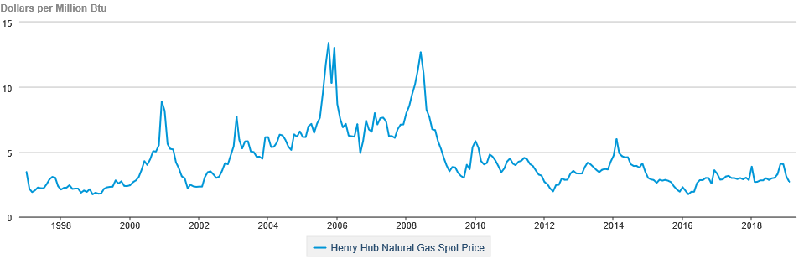
Pricing

Slide 29
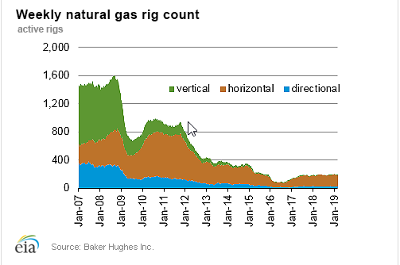
Pricing

Slide 30
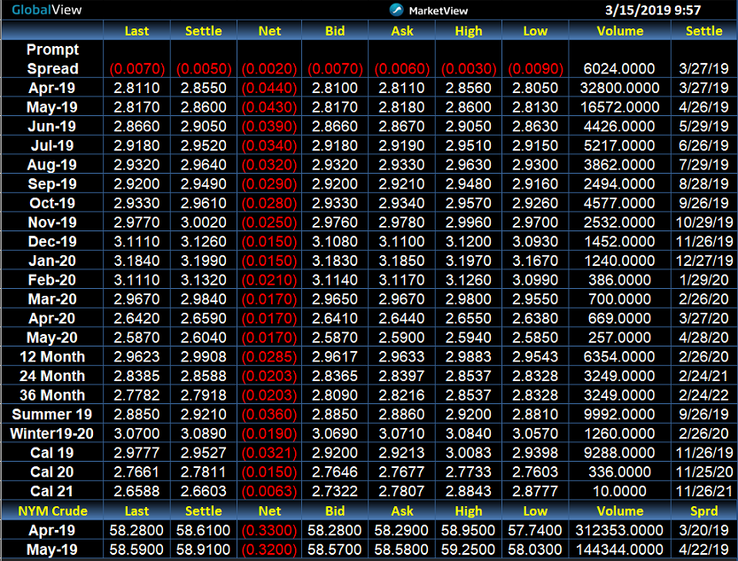
Pricing

Slide 31
Gas Marketing
Before deregulation, there was not a role for natural gas marketers.
  Marketers are a relatively new addition to the gas marketplace.
Marketers sell natural gas as a commodity.
Marketing can be referred to as the process of coordinating, at various levels, the business of delivering natural gas from the wellhead to end users.
Successful marketers add value by saving producers and end users the trouble of finding each other, arranging transportation and storage, and even arranging financing or assuming price risk.

Slide 32
Units and Conversions
Mcf = Thousand Cubic Feet
MMcf = Million Cubic Feet
Btu = British Thermal Unit
MMBtu = Million Btu
GJ = gigajoule (metric measure of energy)
Dth = dekatherm
1 therm = 100,000 Btu
1 Dth = 10 therms
10 therms = 1 MMBtu
1,000,000 Btu = 1 MMBtu
1 Dth = 1MMBtu
1000 Mcf = 1 MMcf
1000 MMcf = 1 Bcf
1 MMcf = 1.07 MMBtu*
1 GJ = .95 MMBtu
  *This conversion rate varies with the energy content of the gas

Slide 33
Glossary
Balancing – The act of matching volumes of gas received by a pipeline or LDC to the volumes of gas removed from the pipeline or LDC at the delivery point
Bid week – The period near the end of each months when the bulk of contracts for monthly gas supply for the following month are finalized
British thermal unit (Btu) – The quantity of heat required to raise the temperature of one pound of water by one degree Fahrenheit
Burnertip – The point where gas is consumed
Citygate – The point at which gas is received into the LDC distribution system
Compressor – Machinery used to increase the pressure of natural gas on a pipeline system
Demand charge – Also known as a reservation charge, the portion of a transportation or storage rate that reserves space on the facility, and is based on contract quantity (paid regardless of whether or not service is taken.) For end-use rates, the demand charge refer to a charge based either on contract quantity or the maximum demand experienced in a given billing period.
Fracking – The process of drilling down into the earth before a high-pressure water mixture is directed at the rock to release the gas inside. Water, sand and chemicals are injected into the rock at high pressure which allows the gas to flow out to the head of the well.

Slide 34
Glossary
Futures contract – A supply contract between a buyer and seller where the buyer is obligated to take delivery and the seller is obligated to provide delivery of a fixed amount of commodity at a predetermined price and location. Futures are bought and sold through an exchange such as NYMEX
Hedge – The initiation of a transaction in a physical or financial market to reduce risk.
Henry Hub – A pipeline interconnect in Louisiana where a number of interstate and intrastate pipelines meet. The standard delivery point for the NYMEX natural gas futures contract.
Imbalance – The discrepancy between the amount a customer contracts to transport or consume and the actual volumes transported or consumed
Index – A calculated number designed to represent the average price of gas bought and sold at a specific location.
Injection – The process by which natural gas is forced back into a reservoir for storage purposes.
Liquefied natural gas (LNG) – Natural gas that has been chilled to the point that it liquefies. LNG is used as a means to store and transport natural gas.
Load factor – The ratio of the amount of gas used over a period of time in comparison to the maximum amount the customer can use.

Slide 35
Glossary (cont.)
Local distribution company (LDC) – The regulated distribution company that moves natural gas from the interstate pipeline to end-use customers and often provides bundled gas supply service to residential and small commercial customers
Natural gas – A combustible gaseous mixture of simple hydrocarbon compounds, primarily methane
Nomination – A request to transport a specific quantity of gas on a specific day under a specific contract
NYMEX – New York Mercantile Exchange, the organization that provides the market for trading of natural gas futures and options
Operational Flow Order (OFO) – An order by a pipeline to users of natural gas to restrict usage in order to maintain the integrity of the system.
Peak – The period of a day, week, month, or year when demand is at it’s highest
Peak Load – The maximum demand for gas in a given period of time (usually monthly or annually).
Rate base – The net investment in facilities, equipment and other property a utility has constructed or purchased to provide utility service to its customers.
Receipt point – The point on a pipeline system at which gas is taken into the system.
Reserves – The quantity of natural gas existing in underground formations.

Slide 36
Glossary (cont.)
Scheduling – The process of confirming nominations and, if necessary, using priority rules to determine which gas can flow under system constraints.
Shipper – Any party that contracts with a pipeline for the transportation of natural gas and retains title while it is transported
Spot market – The short-term market for natural gas.
Storage – A means of maintaining gas in reserve for future demand, either through injection into a storage field or by holding it within the pipeline (known as line packing).
Tariff – All effective rate schedules for a pipeline or LDC, along with the general terms and conditions of service
Therm – A unit of heating value. One therm is equivalent to 100,000 Btu.
Transmission – The process of transporting large volumes of natural gas over long distances.
Usage charge – A component of a pipeline’s or LDC’s rate structure charged on a per unit of usage
Well – The hole drilled into the earth’s surface to produce natural gas
Working Gas – Natural gas in a storage field.
Zone rates – Rates based on the distance gas is transported.

Slide 37
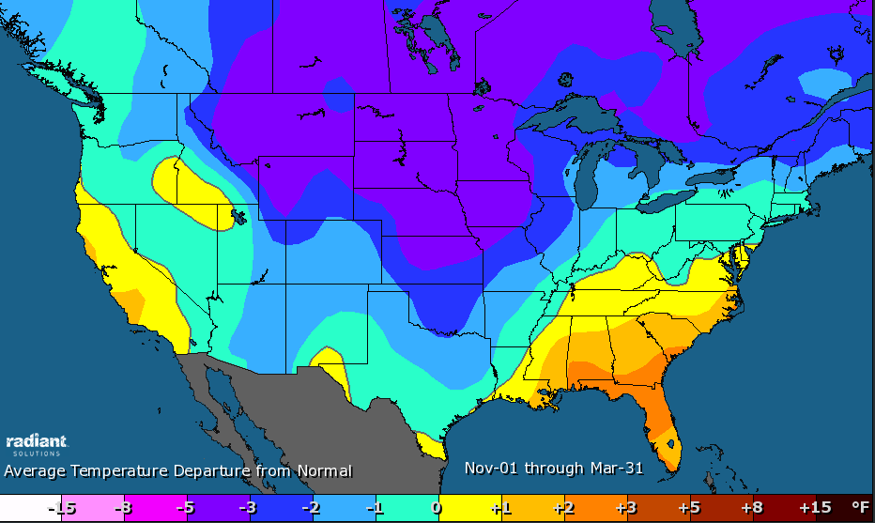
Nov18-Mar19 Weather Review
Gas-weighted Heating Degree Days
2018-2019 | 10-Year Normal | 30-Year Normal
3883 | 3685 | 3798
2018 | 2017 | 2016
3705 | 3293 | 3221
Through mid-March, the weather data shows that the Nov 18 – Mar 19 has been colder than normal, especially in the North Central
Cold weather in late February and early March has put additional pressure on the natural gas storage balance
Sources: RADIANT SOLUTIONS
Notes:
65 degrees is the base and any deviation higher or lower is a degree day so if temperature is 34 degrees, then the HDD total would be 31 HDD. If temp is 78 degrees, then the CDD would be 13 CDD.
Through mid-March, the weather data shows that the Nov 18 – Mar 19 has been colder normal, especially in the North Central
This winter is expected to produce a total of 3,883 gas weighted HDD’s which would exceed last year (3,705 HDD’s). It also would be colder than both the 10-year (5% colder) and 30-year normal levels.
This doesn’t appear on the slide, but in case you were wondering, HDD’s from the 2013/14 Polar Vortex winter totaled more than 4,200.
The North Central and upper-Midwest were the recipients of the majority of the frigid weather this winter, while the Pacific Coast and the Southeast and Mid-Atlantic basked in the glory of warmer-than-normal temps.
The Polar Vortex that plunged southward from Canada in late-January sent temps across the Consuming Regions of the U.S. well-below zero and sent gas demand to an all-time record-high daily total of 150.6 Bcf on January 31st.
Concerns over NG inventory levels have reemerged as a result of cold weather in late February and early March, and historically, the bitter cold and expanding storage deficits would typically result in a significant rally for NYMEX NG Futures.
Let’s just say that this isn’t your grandfathers NG market because NG Futures prices have fallen back into a familiar range between $2.70 and $3.00.

Slide 38
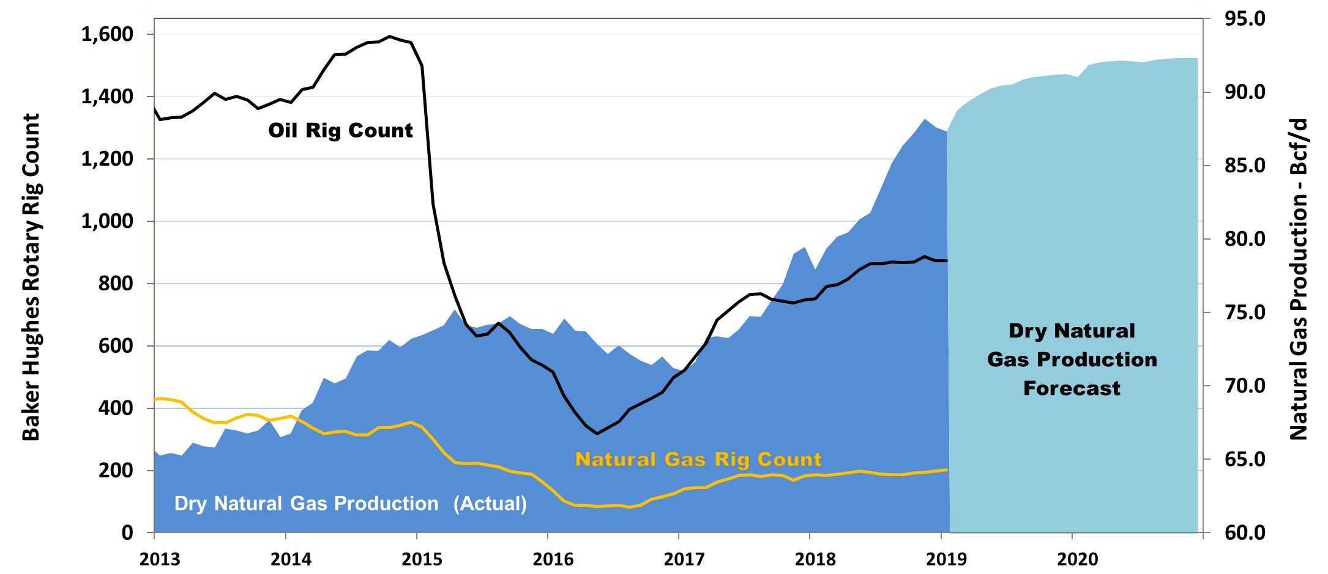
Production and Rig Counts
U.S. dry gas production averaged approximately 82 Bcf/d for 2018 after averaging 74 Bcf/d in 2017.
Production currently stands at 85 Bcf/d and is expected to climb above 90 Bcf/d by the end of 2019, and surpass 92 Bcf/d by end of 2020
After reaching a recent low of 404 rigs in May 2016, total rig count has rebounded to over 1,000 rigs primarily driven by growth in oil rigs
Sources: EIA: Short Term Energy Outlook, Baker Hughes
Notes:
Since 2014, U.S. gas production has increased by 20 Bcf/d, or 30%, from 65 Bcf/d to 85 Bcf/d in 2018
U.S. dry gas production averaged approximately 82 Bcf/d for 2018 vs. 74 Bcf/d in 2017
Production currently stands at 85 Bcf/d and is expected to grow more than 5 Bcf/d to nearly 90 Bcf/d by the end of 2019. Dry gas production is expected to surpass 92 Bcf/d by end of 2020
After reaching a low of 404 rigs in May 2016, total rig count has rebounded to over 1,000 rigs primarily driven by growth in oil rigs
The information in this chart highlights a couple of telling things about the current oil & gas production landscape
First, the dramatic rise in output despite a flattening of the Gas-directed rig count illustrates the technological advancements and efficiency gains that have been made in hydraulic fracturing.
Secondly, the increase in dry gas production in recent years that has occurred during a period in which the gas-directed rig count has declined also shows the magnitude of associated gas production(approx. 40% of all production) in the total supply stack.
But the top production related story over the last 5 years continues to be the Shale Gas Revolution

Slide 39
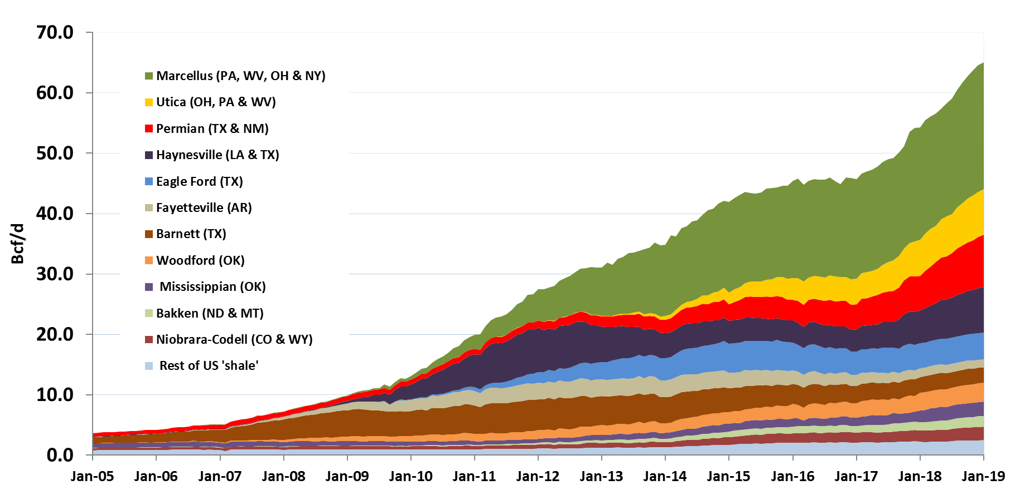
U.S. Shale Gas Production
Shale Gas production now makes up more than 80% of all production in the U.S.
Shale production has risen from 3 Bcf/d in 2006, to 32 Bcf/d in 2014 to 65 Bcf/d at the end of 2018
Marcellus/Utica and Permian will be the primary focus for producers in the near-term
Sources: EIA: Monthly Production Report
Notes:
Shale production has risen from 3 Bcf/d in 2006, to 32 Bcf/d in 2014 to 65 Bcf/d at the end of 2018 and now makes up 80% of all production in the U.S.
Compare this to GOM production that is only 2.8 Bcf/d, just 3% of total production. 20 years ago, production from the GOM made up 20% of total supply
Production growth in recent years has come primarily from 4 regions:
Marcellus, Utica, Permian and Haynesville.
Marcellus/Utica account for 35% of current production, or 28.5 Bcf/d, and posted YOY gains of 4 Bf/d and expected to reach 31.5 Bcf/d by end of 2019
But 2018 was the year of the Permian Basin as production from the region increased by 3 Bcf/d, a 50% increase from one year earlier. Current production = 8.5 Bcf/d and expected to hit 10.5 Bcf/d by end of 2019. Growth in Permian is driven by associated gas from oil production
Haynesville has grown to 8 Bcf/d, but facing headwinds
Current Internal Rates of Return (IRR’s) for production in the regions where the majority of rigs are oil-directed highlights the focus on production in the wet production zones…
Permian 53%, Marcellus and Bakken 48%, Eagle Ford 44%
The benefits of the growing domestic production have been far-reaching, but challenges remain in finding a way to get all of this gas to the market due to inadequate pipeline networks
Permian production growth has been challenged in recent years due to lack of takeaway capacity, allowing the Northeast to continue to post strong results, but things are changing and Haynesville and Northeast/Appalachia could begin to see some slowdown in the production growth as more Permian supply finds it way to the market later this year. In fact, some analysts feel that Northeast production will decline from 2019 to 2020 as a result of the onslaught of associated gas growth from the more oil heavy producing regions.
The Permian is not the only associated gas play on the upward trajectory. Growth is expected in Oklahoma from the SCOOP/STACK and in the Bakken in North Dakota,

Slide 40
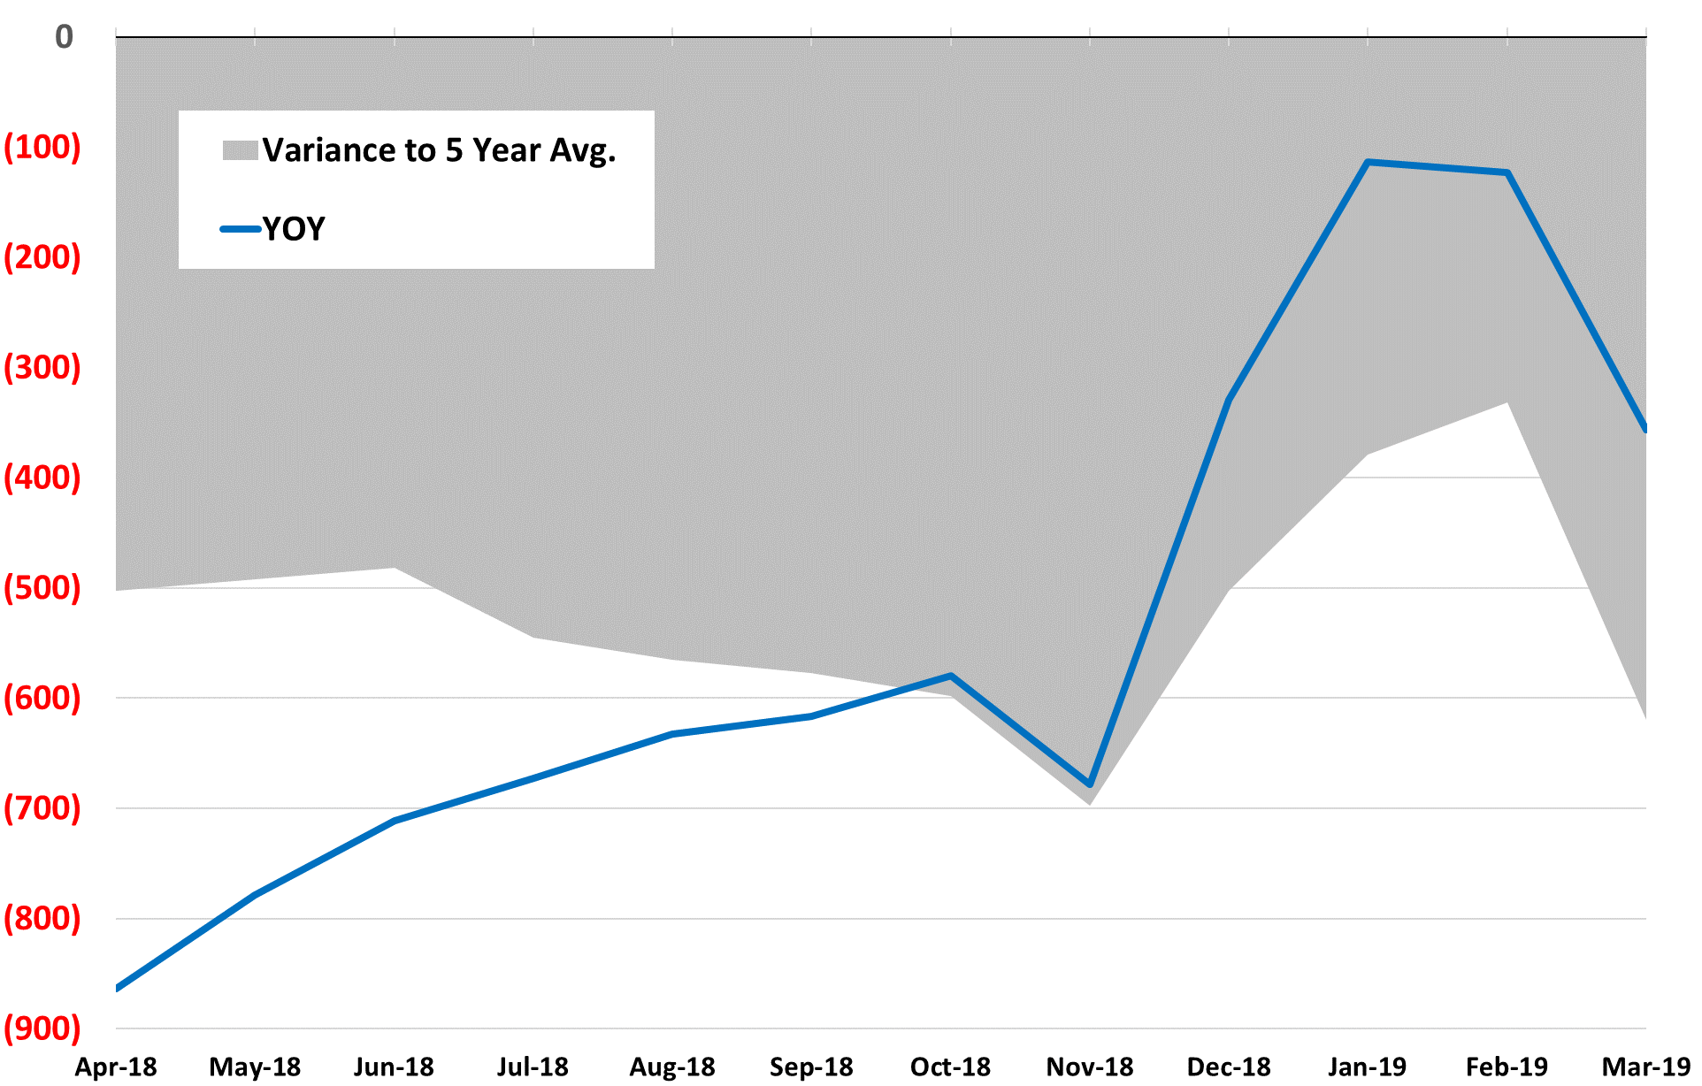
Natural Gas Storage Deficit
Bcf End of Month
Working gas in storage is currently at 1,390 Bcf, a 475 Bcf deficit to the 5-year avg. and 250 Bcf deficit to last year
Last month, EIA forecasted end of withdrawal storage at 1,400 Tcf, which would be 250 Bcf below the 5-year avg.
With the recent cold weather, look for storage to end the winter between 1,000 Bcf and 1,100 Bcf
Notes:
Working gas in storage is currently at 1,390 Bcf, a 475 Bcf deficit to the 5-year average and 250 Bcf deficit to last year
Last month, EIA forecasted end of withdrawal season storage at 1,400 Tcf, which would be 250 Bcf below the five-year average
You can see the reduction in the storage deficits that occurred during December and January as a result of generally mild weather conditions, but with the recent cold weather, expectations for end-of-winter storage have been lowered and I expect levels to dip to between 1,000 Bcf and 1,100 Bcf by April 1st
Later we will take a look at storage projections for the summer injection season but let’s first dive into an overview of the supply side of the NG market

Slide 41
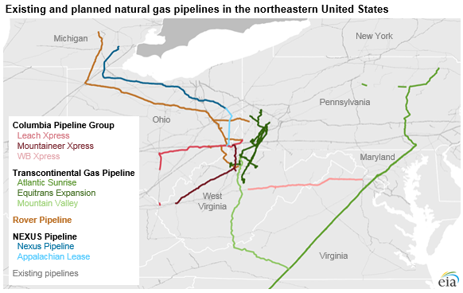
Takeaway Projects-Northeast/Appalachia
Nexus—1.5 Bcf/d
Rover—3 Bcf/d
Leach XPress—1.5 Bcf/d
Atlantic Sunrise—1.5 Bcf/d
Mountaineer XPress—2.5 Bcf/d
Notes:
In recent years, production growth in Marcellus and Utica was constrained by lack of takeaway capacity, but a dramatic build-out of pipeline infrastructure has been the driving force that has pushed output in these regions to 21 Bcf/d and 7.5 Bcf/d levels, respectively. That is a combined increase of 7 Bcf/d in the last 2 years and 15 Bcf/d increase in the last 5 years.
In 2018, 9 pipeline expansion projects totaling 8 Bcf/d of capacity were placed into service, with the majority of them moving gas out of the Northeast to destinations in either the Southeast/Gulf Coast, to feed LNG/Mexico export and petrochem demand, or the Midwest
3 projects (Leach Xpress, Nexus and Rover) totaled more than 6 Bcf/d of deliverability from the east to markets in Midwest Consuming Regions.
An additional 2.5 Bcf/d of takeaway capacity is expected to come online in 2019, with another 4 Bcf/d expected in service by the end of 2020, which would bring total Northeast takeaway capacity to around 38.0 Bcf/d.
These projects have altered gas flows in the Midwest and have kept some Canadian production bottled up north of the border.
Construction delays in many other projects (Constitution Pipeline, Atlantic Coast Pipeline, Mountain Valley Pipeline) continues to be a major issue, primarily as a result of legislative challenges from environmental groups and other regulatory hurdles.
A new question is now being asked, given the growth in associated gas coming over the next two years from Texas, New Mexico, Oklahoma and North Dakota that will put pressure on Northeast production growth, are all these proposed Northeast takeaway projects needed and will demand be able to keep pace with the new capacity and fill the pipelines?

Slide 42
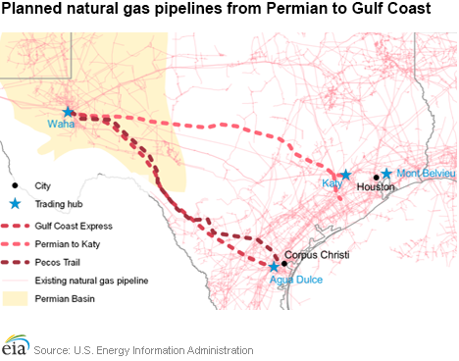
Takeaway Projects-Permian
Over the last 2 years, production from the Permian has increased from 4 Bcf/d to the current 8.5 Bcf/d.
Three major projects in the works are scheduled to add 6 Bcf/d of takeaway capacity from the Permian to the south and east:
  Gulf Coast Express (2 Bcf/d), Permian to Katy Pipeline (2.25 Bcf/d) and Pecos Trail (1.85 Bcf/d)
Sources: EIA: Monthly Natural Gas Report, Bloomberg
Notes:
Over the last 5 years, the Marcellus and Utica have garnered most of the attention from producers, but the new “It” production basin is undoubtedly the Permian.
Located in West Texas, the Permian basin is ideally situated to bring gas from the region to demand areas in the industrial Gulf Coast, LNG export terminals and exports to Mexico
Similar to the challenges that faced the Northeast and Appalachia production, a lack of pipeline infrastructure also plagues the Permian and the SCOOP/STACK region of Oklahoma.
Over the last 2 years, production from the Permian has increased from 4 Bcf/d to the current 8.5 Bcf/d.
While there are numerous pipeline projects under construction, the in-service date of these projects are not scheduled until later in 2019 or 2020, but relief to the constraints in the Permian is coming. Three major projects in the works are scheduled to add 6 Bcf/d of takeaway capacity from the Permian to the east:
Kinder Morgan’s Gulf Coast Express 1.98 Bcf/d connecting Waha to Agua Dulce hubs slated for 3Q 2019 completion
Sempra and Boardwalk’s Permian to Katy Pipeline 2.25 Bcf/d takeaway, 3Q 2020, to Katy and ultimately the HSC
Namerico’s Pecos Trail, 1.85 Bcf/d, Permian to Corpus Christi connecting to Cheniere’s LNG facility as well as interstates, sometime in 2019
I touched on this earlier, but many of the Northeast pipeline takeaway projects and the producers who anchor these expansions have sights set on serving growing Southeast power demand, Gulf industrial demand and LNG exports. But these are same markets that the Permian projects are targeting so the expectation is that producers will focus on the basins rich with oil/liquids and away from dry-gas regions. If this trend becomes the norm, something has to give and that something seems to be declining production from Haynesville, followed by a slowdown in Northeast production as a result of the associated gas vs. non-associated gas competition.
The risk to a continued production boom in the Permian is lower crude oil prices as this would discourage Permian oil production and result in less associated gas. A sustained downward move in crude prices could alter the trajectory of the expectations for the Permian

Slide 43
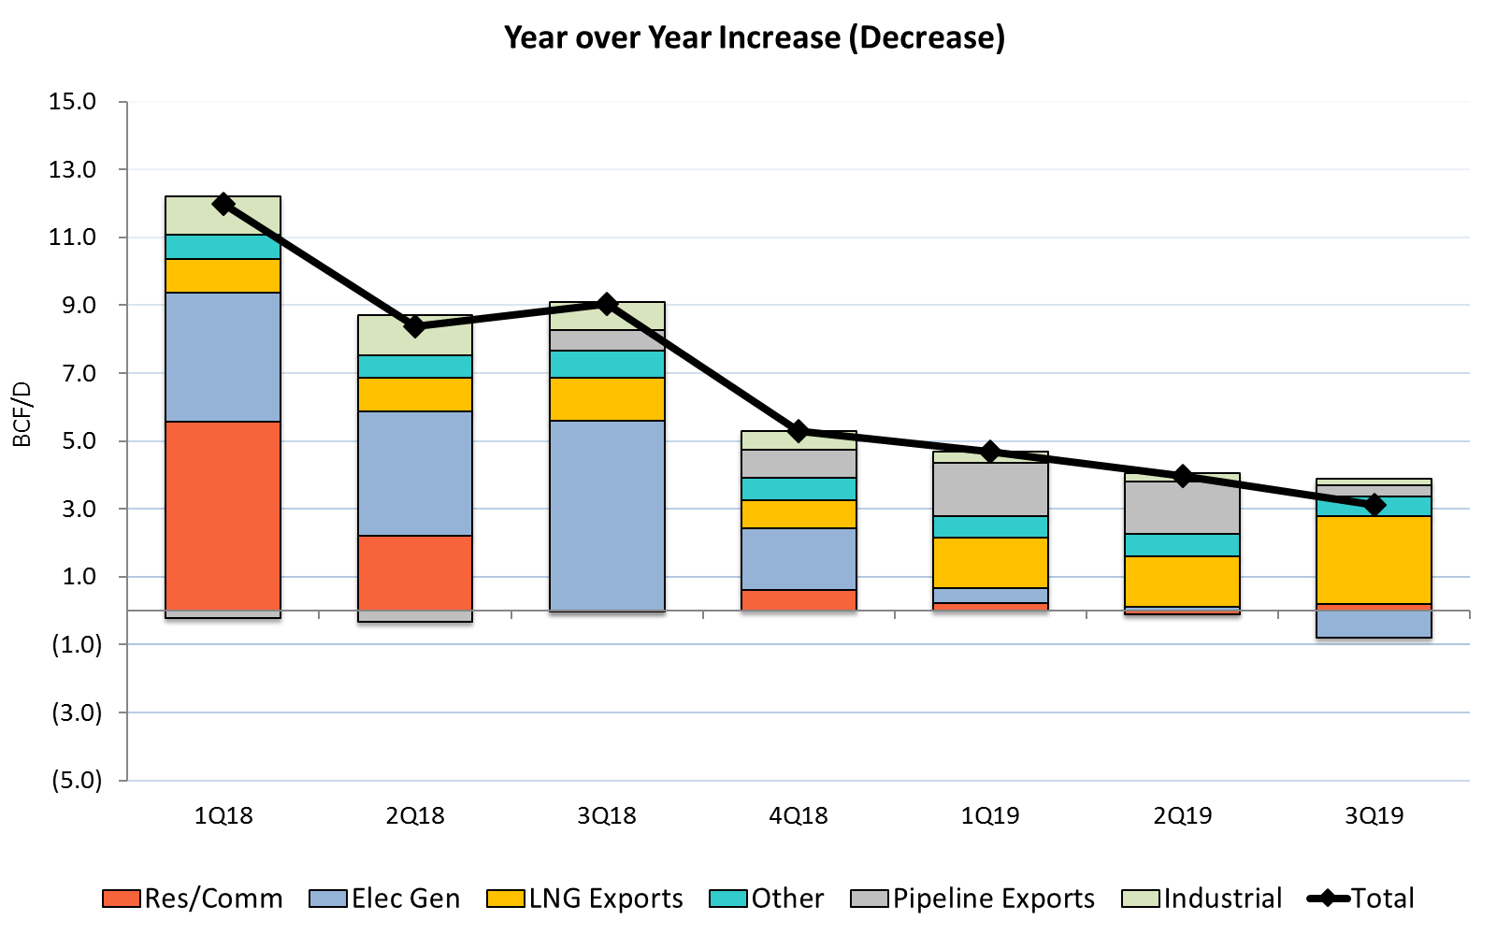
US Gas Demand by Quarter 1Q18-3Q19
Forecast
Demand has steadily been increasing year over year driven by electricity generation, LNG exports, industrial demand, and exports to Mexico
LNG and Mexican exports expected to show continued growth while power gen demand is forecasted to decline (slightly) this summer assuming CDD’s average closer to normal
Source: EIA STEO
Notes:
While the production landscape paints a bearish scenario for NG prices, demand is attempting to keep the market in balance
Demand across all sectors in on an upward trajectory, in particular, power gen demand and gas demand for LNG exports and exports to Mexico are consistently posting impressive gains
As illustrated in the chart, in each Quarter of 2018, total demand posted a net increase from the same quarter for the prior year
2018 marked an all-time record for power generation demand for NG, and through the first 20% of 2019, power burns are averaging 2 Bcf/d higher than for the same period last year, but burns under normalized weather conditions, summer power burns this year are likely to be slightly lower than 2018
Feedgas demand for LNG exports is expected to grow 1 Bcf/d by November 2019 and exports to Mexico should increase 1 Bcf/d by the end of the year
Before getting into the game-changers on the demand side, let’s review Industrial demand…

Slide 44
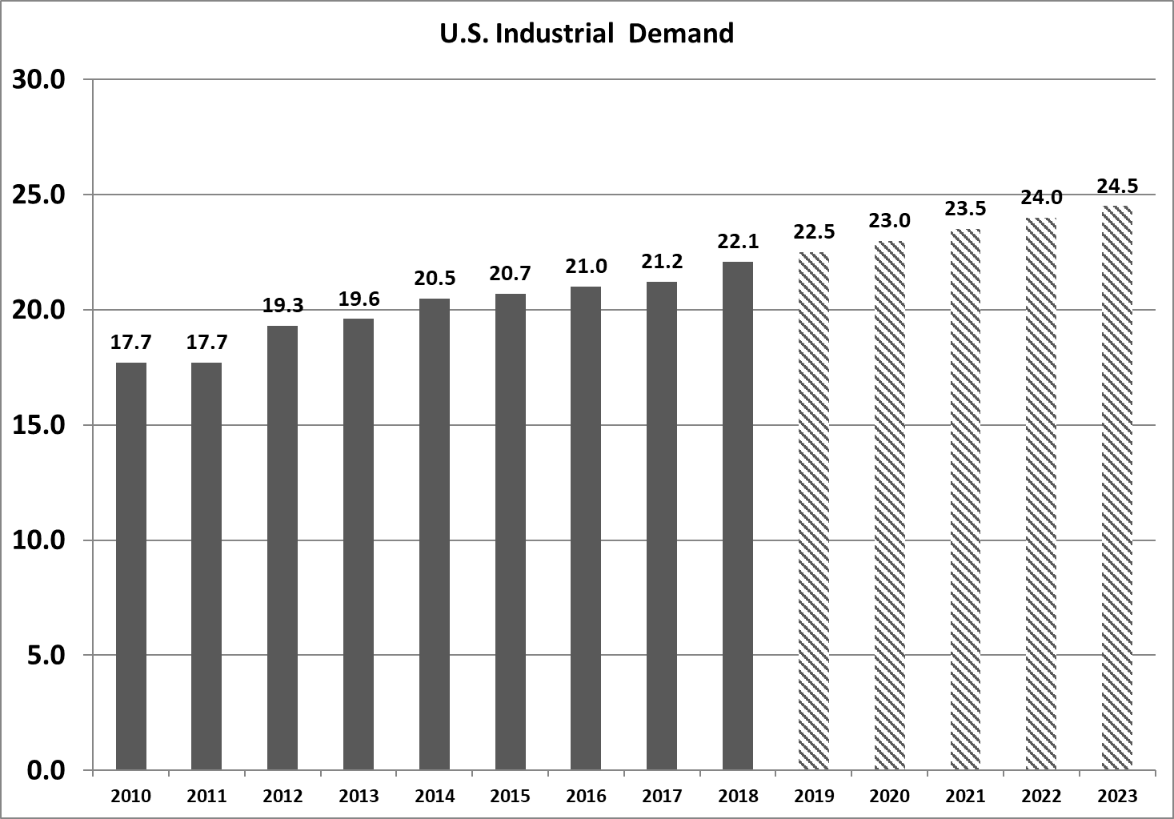
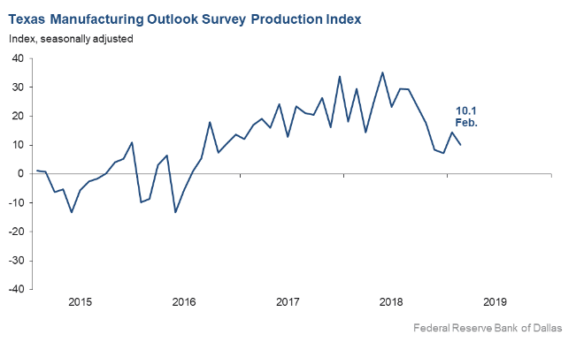
Demand Forecasts-Industrial
Industrial demand is expected to rise for 2019 and 2020 due to a number of new fertilizer, methanol, and petrochemical projects coming online in Southeast Texas and South Louisiana
Texas manufacturing production index remains positive but is not accelerating as rapidly per the Texas Manufacturing Outlook Survey Production Index as prior year
Uncertainty remains regarding the long-term impact of trade tariffs and global economy
Source: EIA STEO, FEDERAL RESERVE BANK OF DALLAS
Notes:
NG demand from the Industrial sector has been on a steady rise since 2010. The boom in petrochemical business in the Gulf region has been a major factor in boosting industrial demand to the current 22 Bcf/d level.
Industrial demand is expected to rise for 2019 and 2020 due to a number of new fertilizer, methanol, and petrochemical projects coming online in Southeast Texas and South Louisiana
Barring a dramatic and long-term increase in domestic NG prices, continued growth in industrial demand can be expected. Demand should increase by 0.5 Bcf/d in 2019 to 22.5 Bcf/d and to more than 23 Bcf/d by the end of 2020.
Texas Manufacturing Outlook Survey Production Index rose to a twelve year high last spring, but growth is not accelerating as rapidly as the increases seen throughout 2017 and 2018.
Still, various petrochemical projects using low-cost natural gas and natural gas liquids are in the works in an effort to meet increasing global demand for petrochemicals
Risks to continued increases in demand for the sector include
Project delays/cancellations
Increasing global competition
Rising U.S. oil and gas prices
Uncertainty regarding long-term impact of trade tariffs and global economic conditions

Slide 45
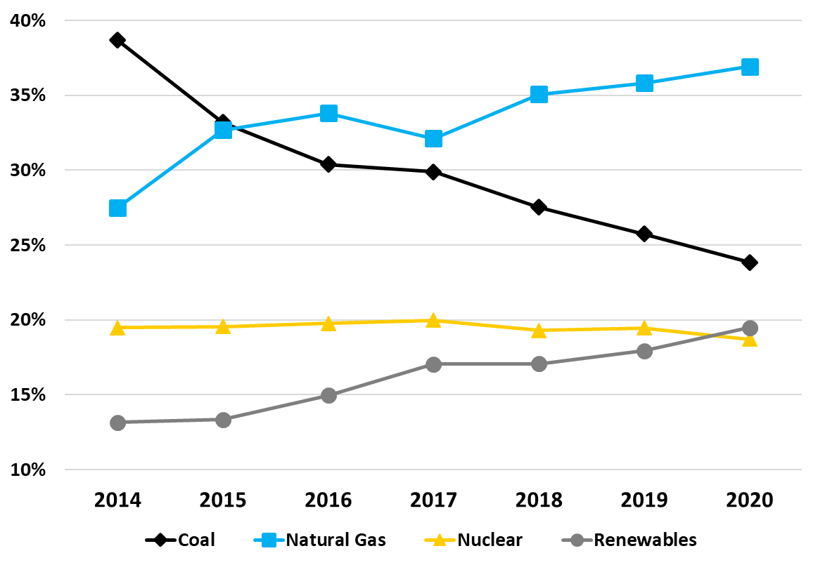
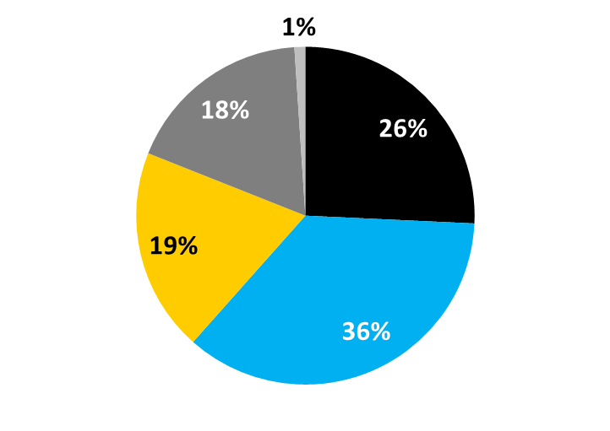
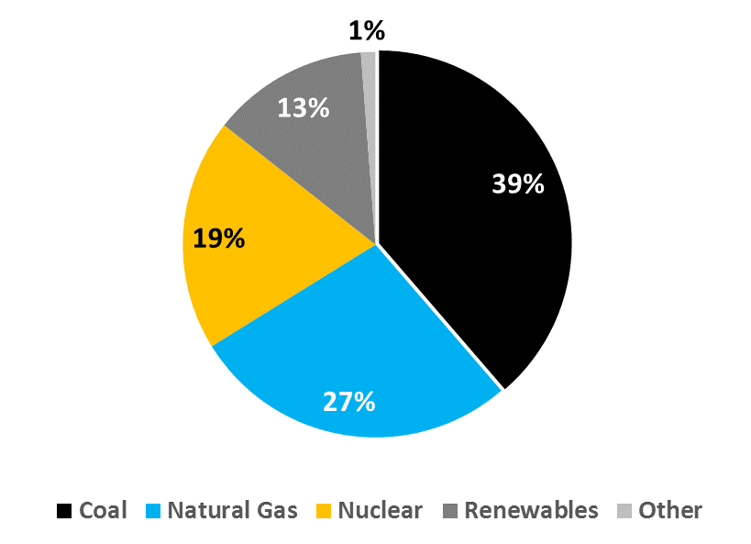
Electricity Generation by Fuel Source
2019
2014
Source: EIA
Notes:
Power gen demand has be the main driver in U.S. gas demand for more than a decade. To better illustrate the shift in generation stack, let’s review the trend in electricity generation by fuel source, as reported by the EIA
Coal appears to be on the same trajectory as the University of Tennessee football…or Louisville Cardinals football for that matter, while natty gas has been a consistent upswing over the last 15 years. NG-fired generation has added nearly 30 GW of new capacity in 2017 and 2018, which has resulted in an additional generation capacity of approximately 5 Bcf/d.
Coal vs. NG
2007 Coal 49% vs. NG 22%
2014 Coal 39% vs. NG 27%
2017 Coal 31% vs. NG 32%
2019 Coal 26% vs. NG 36%
NG’s gains would likely be even greater, but renewable energy has posted impressive gains as environmental policies take center stage across the industry. Non-hydro renewables like wind and solar have helped this sector increase its market share from 4% in 2010 to 18% in 2018.
Wind and hydro both account for around 40% of renewables currently, while solar makes up nearly 10%.
In 2018, renewables accounted for 11.5 GW, or 37% of the 31 GW of U.S. capacity additions
Nuclear power has remained unchanged at 19% for the period
In summary NG demand for electric generation is expected to grow, but not at the same rate as renewables, but there will be many influencing factors in the coming years, whether it be environmental, political, economic, etc… so just be prepared to adapt to the winds of change

Slide 46
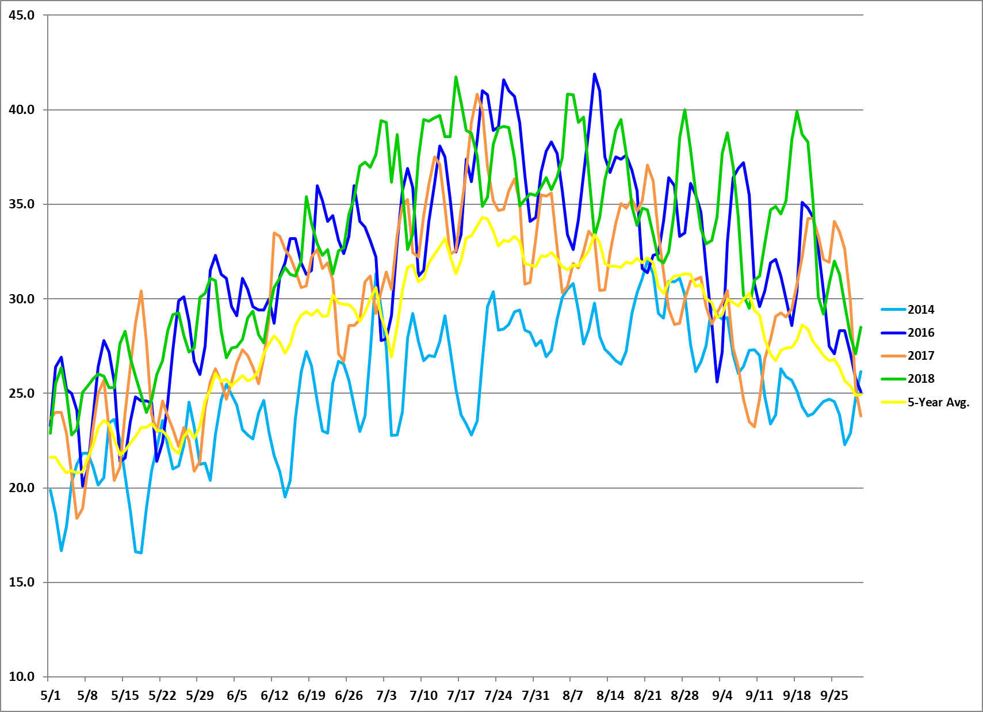
  Summer Power Burns
  (May – September)
2019 Power Burn YTD
Vs. 2018: +2 Bcf/d
Vs. 2017: +6.9 Bcf/d
Vs. 2016: +4.2 Bcf/d
Bcf/d
2018 Power Burn (May – Sep)
Vs. 2017: +2.8 Bcf/d
Vs. 2016: +1 Bcf/d
Power burns for the May 2018 – September 2018 period ranked as the highest on record, averaging 33 Bcf/d, 1 Bcf/d higher than the previous record of 32 Bcf/d in 2016.
2019 YTD power burns are averaging 26.8 Bcf/d, 2 Bcf/d higher than last year for the same period
Source: Platt’s, CES
Notes:
According to Platt’s, power burns for the May 18 – September 2018 period ranked as the highest on record, averaging 33 Bcf/d, 1 Bcf/d higher than the previous record of 32 Bcf/d in 2016.
2019 YTD power gen demand is averaging 26.8 Bcf/d, 2 Bcf/d higher than last year for the same period and 4.2 Bcf/d higher than the same period for the previous record-setting year of 2016
If you recall that was the year when NG prices fell below $2.00 in March and remained below $2.00 through mid-summer. Power gen demand set an all-time record for May –September last year and for the calendar year, but 2019 could be poised to seize that title this summer, but it will be tough to match last summer’s totals.

Slide 47
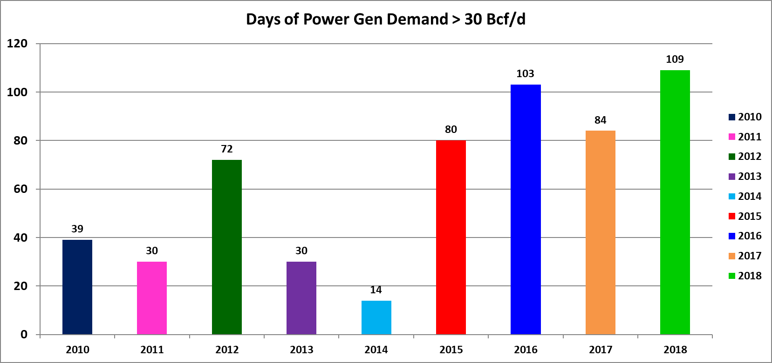
Days with Power Gen > 30 Bcf/d
(2010 to 2018 YTD during May through September)
$4.35
$4.20
$4.20
$3.70
Number of Days per Month
$3.04
$2.75
$2.90
$2.73
$2.65
The low price environment in 2016 combined with major coal retirements to lift power burns to a record high year for power gen demand of 27.5 Bcf/d, producing a record 103 days of power burns in excess of 30 Bcf/d.
The addition of 15 GW of NG-fired capacity in 2018, a lower price environment for NG vs. 2017 and a warmer-than-normal summer resulted in power generation demand hitting new all-time high levels in 2018.
Source: Platt’s, CES
Notes:
I have historically used the 30 Bcf/d level as a measuring stick to indicate a strong power burn day. As the shift from coal-to-gas has expanded, this might need to be raised, but to provide an illustration of the significant growth in power gen demand during the May – September peak cooling season, I have accumulated this data for 2010 – current year.
During last summer’s record for power gen demand, power burns topped 30 Bcf/d on a record 109 days and prices for the period averaged $2.90.
Compare that prior years when NG prices were higher, there is a notable decline in the number of days with power gen demand greater than the 30 Bcf/d mark.
All-time record high demand from power gen of 41.9 Bcf occurred on August 11, 2016. Power burns neared that record last July 16th, climbing above 41.5 Bcf/d
Through March 8th of this year, power burns have averaged 26.8 Bcf/d, 2 Bcf/d higher than for the same period in 2018.
Looking at this summer’s demand forecast, power demand is expected to be strong, but if temps are near 10-year norms, power burns could post a slight decline vs. last year. Factors that will continue to impact NG demand for power generation are:
Coal-to-gas switching—low price environment favors NG vs. coal @ under $3.25 in most regions. Summer 2019 prices are currently averaging $2.90. Economic fuel switching is always a risk, especially if prices move above the $3.25 - $3.50 per MMBtu level.
Coal Retirements—13 GW of coal generating capacity was retired in 2018 and another 10 GW of is retiring in 2019
New Natural Gas Additions-15 GW of gas-fired generation capacity added in 2018 and another 12 GW of gas-fired capacity is expected in 2019
Most importantly…WEATHER

Slide 48
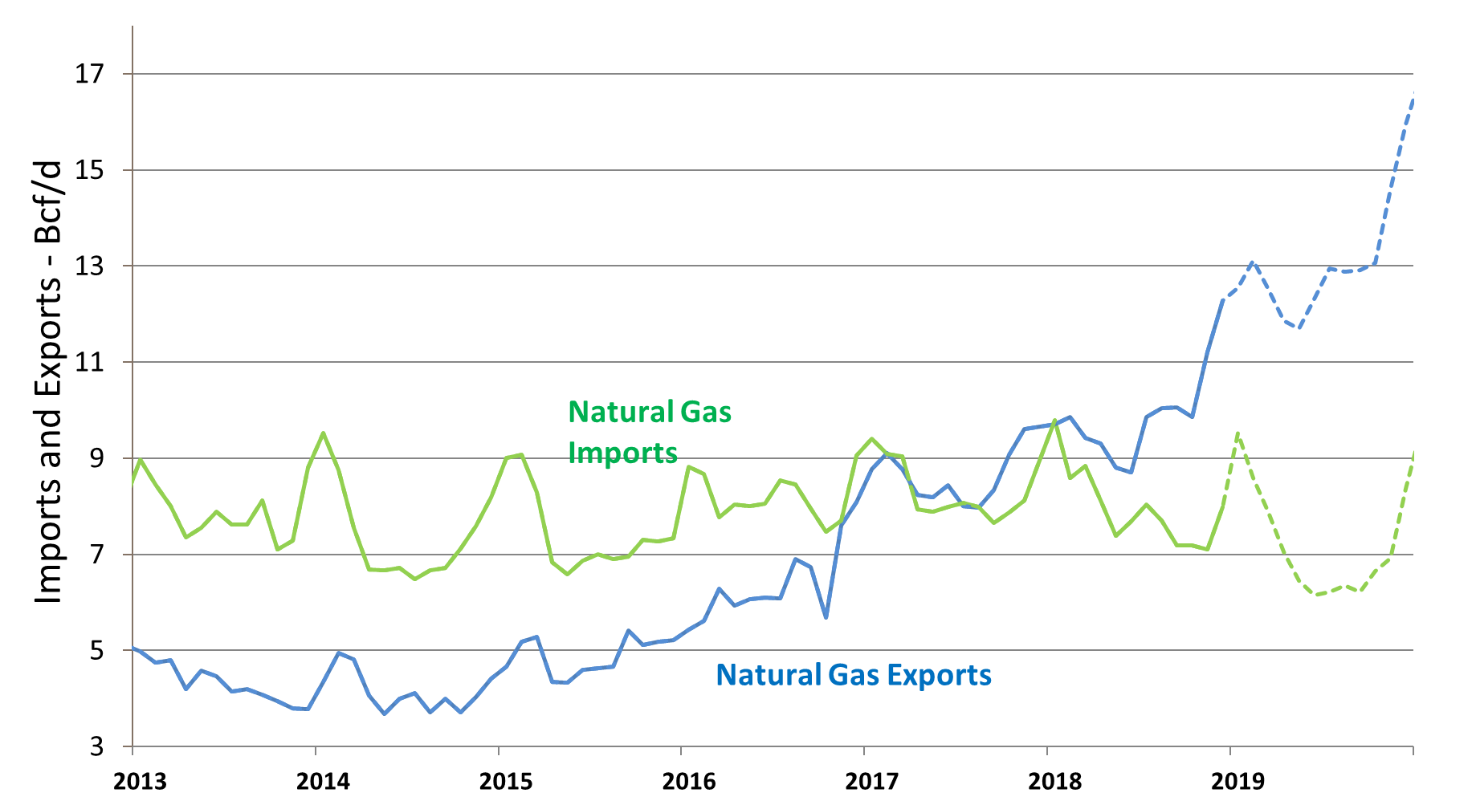
Exports and Imports Forecast
Exports have seen strong growth over the last two years, led by LNG exports and exports to Mexico
LNG exports have skyrocketed from 0 Bcf/d in 2015 to the current 5 Bcf/d level
Exports to Mexico have grown from 3 Bcf/d in 2015 to over 5 Bcf/d
Sources: EIA: Short Term Energy Outlook, Baker Hughes
Notes:
Exports have seen strong growth over the last two years, led by LNG exports and pipelines exports to Mexico
LNG exports have skyrocketed from 0 Bcf/d in 2015 to the current 5 Bcf/d level
Exports to Mexico have grown from 3 Bcf/d in 2015 to over 5 Bcf/d. In Mexico, more than 20 GW of new gas-fired generation capacity is expected to be in service by 2023. The incremental NG demand mainly from these power plant projects has been estimated to be as high as 4 Bcf/d, which could send total exports to 9 Bcf/d by 2023.
Mexico’s growing energy demand is heavily dependent upon NAFTA, so any disruption of the treaty could slow industrial growth, in turn, limiting future gas and power demand.
There are existing take-away pipelines to Mexico however they are transporting far less than they’re capable of because of delays in developing new pipes and gas-fired power generation plants on the Mexican side of the border.
Barring an unforeseen occurrence, it appears that from this point forward that the U.S. will maintain this position as a net exporter of NG as exports to Mexico and LNG exports are predicted to grow at an impressive pace.
But the largest growth sector of demand over the next two years is LNG exports, which make up 4 Bcf/d of the overall 8 Bcf/d of growth in total demand by the end of 2020

Slide 49
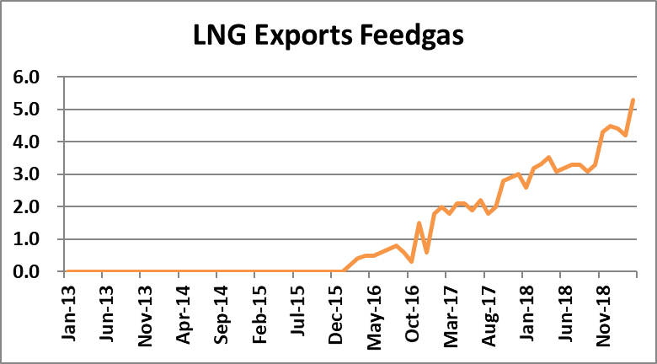
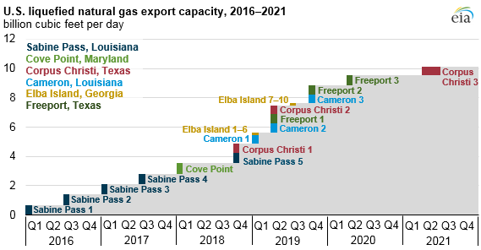
LNG Feedgas Forecast
Bcf/d
Global trade in LNG reached 38.2 Bcf/d in 2017, a 10% (3.5 Bcf/d) increase from 2016.
Expectations are for U.S. liquefaction capacity to reach over 6 Bcf/d by the end of 2019 and 9 Bcf/d by the end of 2020
Sabine Pass, Cove Point, and Corpus Christi are currently in operation with Cameron and Elba nearing their respective in-service dates
Sources: EIA STEO
Notes:
Global trade in LNG reached 38.2 Bcf/d in 2017, a 10% (3.5 Bcf/d) increase from 2016.
Expectations are for U.S. liquefaction capacity to reach over 6 Bcf/d by the end of 2019 and 9 Bcf/d by the end of 2020
6 LNG projects have FERC approval totaling 11 Bcf/d of liquefaction capacity. Sabine Pass, Cove Point, and Corpus Christi are currently in operation with Cameron and Elba nearing their respective in-service dates
Sabine Pass (3.5 Bcf/d; 80% of future capacity); Cove Point (0.82 Bcf/d; 2018); Corpus Christi (2.14 Bcf/d; 2018 - 2021); Freeport (1.8 Bcf/d; 2019 - 2021); Cameron (2.1 Bcf/d; 2019); Elba Island (0.4 Bcf/d; 2019)
Many of these players have subscribed for long term pipeline capacity to meet their demand needs and these LNG facilities will be the home for an abundance of gas delivered via the pipeline projects from Appalachia and the Permian.
RISKS FACING U.S. LNG EXPORTS
Declining net backs in Europe and Asia markets
Utilization rates have been high, driven by strong Asian demand and strong netbacks of at least $2 per MMBtu as a result of delays in Australian LNG projects. Forecasts suggest that long term export contracts and netbacks should result in high utilization through 2019 but always a possibility global LNG prices converging towards HH or falling crude oil complex. JKM (Japan Korea Marker) price has fallen in recent months.
Competition from Russia, Australia and other European and African exporters…and now Canada is trying to leverage a potential U.S. vs. China trade war to gain market share
Trade wars/Trade tariffs
In 2017, 53% of the exports were sent to Mexico, South Korea, and China with Mexico accounting for 20% of the total. China, Japan and Korea account for 50% of LNG demand. Will they be able to absorb growing LNG supply and/or will trade tariffs impact LNG trade?
Delays in completion of LNG projects. Freeport is unlikely to start operations in later in 2019 due to delays.
Regulation on fracking and or domestic export terminals
Global economic health
Economic slowdowns will reduce energy demand and potentially hamper development of future capital intensive LNG projects

Slide 50
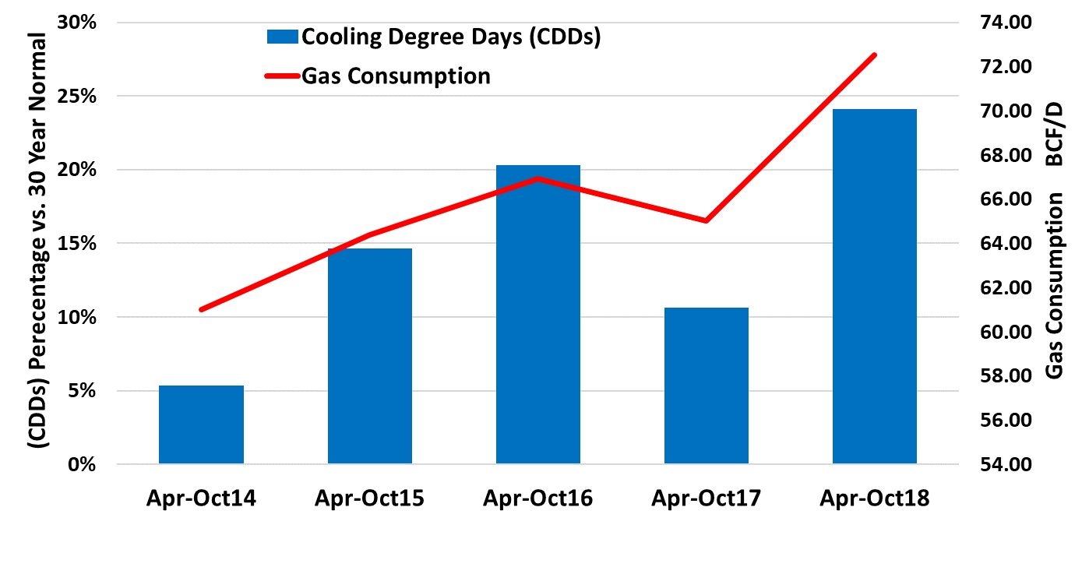
2018 Summer Review and 2019 Summer Forecast
June 2019 – September 2019 Forecast
The 2018 summer ranked as the 4th hottest summer on record, 25% warmer than the 30-year norm and 13% warmer than the 10-year norm and was the warmest summer in the last 69 years
12 of the last 15 summers have ranked in the top 20 warmest on record, while the top 5 hottest summers since 1950 have all occurred in the past 10 years
The ten year normal for cooling degree days is 12% higher than the thirty year normal
Sources: RADIANT SOLUTIONS
Notes:
As I said earlier, weather is always the Big Fundamental in the gas industry
The 2018 summer ranked as the 4th hottest summer on record, 25% warmer than the 30-year norm and 13% warmer than the 10-year norm and was the warmest summer in the last 69 years
While there wasn’t a big impact on NG prices during the summer season, high power gen demand limited storage injections and resulted in the lowest end-of-injection inventory level since 2005, ultimately making the market susceptible to a rally on an early winter weather…which occurred last November and pushed the December 2018 Futures contract to a $4.715 settlement, the highest for any contract since May 2014.
Summary of the last 15 summers:
12 ranked in top 20 warmest
1 ranked in top 20 coolest (2004)
2 summers ranked at the average
Top-5 hottest summers since 1950 have all occurred in the past 10 years
2016 record of 1040 PWCDDs
2019 Summer forecast:
9th hottest on record, but cooler than last year. Population weighted cooling degree days (PWCDD’s) of 955 vs. 1,020 in 2019.
Hotter than 30-year norm of 881 PWCDDs
Near the 10-year normal of 962 PWCDDs

Slide 51
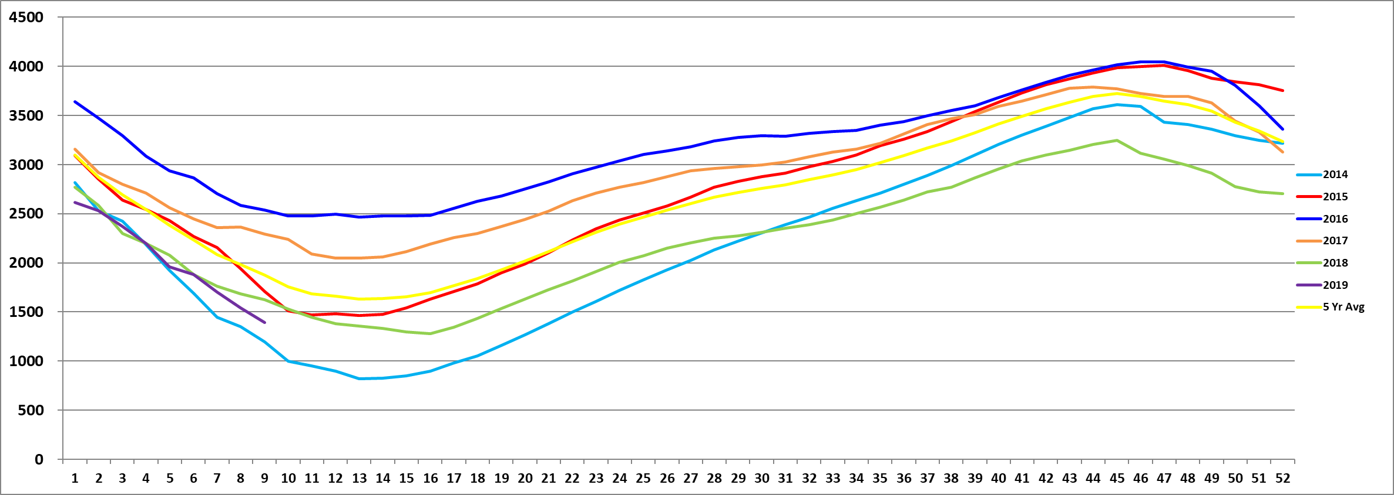
U.S. Natural Gas Storage Scenarios
My 2019 end of injection season storage projection is 3,379 Bcf
Total Working Gas (in Bcf)
If weekly injections equal last year’s weekly injections, storage would reach 3,000 Bcf
If weekly injections equal 5-year avg injections, storage would reach 3,129 Bcf
NG storage is 1,390 Bcf, 243 Bcf, or 15%, lower than last year and 464 Bcf, or 25%, below the 5-year average of 1,854 Bcf
Week of Year
Notes:
Season-to-date storage withdrawals have totaled 1,857 Bcf vs. last year’s 2,165 Bcf and the 5-year average of 1,986 Bcf.
Expectations are for the end of winter storage level to fall to 1,034 Bcf. This would be the 2nd lowest end of winter level since 2004 (822 Bcf in 2014 was the lowest).
Based on the summer supply vs. demand outlook we just reviewed, there should be at 2.4 Bcf/d, or 362 Bcf more gas available to inject this summer vs. last.
The DOTTED LINES REPRESENT END OF SEASON STORAGE SCENARIOS
If weekly injections match last year’s injection total of 1,966 Bcf for April - October, storage would reach just 3,000 Bcf
If weekly injections match the 5-year avg injection total of 2,095 Bcf, storage would reach 3,129 Bcf.
With expectations for U.S. production to add another 4 to 5 Bcf/d to the supply mix by the end of this year, storage levels SHOULD reach a peak of between 3,300 Bcf and 3,500 Bcf. My REALLY early prediction is 3,379 Bcf.

Slide 52
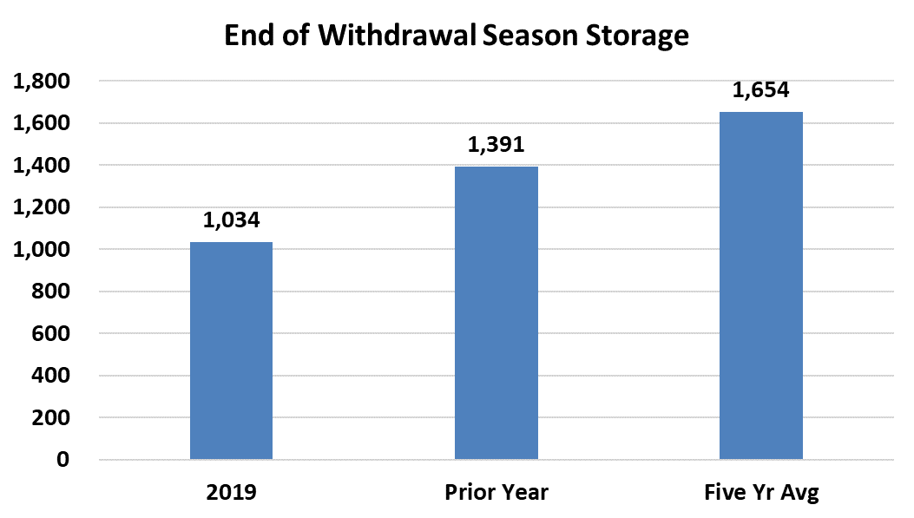
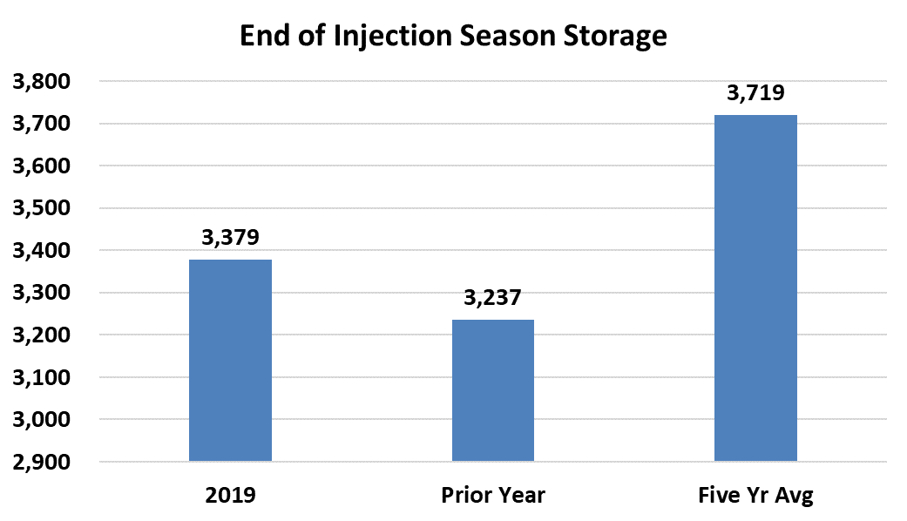
Natural Gas Storage Projections
Projected storage on April 1, 2019
Projected storage on November 1, 2019
Bcf End of Month
Forecasts call for end of withdrawal season storage at 1,034 Bcf, which would be 620 Bcf below the 5-year average
YOY gains in production growth are expected to allow inventory levels to be replenished at a higher rate this injection season vs. 2018. This should flip the deficit to last year to a surplus.
Sources: EIA STEO
Notes:
With the recent cold weather, expectations have been lowered and I expect storage to dip to between 1,000 Bcf and 1,100 Bcf by April 1st
Looking at the chart on the left hand side you see the comparison of the end-of-winter projection of 1,034 Bcf to the prior year and 5-year average. The deficits are expected to stand at 357 Bcf to last year and 620 Bcf, 37% lower than the 5-year average.
YOY gains in production growth are expected to allow inventory levels to be replenished at a higher rate this injection season vs. 2018. This would be slightly above last year’s peak and flip the YOY deficit to a surplus but would still be 340 Bcf, or 9%, below the 5-year average pre-winter high of 3,719 Bcf
There are upside and downside price risks to the storage projections:
Upside
Significantly warmer-than-normal temps and the associated spike in power gen demand
Delays in pipeline expansion projects
Higher export demand
Downside
Significantly cooler-than-normal temps and lower power burns
Reduced LNG demand and/or continued delays in the in-service dates of LNG export terminals

Slide 53

Storage Deviation to 5-Year Average
Historically Strong Correlation to Pricing
Surplus of 875 Bcf Apr’16
Surplus of 911 Bcf Apr’12
Current deficit near 475 Bcf after reaching 700 Bcf this winter. Short-term weather risk still a factor
Deficit of 1,000 Bcf Apr’14 (Polar Vortex)
Sources: EIA
Notes:
Historically, there has been a strong correlation between the storage deficit to the 5-year average and prompt-month NYMEX NG prices
History tells us that NG prices climb higher when a deficit to the 5-year average storage level grows
History also tells us that NG prices fall during periods of an expanding surplus to the 5-year average storage level
The changing market dynamics over the last 5 years has somewhat muted the impact of this indicator since many traders feel that production can be used as “On Demand” storage.
Now…onto a natural gas price outlook

Slide 54


NYMEX NG Continuation Chart
March 8, 2019
Source: CME
Notes:
When the prompt-month NG Futures contract fell to a 17-year low of $1.639 on March 3rd, 2016, the Cal 19, Cal 20 and Cal 21 strips were trading at all-time lows of $2.737, $2.817 and $2.937, respectively.
As of the March 8th, 2019 close, the prompt-month contract had gained $1.226 per MMBtu to $2.865, while the Cal 19, Cal 20 and Cal 21 strips are still in a range near the all-time lows and currently stand at $3.009, $2.777 and $2.645, respectively.
Since 1999 there have been just 4 occasions that the prompt-month NG contract has fallen below the $2.00 level. While this chart dates back to only 2005, you can see 3 of these occasions (2009, 2012 and 2016). Each time prices fell below $2.00, the market has rebounded swiftly, and back to the $4.00 mark within 12 to 18 months
Over the last 2 years, the market has made numerous attempts to find success below the $2.50 level, but judging by the support level that has formed in the market at the $2.50 level, it will take a significant bearish event to trend below the $2.50 level for any period. That wouldn’t be good for anyone…even end users.
Compared to a 20-year history of NYMEX NG Futures prices dating back to 1999, there have been only a few years that have produced a calendar year average price lower than these prices are today.

Slide 55

Historical and Future NYMEX NG Calendar Year Averages
March 8, 2019
Source: CME
Notes:
In the 20-year span from 1999 – 2018, only 3 times have annual NG Futures Settlement prices averaged less than $2.79…1999, 2015 and 2016.
As of March 8th, 2019, the Cal 19, Cal 20 and Cal 21 prices are trading:
Cal 19 $3.009 (includes Jan 19 – Mar 19 contract settlement prices)
Cal 20 $2.777
Cal 21 $2.643
Cal 22 $2.640
Implied volatilities in the NYMEX options futures are skewed to the call side which depicts more upside risk for prices over the next two years than downside potential

Slide 56

NYMEX NG Prices – Calendar Year (CY) Strips
$2.96
2019
$2.775
2020
$2.64
2021
$2.64
2022
NYMEX NG CY strip prices for 2020 to 2022 had been in a tight 10 cent range but 2020 starting to diverge from 2021-2022
Prices reached short-term support levels (just above $2.50) and are attempting to build a floor
Gas consumers are taking advantage of these historically low futures prices and locking portions of their gas needs for two, three, and even four or five years out
Source: FutureSource (ICE), CME Settlements February 8 2019
Notes:
With limited market volatility in recent years due to record-high domestic production, the forward curve for NYMEX Futures prices has shifted dramatically lower over the last 5 years.
In particular, the Cal 20, 21 and 22 strip averages have dropped between $2.00 and $2.50 per MMBtu and have converged to the point that there is only a $0.10 to $0.15 spread between the calendar years
By our estimates the current strip prices equate to the current break-even costs of production in shale plays and associated gas
As for the prompt-month NG Futures contract, since the calendar rolled into the New Year, there has been only one sizeable rally, but that fizzled out at the $3.60 level during the second week of January. Less than 2 weeks later, NG was back below the $3.00 mark where it has once again settled into a monotonous trading range.
For the last 30 days, the prompt-month NG contract has posted a daily settlement within a tight $0.30 trading range between $2.60 and $2.90.
As always, near-term weather forecasts will ultimately provide price direction, but barring abnormally hot or abnormally cool weather conditions for the next 2 months, this should be a range for prompt-month natty gas Futures. The market definitely has the potential to increase significantly and in a short time frame (i.e. last November), so my advice is to always have a plan. And with prices hovering near historical lows, the market is offering up good long-term buying opportunities.
My forecasted price ranges for the next 3 years, assuming weather based on 30 year norms:
Cal 20 $2.75 - $3.25
Cal 21 $3.10 - $3.60
Cal 22 $3.00 - $3.50

Slide 57









Bull & Bear Summary
Production
Storage
LNG & Mexico
  Storage deficit to five-year average remains elevated with constructive winter demand
  Continued below normal winter weather adds risk to pace of weekly storage recovery
  Production curve expected to grow for balance of 2019, but at a lower rate than 2018
  Summer power burn projected to be slightly less than 2018 with a reversion back to the 10-year normal on cooling degree days but mitigated by increased gas-fired electric generation market share
Weather
Demand
Summary
Notes:
Northeast production remains King of the Gas World, but Texas production is also posting sizeable gains. Dry gas production is expected to grow 10 Bcf to 95 Bcf/d by 2023 while demand also grows 10 Bcf by 2023.
Pipeline project delays continue to limit takeaway from the Northeast highlights ongoing deliverability issues during peak demand periods, but 8 Bcf/d of additional takeaway capacity went into service in 2018 and another 5 Bcf/d by 2020, while 10 Bcf/d of pipeline capacity into Mexico is expected to be in-service by the end of 2020.
Storage levels are expected to end the winter at the 2nd lowest level in the last 15 years. An early summer poses a potential risk of an injection season rally if the pace of storage refill lags behind historical norms. But expectations are that YOY production growth and lower power burns this summer will allow for storage to top last year’s peak level.
U.S. LNG exports and exports to Mexico will be the key drivers of demand in the next 5 years with expectations of an additional 10 Bcf/d of additional combined demand.
Weather—always the most important short-term fundamental. Currently bullish with the cold weather in early-March but forecasts have turned more seasonal
2018 was a record year for power gen demand, but 2019 has started the year strong. The shift from coal-to-gas continues with another 10 GW of coal-fired generation retiring in 2019. Power burns will be strong, just not as strong as in 2018. Renewable energy is projected to post the most sizeable gains in generation capacity by 2030.
Aside from several short-term peaks and valleys, NYMEX NG Futures have been corralled in a range between $2.75 - $3.50 for much of the last 5 years.
As we saw this past December, the market remains susceptible to price spikes on short-term weather events. The current forward curve provides an opportunity to lock in a fixed price on physical gas needs for the next 5 years at prices near historical lows.
There are tools available to take advantage of what I consider a sound buying opportunity that provides the end users the ability to guarantee the price they pay for gas for the next 3 to 5 years…AND it eliminates risk of the unknowns…weather, regulatory changes and global economics
Potential threats from environmental and regulatory legislation, combined with new concerns over the threat of global trade wars or increased tariffs could be a game changer for domestic demand and export forecasts and threaten the low-price environment for domestic natural gas.

Slide 58
That Was Then, This is Now
June 2000
Total Supply – 64 Bcf/D
  U.S. Dry Production – 53 Bcf/D
  Canada –10 Bcf/D
  LNG -- 0.60 Bcf/D
Total Demand – 59 Bcf/D
  R/C – 23 Bcf/D
  Industrial – 22 Bcf/D
  Power Gen – 14.5 Bcf/D
Working Gas in Storage
  1.60 Tcf
  5 yr Avg 1.65 Tcf
Shale Gas Production 1 Bcf/D
NG Rig Count – 675
NYMEX NG Futures
  Prompt = $4.25
  12 Mo Avg = $4.15
  36 Mo Avg = $4.10
NYMEX Crude Futures
  Prompt = $32 per bbl
June 2006
Total Supply – 62 Bcf/D
  U.S. Dry Production – 51 Bcf/D
  Canada – 9 Bcf/D
  LNG -- 1.60 Bcf/D
Total Demand – 56.75 Bcf/D
  R/C – 21.75 Bcf/D
  Industrial – 18 Bcf/D
  Power Gen – 17 Bcf/D
Working Gas in Storage
  2.50 Tcf
  5 yr Avg 1.90 Tcf
Shale Gas Production 2.7 Bcf/D
NG Rig Count - 1,400
NYMEX NG Futures
  Prompt = $7.00
  12 Mo Avg = $9.00
  36 Mo Avg = $9.25
NYMEX Crude Futures
  Prompt = $70 per bbl
June 2014
Total Supply– 72 Bcf/D
  U.S. Dry Production – 66.6 Bcf/D
  Canada – 5.2 Bcf/D
  LNG -- 0.20 Bcf/D
Total Demand – 73 Bcf/D
  R/C – 26 Bcf/D
  Industrial – 20.8 Bcf/D
  Power Gen – 19.7 Bcf/D
  Mexican Exports – 1.8 Bcf/D
Working Gas in Storage
  1.61 Tcf
  5 yr Avg 2.48 Tcf
Shale Gas Production 32 Bcf/D
NG Rig Count - 320
NYMEX NG Futures
  Prompt = $4.74
  12 Mo Avg = $4.64
  36 Mo Avg = $4.25
NYMEX Crude Futures
  Prompt = $106 per bbl
June 2018
Total Supply– 83 Bcf/D
  U.S. Dry Production – 79.8 Bcf/D
  Canada – 5.2 Bcf/D
  LNG -- 0.20 Bcf/D
Total Demand – 81 Bcf/D
  R/C – 24.5 Bcf/D
  Industrial – 21.8 Bcf/D
  Power Gen – 27.5 Bcf/D
  Mexican Exports – 4.5 Bcf/D
  LNG Feedgas – 2.5 Bcf/d
Working Gas in Storage
  2.0 Tcf
  5 yr Avg 2.5 Tcf
Shale Gas Production 60 Bcf/D
NG Rig Count - 194
NYMEX NG Futures
  Prompt = $2.996
  12 Mo Avg = $2.95
  36 Mo Avg = $2.78
NYMEX Crude Futures
  Prompt = $73 per bbl

Slide 59
CenterPoint Energy Contact
CenterPoint Energy Services
Trevor L. Atkins
295 N. Hubbards Lane; Suite 103
  Louisville, KY 40207
  Work: (502) 899-2822
  Cell: (502) 386-0094
  trevor.atkins@centerpointenergy.com

