Slide 1
2023 OGA Technical Seminar
Joe Dragovich, PE
Program Manager
Gas Pipeline Safety Section
Facility and Operations Field Division
Public Utilities Commission of Ohio

Slide 2
Gas Pipeline Safety Section
Program Manager - Joe Dragovich, PE
Support Staff - Tom Stikeleather
Field Staff
Dennis Cramer
Chris Domonkos
Josh Knox
Scott Landon, PE
Mary McKelvey
Victor Omameh
Jeff Polka
Dave Price
Mike Purcell
Keith Topovski

Slide 3
Topics
Annual Reports and Throughput
2023 Inspections
Incident Reporting and Investigations
State Rule Changes
Federal Rule Updates
Advisory Bulletins

Slide 4
Annual Reports and Throughput
Case No. 23-002-PL-RPT directs all gas pipeline operators to file a 2022 Gas Pipeline Safety annual report by March 30, 2023. Pursuant to R.C. 4905.92, all pipeline operators, including natural gas companies, pipeline companies, master-meter system operators, municipal corporations, and cooperative associations, when engaged in supplying or transporting gas by pipeline in the state of Ohio, are required annually to report the prior year’s total throughput of gas, in thousands of cubic feet (Mcfs), supplied or delivered in the state and to pay the gas pipeline safety (GPS) assessment. To file, please use the PUCO's web-based filing system, the PUCO Community to submit the throughput report as well as add the additional required forms.

Slide 5
2023 Inspections
Separated Standard Records Inspections into two forms last year
One form covers questions that apply company-wide
This will be filled out once for every operator
Includes damage prevention questions
Second form used for shop specific records questions and field observations
This will include our normal records and field related questions and space for field observations
This will be filled out for each shop/operating area
For smaller operators this will only be filled out once
For larger operators with multiple inspection units this will be filled out for each unit

Slide 6
PIPES Act of 2020 - Section 114 Inspection
All operators completed in 2022
PHMSA did not collect our reports but did ask us to report completion dates for each operator and whether we had any enforcement or compliance issues
These will be required again in 5 years

Slide 7
Future Plans
Split transmission form and gathering form into separate forms
May develop stand alone MAOP reconfirmation form

Slide 8
Incident Reporting and Investigations

Slide 9
Incident Reporting
Incident Criteria
191.3 – definition
191.5 – reporting requirements
Who to call
NRC – (1-800-424-8802)
OHCall1 - (1-844-642-2551)
Program Manager – (614-361-0464)
If you can’t reach me – call Pete Chace (614-561-6880)
Other reasons to call us
Outage of 100+ customers for 2+ hours
Media Coverage

Slide 10
Incident Criteria
An event that involves the release of gas that results in:
A death, or personal injury necessitating in-patient hospitalization;
Estimated property damage of $50,000/$129,300 or more, including a loss to the operator and others, or both, but excluding the cost of gas lost; or
Unintentional estimated gas loss of three million cubic feet or more.

Slide 11
Federal Reporting Language
§191.5 Immediate notice of certain incidents.
At the earliest practicable moment following discovery, but no later than one hour after confirmed discovery, each operator must give notice in accordance with paragraph (b) of this section of each incident as defined in § 191.3.
Each notice required by paragraph (a) of this section must be made to the National Response Center either by telephone to 800-424-8802 (in Washington, DC, 202 267-2675) or electronically at http://www.nrc.uscg.mil and must include the following information:
Names of operator and person making report and their telephone numbers.
The location of the incident.
The time of the incident.
The number of fatalities and personal injuries, if any.
All other significant facts that are known by the operator that are relevant to the cause of the incident or extent of the damages.
Within 48 hours after the confirmed discovery of an incident, to the extent practicable, an operator must revise or confirm its initial telephonic notice required in paragraph (b) of this section with an estimate of the amount of product released, an estimate of the number of fatalities and injuries, and all other significant facts that are known by the operator that are relevant to the cause of the incident or extent of the damages. If there are no changes or revisions to the initial report, the operator must confirm the estimates in its initial report.

Slide 12
State Reporting Language
4901:1-16-05: Notice and reports of service failures and incidents; twenty-four hour contacts; one-call participation; post-incident testing; and cast iron pipeline program.
Telephone notice of incidents and service failures.
Operators shall notify the state of Ohio on all incidents, as defined in rule 4901:1-16-01 of the Administrative Code, by calling 1-844-OHCALL1 (1-844-642-2551) within thirty minutes of discovery unless notification within that time is impracticable under the circumstances. This includes any telephone notice which is required to be made to the United States department of transportation pursuant to 49 C.F.R. 40, 191, 192, and 199 as effective on the date referenced in paragraph (D) of rule 4901:1-16-02 of the Administrative Code.
Operators shall notify the state of Ohio on all service failures, which involve an interruption of service to one hundred or more customers for a period of two hours or more, by calling 1-844-OHCALL1 (1-844-642-2551) within thirty minutes after discovery unless notification within that time is impracticable under the circumstances.

Slide 13
Previous Language in §192.617
Each operator shall establish procedures for analyzing accidents and failures, including the selection of samples of the failed facility or equipment for laboratory examination, where appropriate, for the purpose of determining the causes of the failure and minimizing the possibility of a recurrence.

Slide 14
New Language in §192.617
(a) Post-failure and incident procedures. Each operator must establish and follow procedures for investigating and analyzing failures and incidents as defined in § 191.3, including sending the failed pipe, component, or equipment for laboratory testing or examination, where appropriate, for the purpose of determining the causes and contributing factor(s) of the failure or incident and minimizing the possibility of a recurrence.
(b) Post-failure and incident lessons learned. Each operator must develop, implement, and incorporate lessons learned from a post-failure or incident review into its written procedures, including personnel training and qualification programs, and design, construction, testing, maintenance, operations, and emergency procedure manuals and specifications.

Slide 15
New Language in §192.617 cont.
(c) Analysis of rupture and valve shut-offs. If an incident on an onshore gas transmission pipeline or a Type A gathering pipeline involves the closure of a rupture-mitigation valve (RMV), as defined in § 192.3, or the closure of alternative equivalent technology, the operator of the pipeline must also conduct a post-incident analysis of all of the factors that may have impacted the release volume and the consequences of the incident and identify and implement operations and maintenance measures to prevent or minimize the consequences of a future incident. The requirements of this paragraph (c) are not applicable to distribution pipelines or Types B and C gas gathering pipelines. The analysis must include all relevant factors impacting the release volume and consequences, including, but not limited to, the following:
(1) Detection, identification, operational response, system shut- off, and emergency response communications, based on the type and volume of the incident;
(2) Appropriateness and effectiveness of procedures and pipeline systems, including supervisory control and data acquisition (SCADA), communications, valve shut-off, and operator personnel;
(3) Actual response time from identifying a rupture following a notification of potential rupture, as defined at § 192.3, to initiation of mitigative actions and isolation of the pipeline segment, and the appropriateness and effectiveness of the mitigative actions taken;
(4) Location and timeliness of actuation of RMVs or alternative equivalent technologies; and
(5) All other factors the operator deems appropriate.

Slide 16
New Language in §192.617 cont.
(d) Rupture post-failure and incident summary. If a failure or incident on an onshore gas transmission pipeline or a Type A gathering pipeline involves the identification of a rupture following a notification of potential rupture, or the closure of an RMV (as those terms are defined in § 192.3), or the closure of an alternative equivalent technology, the operator of the pipeline must complete a summary of the post-failure or incident review required by paragraph (c) of this section within 90 days of the incident, and while the investigation is pending, conduct quarterly status reviews until the investigation is complete and a final post-incident summary is prepared. The final post-failure or incident summary, and all other reviews and analyses produced under the requirements of this section, must be reviewed, dated, and signed by the operator's appropriate senior executive officer. The final post-failure or incident summary, all investigation and analysis documents used to prepare it, and records of lessons learned must be kept for the useful life of the pipeline. The requirements of this paragraph (d) are not applicable to distribution pipelines or Types B and C gas gathering pipelines.

Slide 17
Incident Response Related Records
Records from the initial response :
Confirm the address or location.
What incident criteria was met that made this reportable?
Timeline of events including (but not limited to):
Time operator was notified
Time first responder arrived
Time gas was turned off
Time of leak survey of immediate area
Time of odor level check
Time of any other testing that was completed
Records of emergency response activities:
Leak survey
Odor level check
Any pressure testing activity performed
OUPS tickets for any excavation required for testing or emergency response activities

Slide 18
Other Records to Begin Gathering
Facilities related records we will request:
Service line drawing/tap card which should include
Materials
Installation date
Pressure test record
Meter make and model
Service call history for address
MAOP of system
System operating pressure at time of event
If applicable
Data from meter showing usage history leading up to event
Service regulator make and model

Slide 19
State Rules Update

Slide 20
2021 State Rule Changes
Inactive Service Lines – language on next slide
Construction Reporting – down to 2 reports instead of 3
Eliminated requirements for annual construction report and annual incident and outage report.
Electronic Communications – we may send some things via email instead of mailing a hard copy
Updated code reference

Slide 21
Inactive Service Lines
(J) Beginning 24 months after the effective date of this rule, each operator will have a plan for tracking and abandoning inactive service lines in accordance with 49 CFR 192.727 and will have a copy of its plan available for inspection. The plan will include the following:
(1) A service line is considered inactive and ready for abandonment when gas has not been billed to any customers served by the line for a period of 36 months.
(2) Beginning 48 months after the effective date of this rule, inactive service lines will be abandoned within 12 months of becoming inactive as defined in paragraph (J)(1) of this rule unless the operator determines there is a reasonable prospect for future use.
Until a service line is abandoned under paragraph (J)(2) of this rule, the service line will be treated as active for the purpose of applying the requirements of the pipeline safety code.
(4) Unrecorded inactive service lines discovered in the course of leakage surveillance, construction, maintenance or inspection of facilities will be abandoned as soon as practicable but no later than 12 months after discovery. Unrecorded service lines that are not abandoned immediately upon discovery will also be fully located and leak surveyed within 10 days of discovery and incorporated into maps of the operator’s service area until they are properly abandoned.

Slide 22
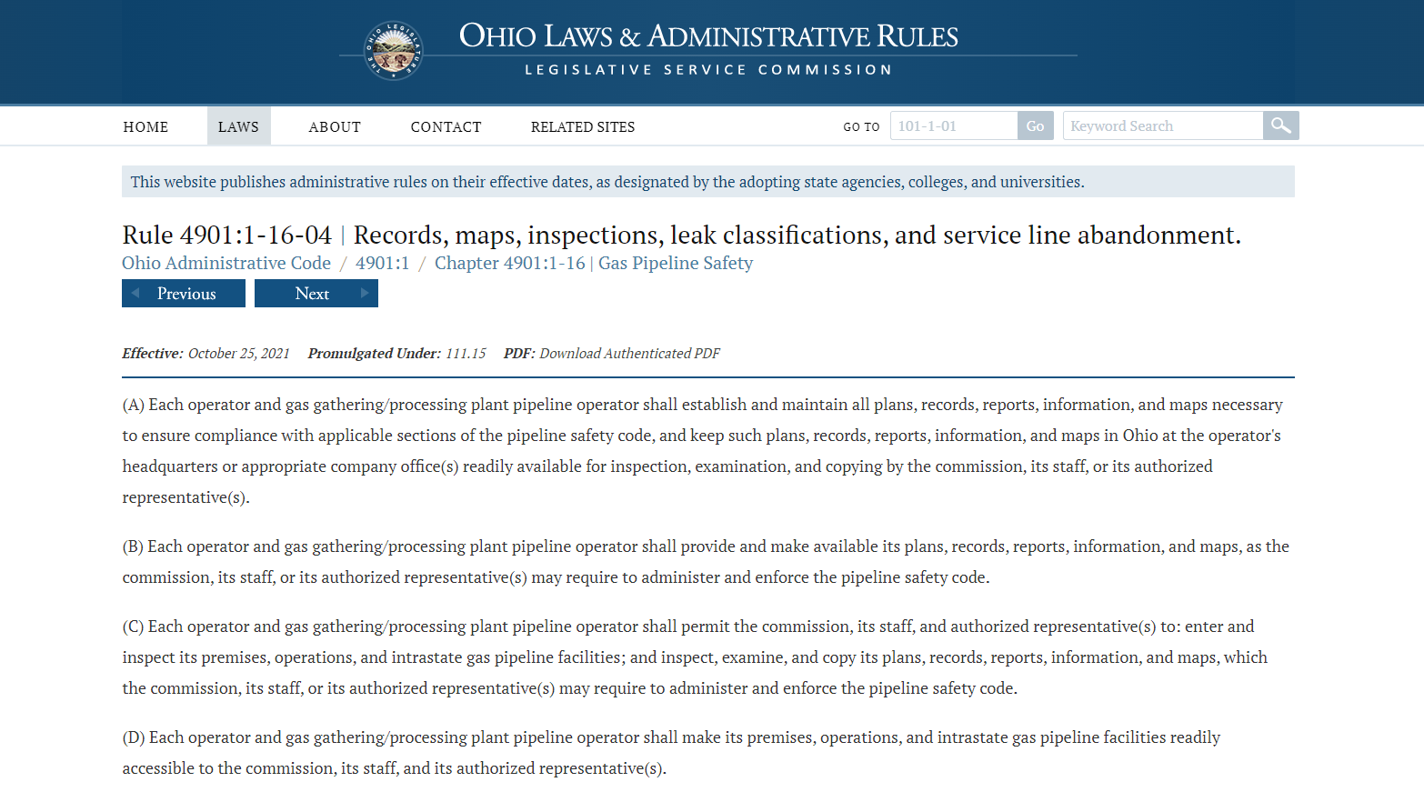
Effective Date

Slide 23
Effective Date

Slide 24
Effective Date

Slide 25
Effective Date

Slide 26
Effective Date
The effective date of this rule was August 5, 2021 which means the requirements of (J) go into effect August 5, 2023.
(J) Beginning 24 months after the effective date of this rule, each operator will have a plan for tracking and abandoning inactive service lines in accordance with 49 CFR 192.727 and will have a copy of its plan available for inspection. The plan will include the following:
In a future rule update we will revise this to say “As of August 5, 2023…”

Slide 27
Regulatory Reduction
In 2022, Senate Bill 9 required all agencies to reduce regulatory requirements by 30% by June 30, 2025
The PUCO is working through that process

Slide 28
Federal Rule Updates
RIN 1
RIN 2
RIN 3
Valve Rule
Leak Detection
Safety of Gas Distribution Lines
Idled Pipelines
Class Location Change Requirements
LNG Rule
CO2 Rule
Standards Updates

Slide 29
Safety of Gas Transmission Lines (RIN-1)
Published in Federal Register on October 1, 2019; effective date of July 1, 2020
Addresses MAOP Reconfirmation, use of Engineering Critical Assessment as an option, created Moderate Consequence Areas, “grandfathered” pipelines clause eliminated, mitigation methods, etc.
Some changes immediate, others have compliance dates several years in the future
PHMSA has published a set of Frequently Asked Questions (FAQs), Batch 1 and Batch 2
PHMSA is conducting inspections with interstate operators to evaluate how they are and will comply with the new Gas Transmission Rules
Operators should be revising procedures to ensure compliance with the current and future rules
Workshops and/or training will be scheduled by PHMSA

Slide 30
Safety of Gas Transmission Lines (RIN-2)
NPRM published 4/8/2016
Comment period closed 7/7/2016
Split from original Gas Transmission NPRM
GPAC meetings held January 2017; June 2017, Dec 2017, March 2018Fina
Final rule published 8/24/2022; effective date May 24, 2023
Stay of enforcement issued for some parts until February 24, 2024

Slide 31
Safety of Gas Transmission Lines (RIN-2)
“Accordingly, to ensure timely, careful, and complete implementation of the safety- and environment-improving requirements of the Final Rule, PHMSA will exercise its inherent enforcement discretion to refrain from taking enforcement action alleging violations of the Final Rule’s requirements (subject to certain exceptions described below) for nine additional months(i.e., from May 24, 2023, to February 24, 2024) against operators of existing onshore gas transmission pipelines in-service as of the publication date of the Final Rule on August 24, 2022. During that nine-month period, PHMSA will prepare and issue guidance to aid operators in their compliance with the Final Rule. This enforcement discretion will not apply to (1) those provisions of the Final Rule for which the Final Rule prescribed independent compliance timelines (i.e., 49 CFR 192.917(b) and 192.13(d)); and (2) pipelines that are new or replaced after August 24, 2022. PHMSA will memorialize this enforcement discretion within implementation material for PHMSA inspectors and recommend that its state partners conform to the contents of this limited enforcement discretion. This enforcement discretion will remain in effect until February 24, 2024.”

Slide 32
Safety of Gas Transmission Lines (RIN-2)
Major Topics Include
Repair criteria for both HCA and non-HCA areas
Extreme weather inspections
Strengthening assessment requirements
Corrosion control
Management of change
IM clarifications
Definitional changes, including the definition of Transmission line and Distribution center

Slide 33
Safety of Gas Transmission Lines (RIN-2)
Distribution center means the initial point where gas enters piping used primarily to deliver gas to customers who purchase it for consumption, as opposed to customers who purchase it for resale, for example:
(1) At a metering location;
(2) A pressure reduction location; or
(3) Where there is a reduction in the volume of gas, such as a lateral off a transmission line.

Slide 34
Safety of Gas Transmission Lines (RIN-2)
Transmission line means a pipeline or connected series of pipelines, other than a gathering line, that:
(1) Transports gas from a gathering pipeline or storage facility to a distribution center, storage facility, or large volume customer that is not down-stream from a distribution center;
(2) Has an MAOP of 20 percent or more of SMYS;
(3) Transports gas within a storage field; or
(4) Is voluntarily designated by the operator as a transmission pipeline.

Slide 35
RIN 3: Gathering Line Regulations
Published in Federal Register on November 15, 2021
Effective Date is May 16, 2022
Major Topics include
Reporting
Definition Changes
Regulation of large diameter HP lines

Slide 36
Compliance Dates
Publication Date: 11/15/2021
Effective Date: May 16, 2022
Reporting
Incident Reports: Report events occurring after May 16, 2022
Annual Reports: 2022 reports due March 2023
Identify Type C lines: November 16, 2022
Section 192.9 compliance: May 16, 2023
MAOP lookback: 5-year period ending May 16, 2023

Slide 37
New Gathering Line Types
Type | Feature | Area
C | Outside diameter greater than or equal to 8.625 inches and any of the following: —Metallic and the MAOP produces a hoop stress of 20 percent or more of SMYS; —If the stress level is unknown, segment is metallic and the MAOP is more than 125 psig (862 kPa); or —Non-metallic and the MAOP is more than 125 psig (862 kPa) | Class 1 location
R | —All other onshore gathering lines | Class 1 and Class 2 locations

Slide 38
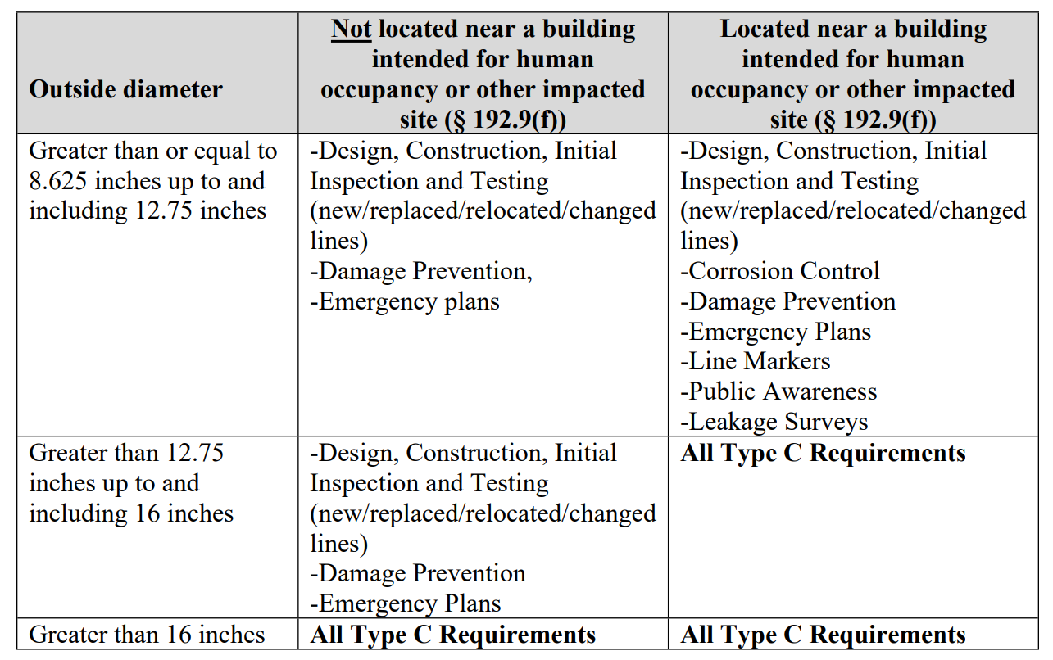
Type C Applicability

Slide 39
Type R Requirements
192.8 (c) (3)
A Type R gathering line is subject to reporting requirements under part 191 of this chapter but is not a regulated onshore gathering line under this part.

Slide 40
Valve and Rupture Detection Rule
Final Rule published 4/8/2022; effective date 10/5/2022.
NPRM published 2/6/20
Comment period closed 4/6/20
PAC Meetings held 7/22/20 to 7/23/20
In PHMSA’s 2020 Appropriations (Budget) Bill; Congress directed for this final rule to be completed by June 28, 2021.

Slide 41
Valve and Rupture Detection Rule
Installation of automatic shut-off valves (ASV) or remote controlled valves (RCV) on newly constructed or entirely replaced (2 miles or more) natural gas and hazardous liquid transmission pipelines (with nominal diameters ≥ 6 inches) with the objective of improving overall incident response for new and replaced pipelines
If an operator observes or is notified of a release of gas or hazardous liquid (HL) that may be representative of a “notification of potential rupture,” the operator must, as soon as practicable but within 30 minutes:
identify the rupture, fully close any rupture-mitigation valves necessary to mitigate the rupture – mainline valves, cross-over valves and laterals.
Development of written procedures to identify and confirm whether a “notification of potential rupture” is a rupture.
Maintenance and drill requirements for equivalent technology to ensure the valve can close within 30 minutes after identifying a rupture.
Operator investigation following a rupture with any lessons learned implemented throughout the pipeline system.
Updated 9-1-1 notification requirements (direct notification of appropriate public safety answering point).

Slide 42
Upcoming Federal Rule Making Activity
Leak Detection (RIN 2137- AF-51)
Safety of Gas Distribution Pipelines (RIN: 2137-AF53)
Pipeline Operational Status (Idled Pipelines) (RIN: 2137-AF52)
Class Location change Requirements
LNG Rule
CO2 Rule
Standards Updates I and II

Slide 43
Leak Detection (RIN 2137- AF-51)
NPRM stage (Two efforts required by the PIPES 2020 Act)
Rulemaking to address Section 113 – Leak Detection and Repair
Rulemaking will be considered based on the results of the studies and reports required by Section 114 ( Study based on Inspection and Maintenance Plan Oversight and Best Technology/Practices Report to minimize NG releases)
Major topics under consideration include leak survey frequency, repairs of leaks, use of advanced technology, etc.
Section 114 is “Self Executing” and required changes to operator O&M Plans
Next action: 2023 NPRM
Notes:
Addresses Leak Detection issues (GT/GG/GD) addressed in Section 113/Section114 of the PIPES 2020 Act
Considering revisions to leak survey frequency, repairs of leak survey and the use of Advance Leak Technology.
Section 114 contains self executing provision for operators to minimize releases of natural gas.
Per section 114, PHMSA is initiating a study on best available practices to minimize leaks. Byron Coy leading this effort
Self executing provision directed towards operators – State programs will be reviewing O&M plans in 2022
Summer 2022 NPRM

Slide 44
Safety of Gas Distribution Pipelines (RIN: 2137-AF53)
NPRM Stage
Addresses Leonel Rondon Act within the PIPES Act of 2020
Major topics under consideration
Sections 202; 203; 204 and 206 – DIMP Plans, Emergency Response Plans, Records, presence of qualified employees, safety of district regulator stations, etc.
Low pressure system focus
Next action: 2023 NPRM
Notes:
This is all of the items in the 200 sections of the 2020 PIPES Act.
This set of items was mainly in response to the Merrimack Valley, MA overpressure incident, but for now look at the Act – Section 202-206. It addresses:
Prescribed inspection intervals
Section 202 – DIMP plans
Section 203 – Emergency Response plans
Section 204 - Operations and Maintenance Plans
Section 206 – Records, Presence of qualified employees in certain circumstances, safety of District Regulator Stations.
Summer 2022 Anticipated NPRM; Dave Lehman will address more later but you may go into further detail as noted below (review the Sections, first):
Major topics under consideration:
Risks related to the presence of cast iron via DIMP
Risks related to operation of low-pressure distribution systems on low pressure gas burning equipment
Communications during a pipeline emergency / upgraded emergency response plans
O&M manuals in regard to the handling of overpressurizations and management of change procedures
Critical records for ensuring proper pressure controls – similar to TVC with respect to making sure proper pressure control in place
Presence of qualified employees relative to pressure controls
Assessments and upgrades for district regulator stations - secondary or backup pressure limiting devices, no single mode of failure.

Slide 45
Pipeline Operational Status (Idled Pipelines) (RIN: 2137-AF52)
NPRM Stage
PIPES Act of 2020 defines an “idled pipeline”
Will not resume service in 180 days
Has been isolated from all sources of hazardous liquid, natural gas has been purged.
API RP 1181; addresses idled pipelines
Next action: 2023 NPRM
Notes:
Finalizes regulations within 2 years prescribing the applicability of the pipeline safety regulations to idled pipelines.
API standard could be extended to both gas and liquid
Potential spring of 2023 NPRM

Slide 46
Class Location Change Requirements
NPRM stage
NPRM published 10/14/20
Comment period ended 12/14/20
Current Requirements when class locations change:
Reduce operating pressure
Confirm new MAOP with pressure test
Replace pipe with thicker wall pipe
Special permits to operate segments at previous MAOP while performing certain measures to mitigate risk and ensure safety
Major Topics under consideration include option of management type approach vs pipe replacement, examination of additional options, etc.
PIPES Act 2020 mandate to have a GPAC meeting
Anticipate 2023 Final Rule
Notes:
Current requirements when class locations change:
Reduce operating pressure
Confirm new MAOP with pressure test
Replace pipe with thicker wall pipe
Special permits to operate segments at previous MAOP while performing certain measures to mitigate risk and ensure safety
Major topics under consideration:
Examining additional options, a management type approach vs a pipe replacement or lowering of pressure approach for existing pipe when class locations change due to population increases near pipeline and MAOP is not commensurate with new class location

Slide 47
Liquified Natural Gas (LNG) Rule
NPRM Stage
PIPES Act 2020 (Section 110; PSM) requires review of the LNG regulations and for making improvements where necessary and for using risk-based approaches
Proposal due in 2023
Notes:
Current requirements when class locations change:
Reduce operating pressure
Confirm new MAOP with pressure test
Replace pipe with thicker wall pipe
Special permits to operate segments at previous MAOP while performing certain measures to mitigate risk and ensure safety
Major topics under consideration:
Examining additional options, a management type approach vs a pipe replacement or lowering of pressure approach for existing pipe when class locations change due to population increases near pipeline and MAOP is not commensurate with new class location

Slide 48
Liquified Natural Gas (LNG) Rule
Major topics under consideration:
Revise 49 CFR Part 193 to incorporate current industry developed standards (via NFPA 59A-2019)
Address LNG Export Facilities
Address Small Scale LNG Facilities
Incorporate other provisions as necessary
PIPES Act 2020 (Section 110; PSM) - TBD
Notes:
Current requirements when class locations change:
Reduce operating pressure
Confirm new MAOP with pressure test
Replace pipe with thicker wall pipe
Special permits to operate segments at previous MAOP while performing certain measures to mitigate risk and ensure safety
Major topics under consideration:
Examining additional options, a management type approach vs a pipe replacement or lowering of pressure approach for existing pipe when class locations change due to population increases near pipeline and MAOP is not commensurate with new class location

Slide 49
Carbon Dioxide (CO2) Rule
NPRM Stage
Major Topics under consideration include
Regulating gaseous form of Co2
Conversion of service
Reporting requirements
Odorization
Major incident in Satartia MS in 2020.
Proposal due in 2023
Notes:
Current requirements when class locations change:
Reduce operating pressure
Confirm new MAOP with pressure test
Replace pipe with thicker wall pipe
Special permits to operate segments at previous MAOP while performing certain measures to mitigate risk and ensure safety
Major topics under consideration:
Examining additional options, a management type approach vs a pipe replacement or lowering of pressure approach for existing pipe when class locations change due to population increases near pipeline and MAOP is not commensurate with new class location

Slide 50
Standards update I and II
Standards Update I
NPRM Stage
NPRM published 1/15/2021
Comment period ended 3/16/2021
Updates to standards including
API 5 L - 46th edition
API 1104 – 21st edition
B31.8 – Nov 2018
B31.8S - 2016 edition; asks for comments on 2018 edition
NFPA 58 – 2020 edition
Standards Update II
NPRM Stage
NPRM published 8/29/22;
Comment period ended10/28/2022
Updates to standards including
API 652
API RP 2003
NACE SP0102
NACE 0502
Notes:
Major topics under consideration:
Address the set of incorporated by reference (IBR) standards throughout PHMSA’s Part 192 and Part 195 with updated revisions of standards from all standard organization bodies
Addresses (among others):
API 5 L - 46th edition
API 1104 – 21st edition
B31.8 – Nov 2018
B31.8S - 2016 edition; asks for comments on 2018 edition
NFPA 58 – 2020 edition

Slide 51
PHMSA Advisory Bulletins
Found on PHMSA’s website – search does not work well
Advisory Bulletins are also accessible in WinDOT
Not enforceable but explain how PHMSA understands and intends to enforce the regulations
Helps your organization learn from other operator experiences and best practices

Slide 52
Potential for damage to pipeline facilities caused by earth movement and other geological hazards – Advisory Bulletin 2022-01 – 6/2/2022
This is an updated version of ADB -2019-0087 – 5/2/2019
Advisory issued due to potential for damage from earth movement as illustrated in 17 examples (gas and HL) outlined in the Advisory Bulletin
PHMSA reminded operators of the potential for damage to pipeline facilities that could happen especially in areas of steep terrain where pipeline movement or soil subsidence could occur
Operators must use their IMP and DIMP plans to assess the risk of pipeline movement and failure under these conditions and to mitigate such risks
A number of examples of methods, processes, and techniques were related in the Bulletin that can be used to help mitigate risks from earth movement including lowering pressure, moving the pipeline, installing retaining walls, bringing pipelines above ground, installing monitoring equipment, etc.

Slide 53
Section 114 Advisory Bulletin & Beyond
Issued in Federal Register on June 10, 2021, Docket No. PHMSA–2021–0050
Reminds operators that the Congressional mandate from the 2020 PIPES Act, Section 114 is “self-executing” and does not require a regulation to have effect
Operators must update their inspection and maintenance plans to address eliminating hazardous leaks and minimizing releases of natural gas (including intentional venting during normal operations) from their pipeline facilities
Operators must also revise their plans to address the replacement or remediation of pipeline facilities that are known to leak based on their material, design, or past operating and maintenance history.
The statute requires pipeline operators to complete these updates by December 27, 2021.
Operators should review the Advisory Bulletin and Section 114 to ensure these items are addressed in their O&M Plans

Slide 54
Overpressure protection on low pressure natural gas systems – Advisory Bulletin 2020-0025 – 9/29/2020
Advisory issued due to deficiencies found surrounding the Merrimack Valley, MA overpressure condition that resulted in multiple explosions, fires, and a fatality
One person died, 131 structures damaged, and 133 persons transported to the hospital
Replacement/repair work was being done on a cast iron, low pressure, gas system
Sense lines for a district regulator station were not connected and thus the system failed open, over pressurizing the entire system
PHMSA made initial recommendations related to IMP/DIMP and knowledge of system and the risks of overpressures, having oversight by qualified personnel, procedures to mitigate potential overpressure conditions, properly identifying potential risks and using integrity management principles to mitigate risk
NTSB report issued later reflects the causes and similar recommendations and 2020 Reauthorization also addresses similar issues in mandates to PHMSA

Slide 55
Inside Meters and Regulators – Advisory Bulletin 2020-0115 – 9/29/2020
Advisory Bulletin issued to remind operators of the consequences of failures that could occur with inside meter sets
Prompted by the Silver Spring, MD incident which resulted in 7 fatalities and 65 persons transported to the hospital
The probable cause was a disconnected vent line on an inside meter set pressure regulator in the basement that leaked gas, collected and found a source of ignition
PHMSA reminded operators to review DIMP Plans for potential risks related to inside meter sets
PHMSA also recommends reviewing meter set locations and setting them outside if possible and/or making sure vent lines are vented to an outside location

Slide 56
Questions?
Contact Info:
Joe Dragovich, PE
Public Utilities Commission of Ohio
Service Monitoring and Enforcement
Program Manager – Gas Pipeline Safety
(614) 361-0464
www.PUCO.ohio.gov

